Slide 1
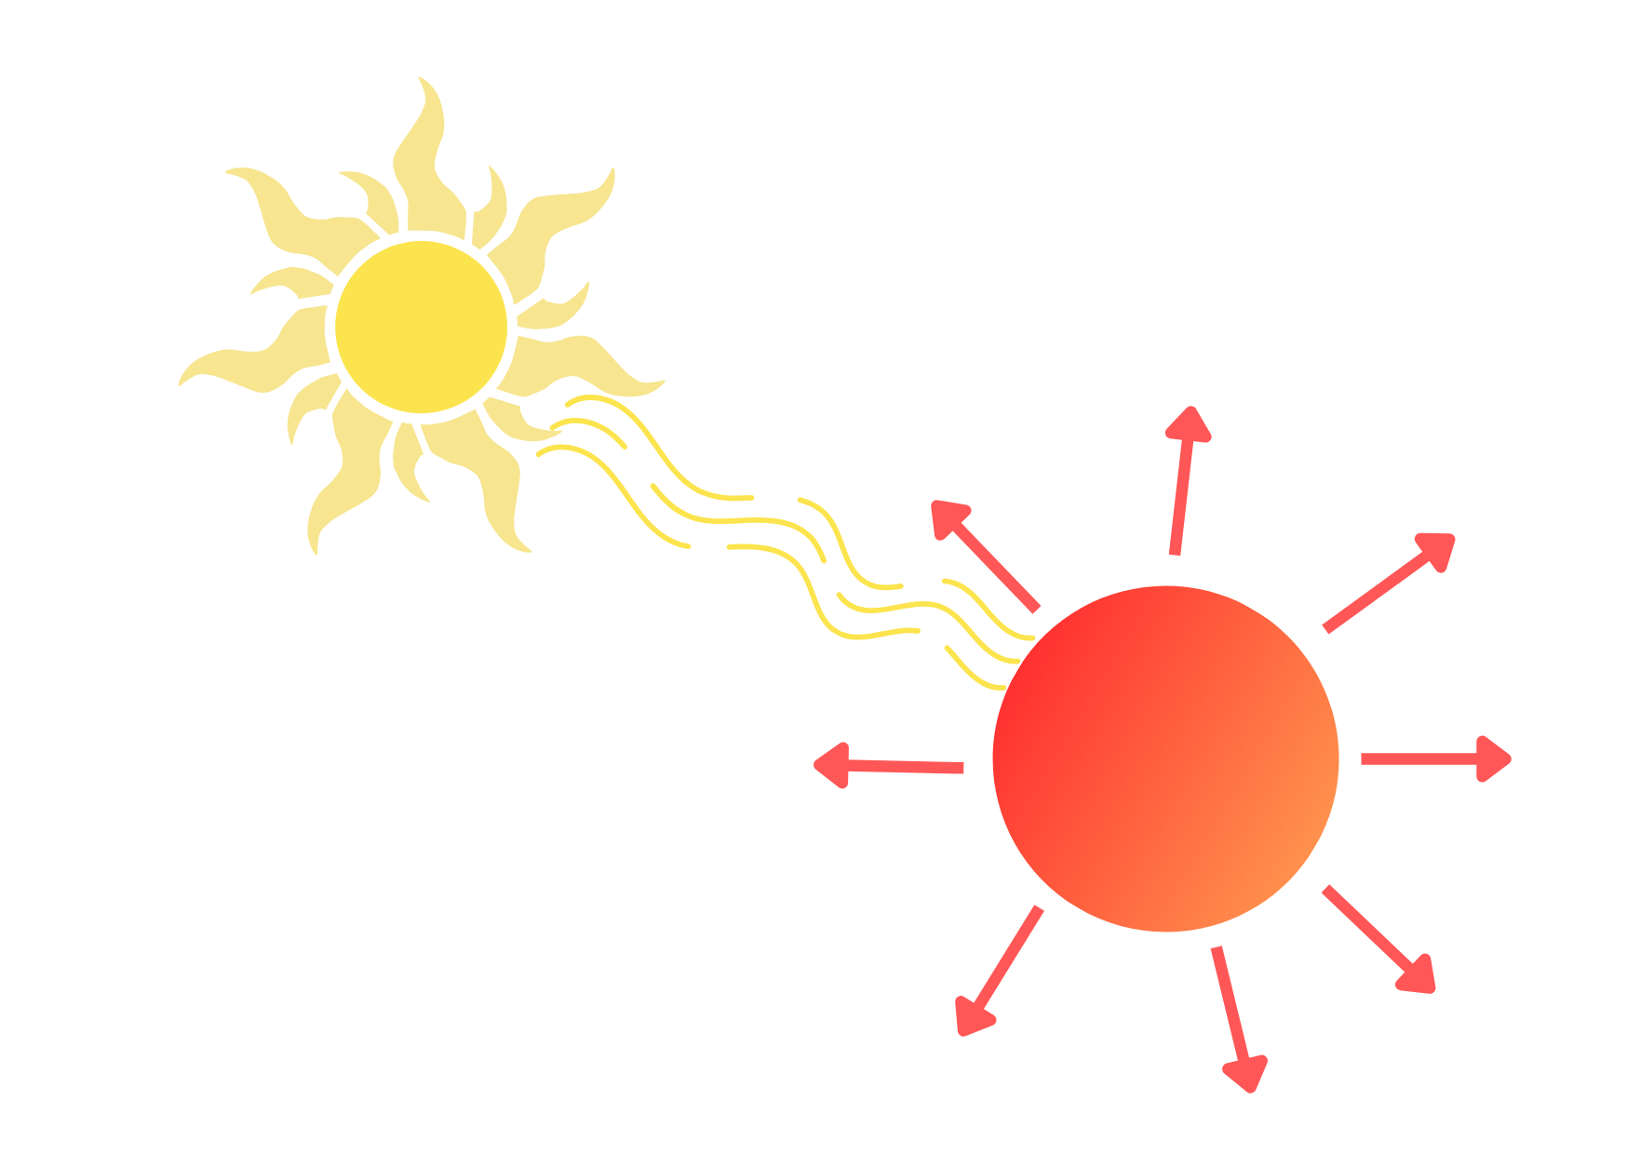


The Cooling Efficiency Factor Index (CEFI): A New Satellite-Based Drought Impact Indicator for Research and Operational Monitoring
$$c=\frac{\int{R_{n}}}{∆T}$$
JRC Data Catalogue (search “CEFI”)
https://doi.org/10.2905/JRC.401M4D8
matteo.v.zampieri@gmail.com

Slide 2
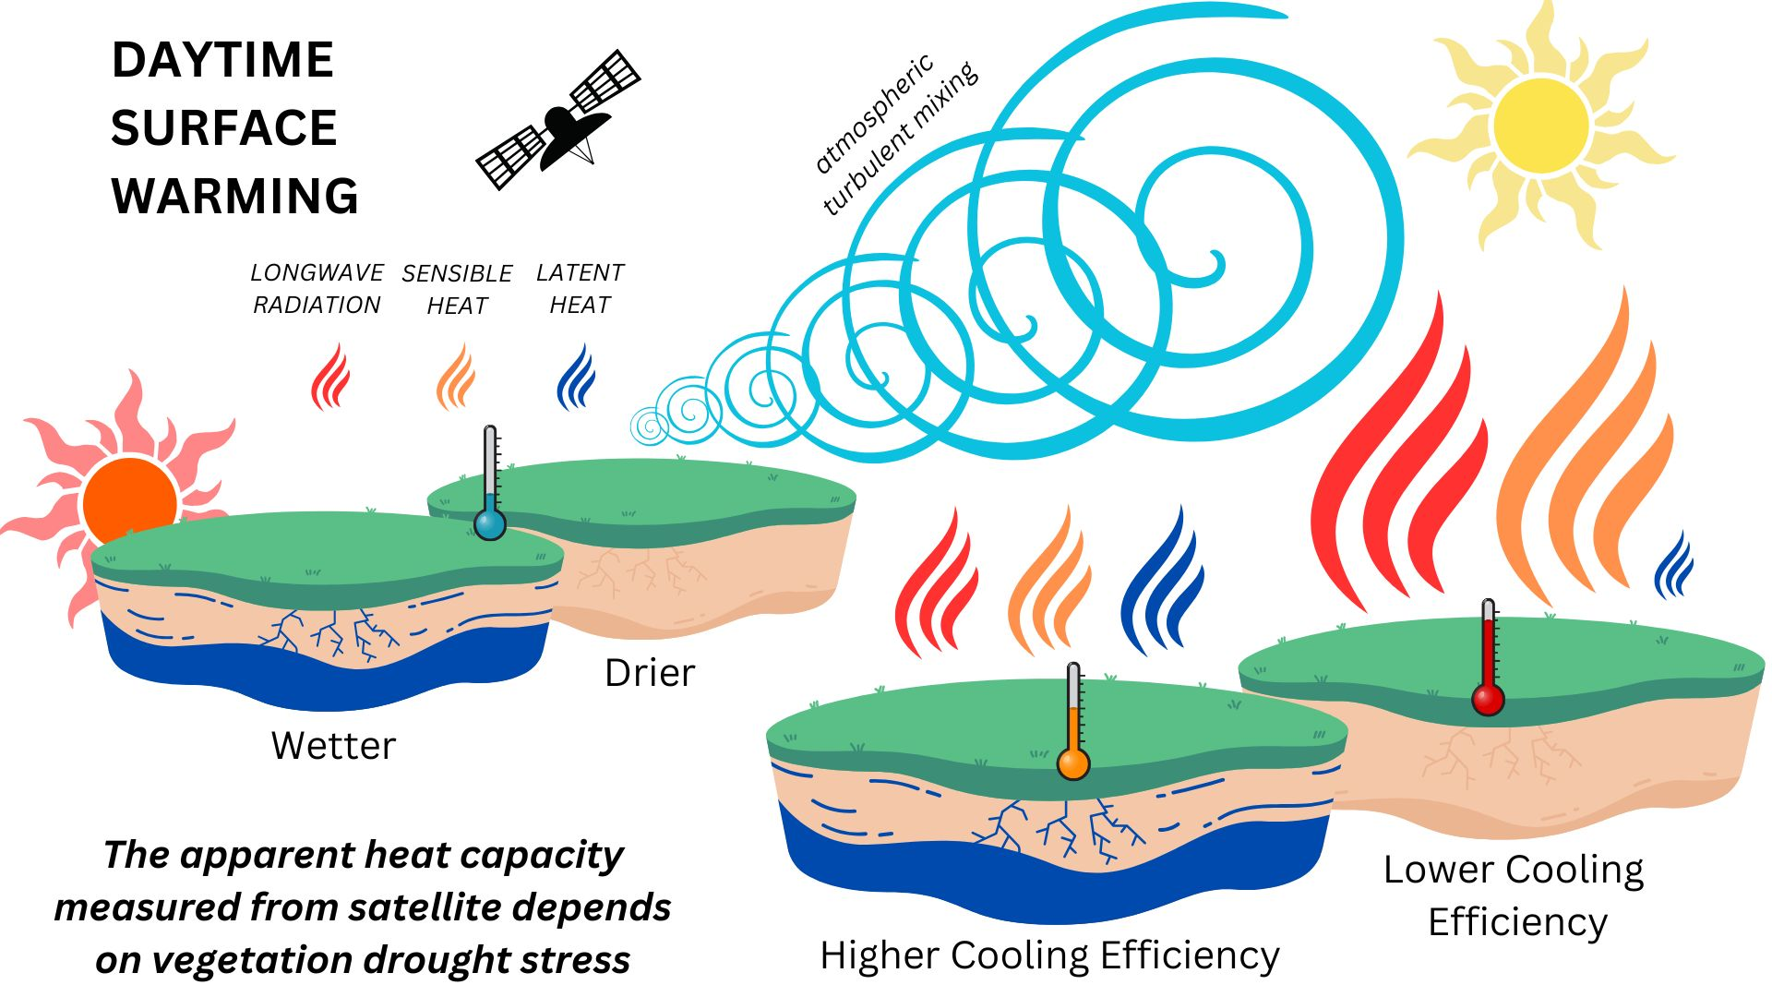

Slide 3
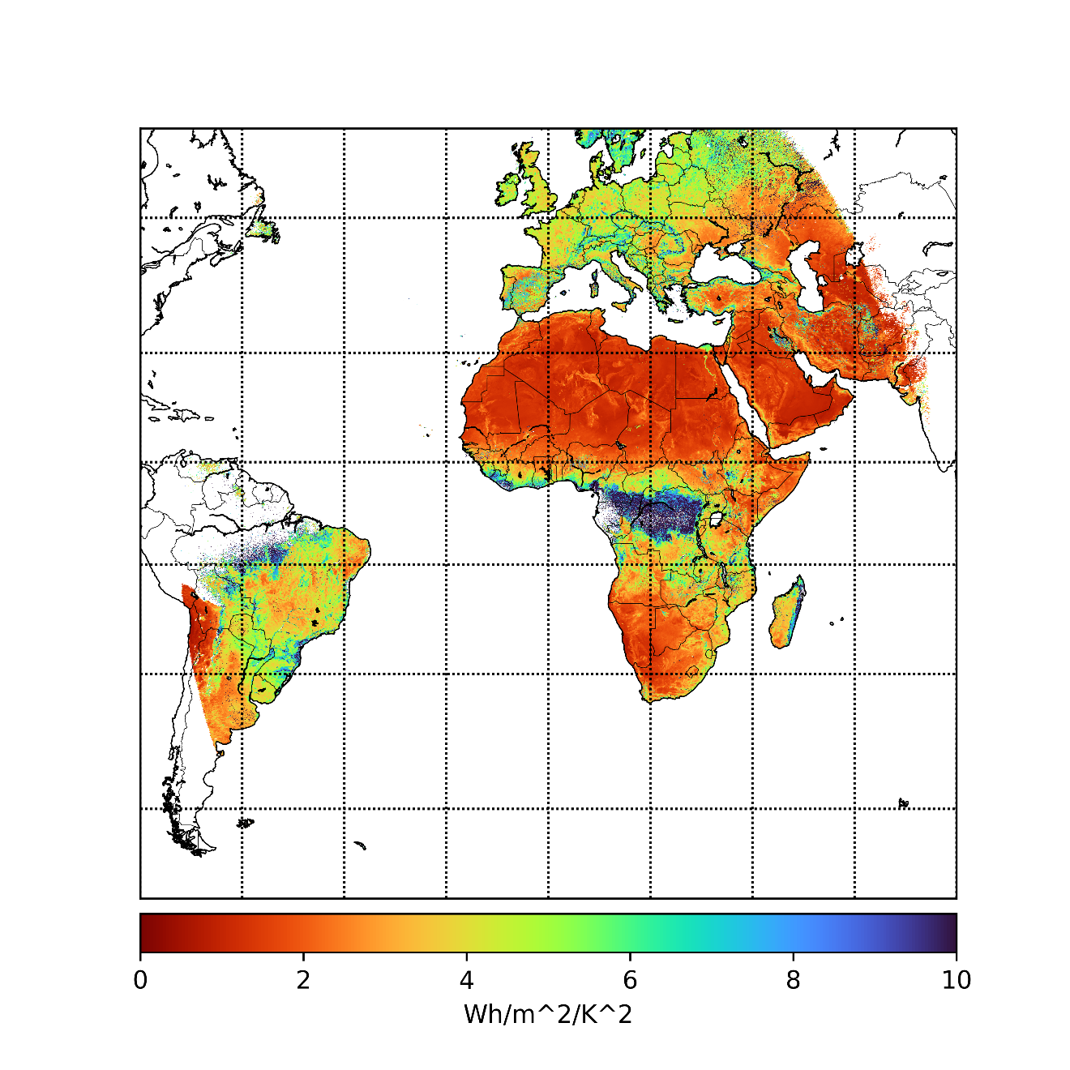

CEFI
Cooling
Efficiency
Factor
Index
2005-2025 average,
5 km resolution

Slide 4
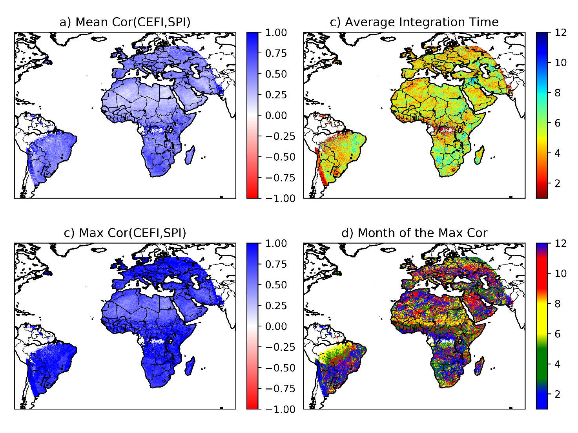
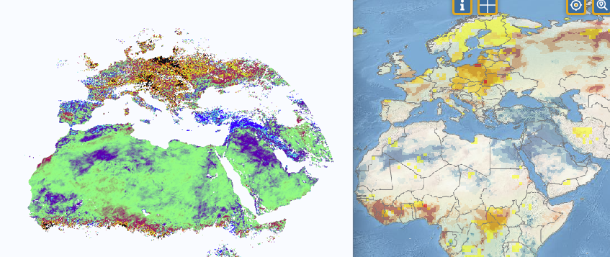
CEFI
vs.
Meteorological drought
May 2026
CEFI anomaly
vs.
SPEI
(JRC Drought Observatory)

Slide 5
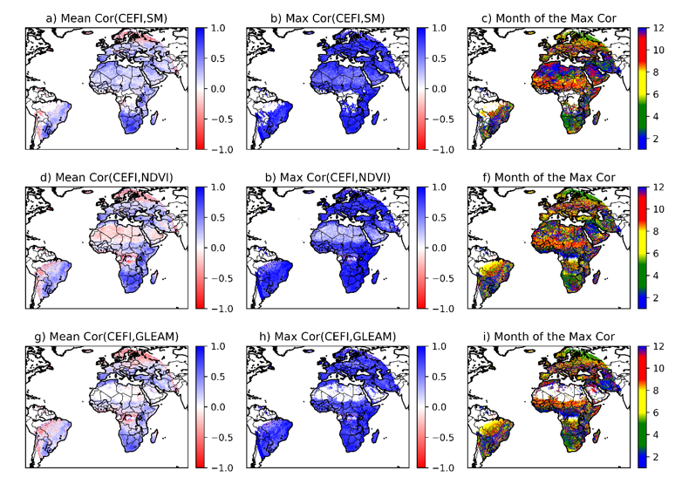
CEFI
vs.
Soil moisture
and vegetation drought

Slide 6
Thanks for the attention!
JRC Data Catalogue (search “CEFI”)
https://doi.org/10.2905/JRC.401M4D8
matteo.v.zampieri@gmail.com

