Slide 1
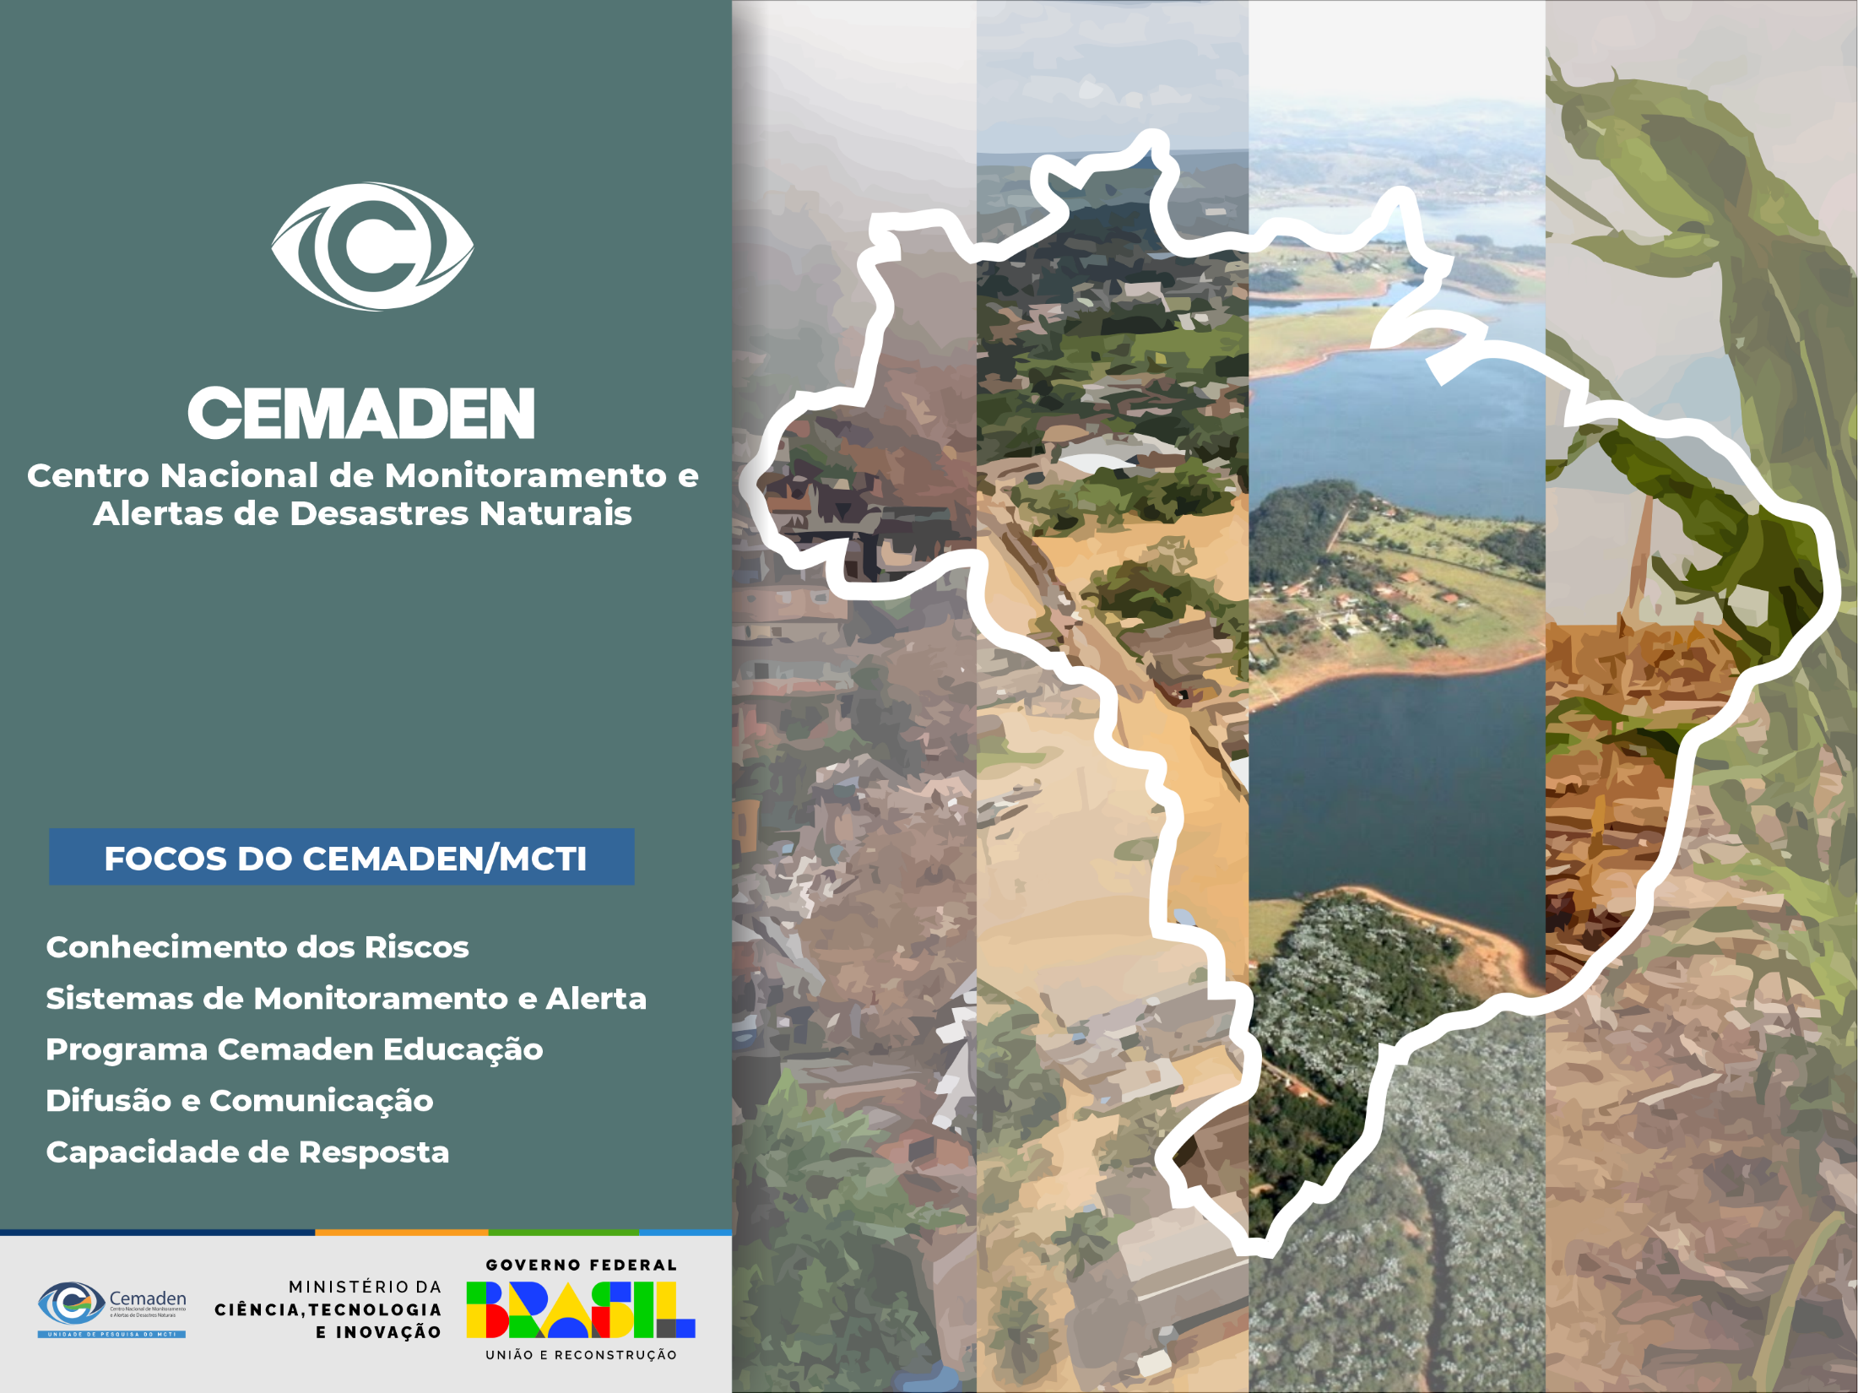

Drought, Heat, and Fire: The Growing Challenge of Compound Risks
Drought in Amazonia
Dr. Jose A. Marengo
(jose.marengo@cemaden.gov.br)
WMO
June 16 2025

Slide 2
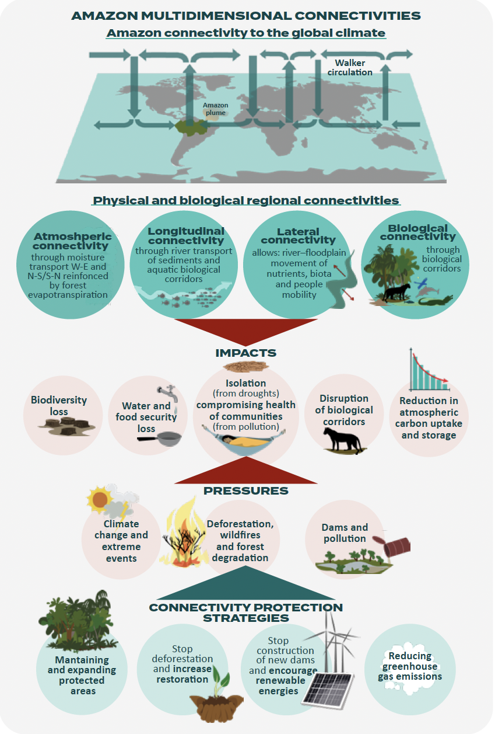
Connections across the Amazon
Increases in deforestation, extreme wildfires, and the frequency of compound drought-heat events.
These changes exacerbate the climate crisis at local, regional, and global scales
Amazonian connectivity is compromissed
The Amazon’s climate both influences and is influenced by large-scale atmospheric phenomena
The Amazon forest sustains other biomes and economic activities for regions
Decreased river connectivity during extreme droughts determines isolation, food and water security
Need to prevent further degradation to avoid risk of approaching critical environmental thresholds

Slide 3
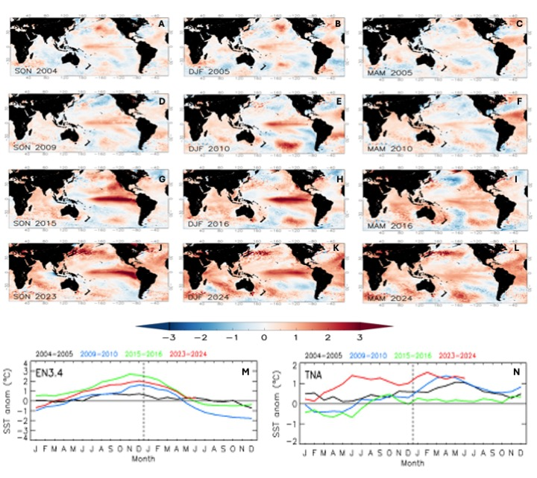
Drought in Amazonia in El Nino and non El Niño years
2005
2010
2016
2023-24

Slide 4
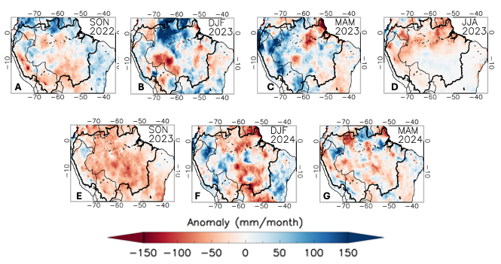
Drought in Amazonia 2023-2024: rainfall anomalies

Slide 5
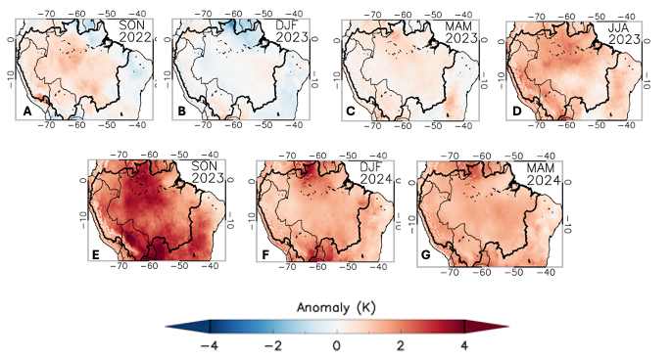
Drought in Amazonia 2023-2024: Air temperature anomalies

Slide 6
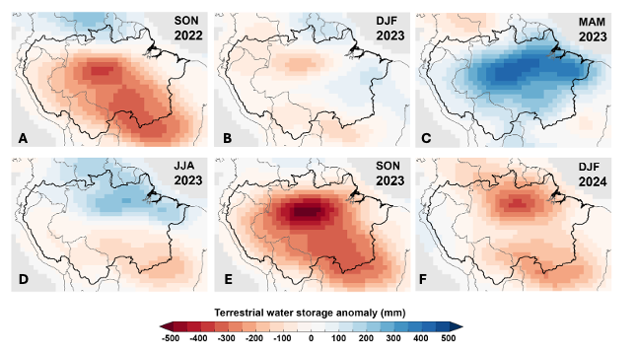
Drought in Amazonia 2023-2024: TWS anomalies

Slide 7
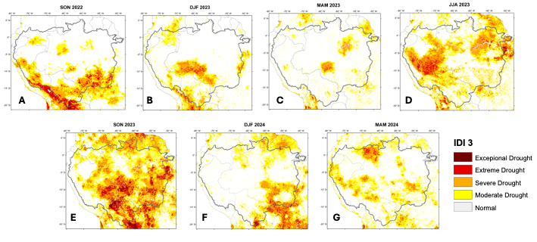
Drought in Amazonia in 2023-2024: Integrated Drought Index

Slide 8
Cascading effects of drought in Amazonia
Droughts in the Amazon are not isolated events. They trigger a cascade of interconnected environmental
Drought reduces soil moisture, causing hydraulic stress in trees. Large trees are particularly vulnerable
Drought dries vegetation and leaf litter, increasing fire susceptibility. Fire-damaged forests become more vulnerable to future droughts, creating a positive feedback loop.
During severe droughts photosynthesis declines, tree mortality increases, fire emissions rise, carbon uptake decreases. This can transform portions of the Amazon from a net carbon sink into a net carbon source, amplifying global warming.
Major rivers experience historically low water levels during drought years, and many communities depend on rivers for mobility and economic activities.
Amazon floodplains and wetlands there is a lose aquatic habitat, experience reduced nutrient cycling, and fish spawning areas are particularly affected.
The 2023 drought caused unprecedented mortality of river dolphins in parts of the Amazon.
The Amazon recycles moisture through evapotranspiration, and under drought less evaporation occurs, atmospheric moisture declines, rainfall decreases further and this feedback can intensify regional drying.
The Amazon contributes moisture transport across South America through atmospheric circulation.
Hydropower generation may decline, River transport affected, major impacts on continental climate regulation

Slide 9
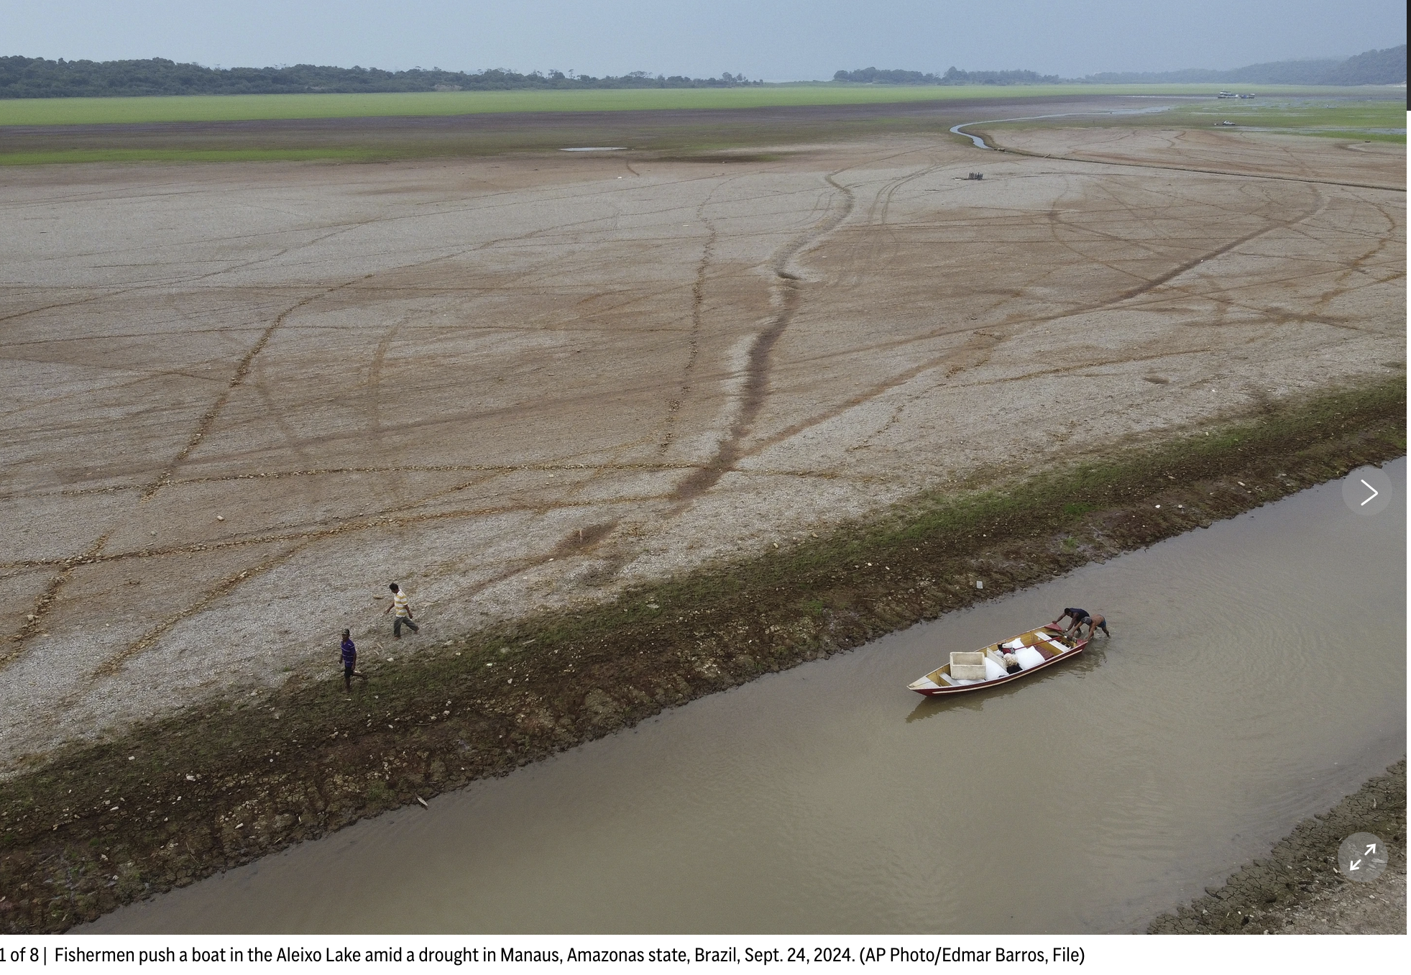
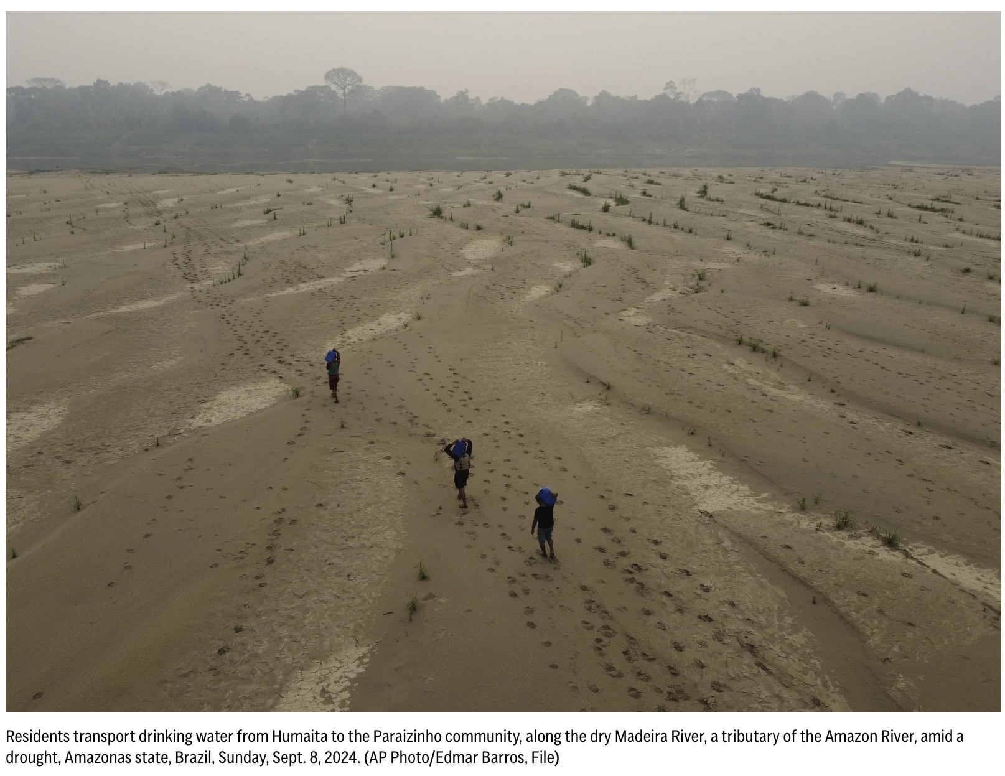
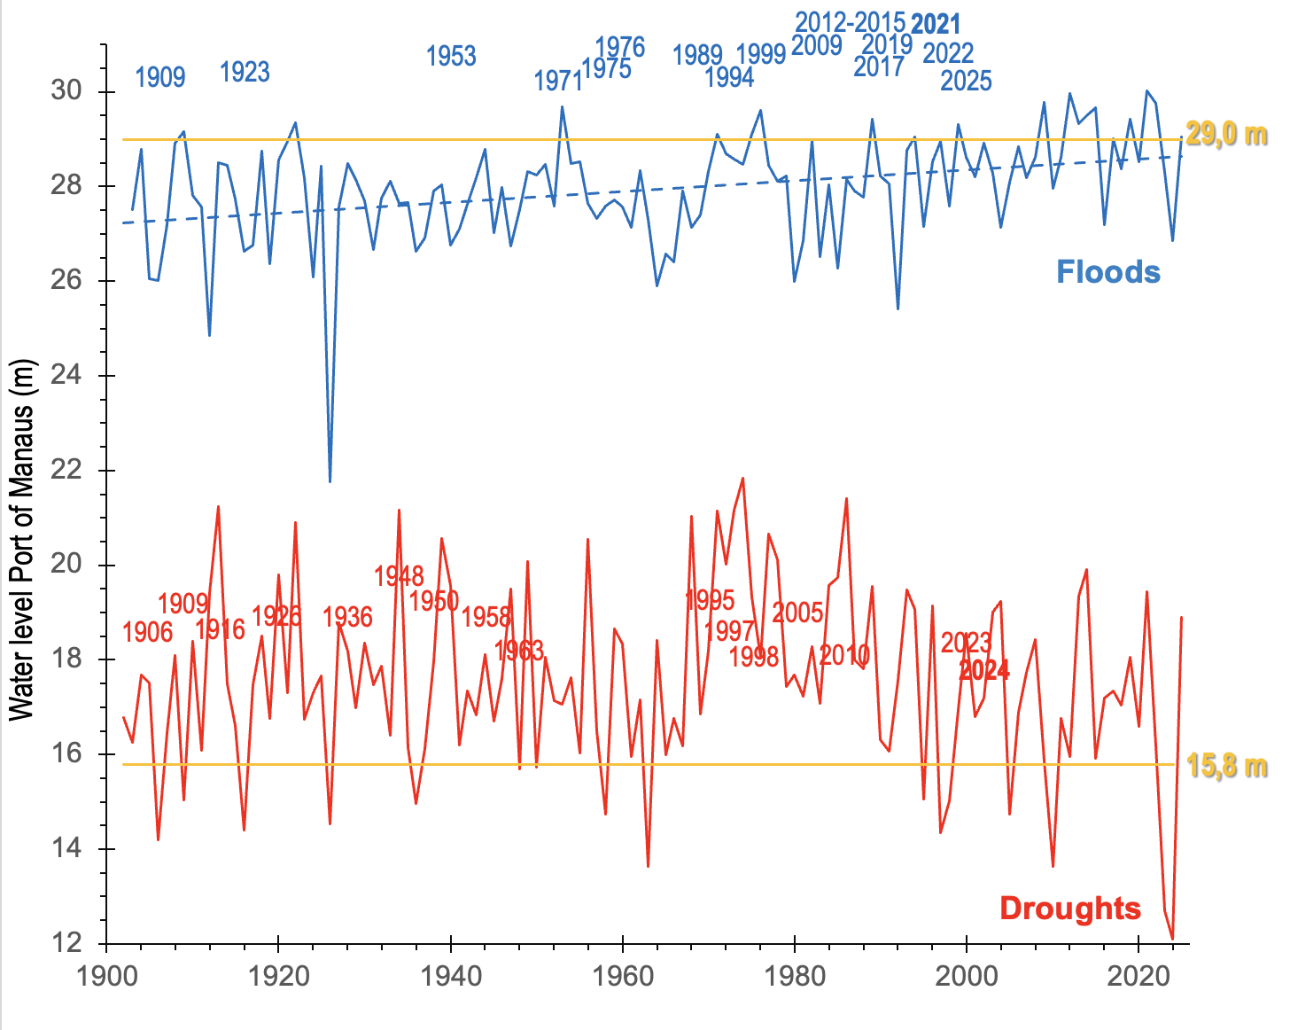
Drought in Amazonia: Hydrology of Rio Negro in Manaus
The Amazon rainforest has faced years of intense drought, warm TNA or El Niño-induced drought (2005, 2010, 2015-16, 2023-24) and the combined effects of deforestation and climate change put it at risk below 2°C of global warming (climate change).
During past El Niño Years, the Amazon region was affected by severe droughr and inten se heat waves, and in some regions, as in eastsren Amazon ia, the forest behave as source of CO2. During La Nina years the forest recovered its role as sink of CO2 (clima variability)
Marengo et al (2024, 2025)

Slide 10
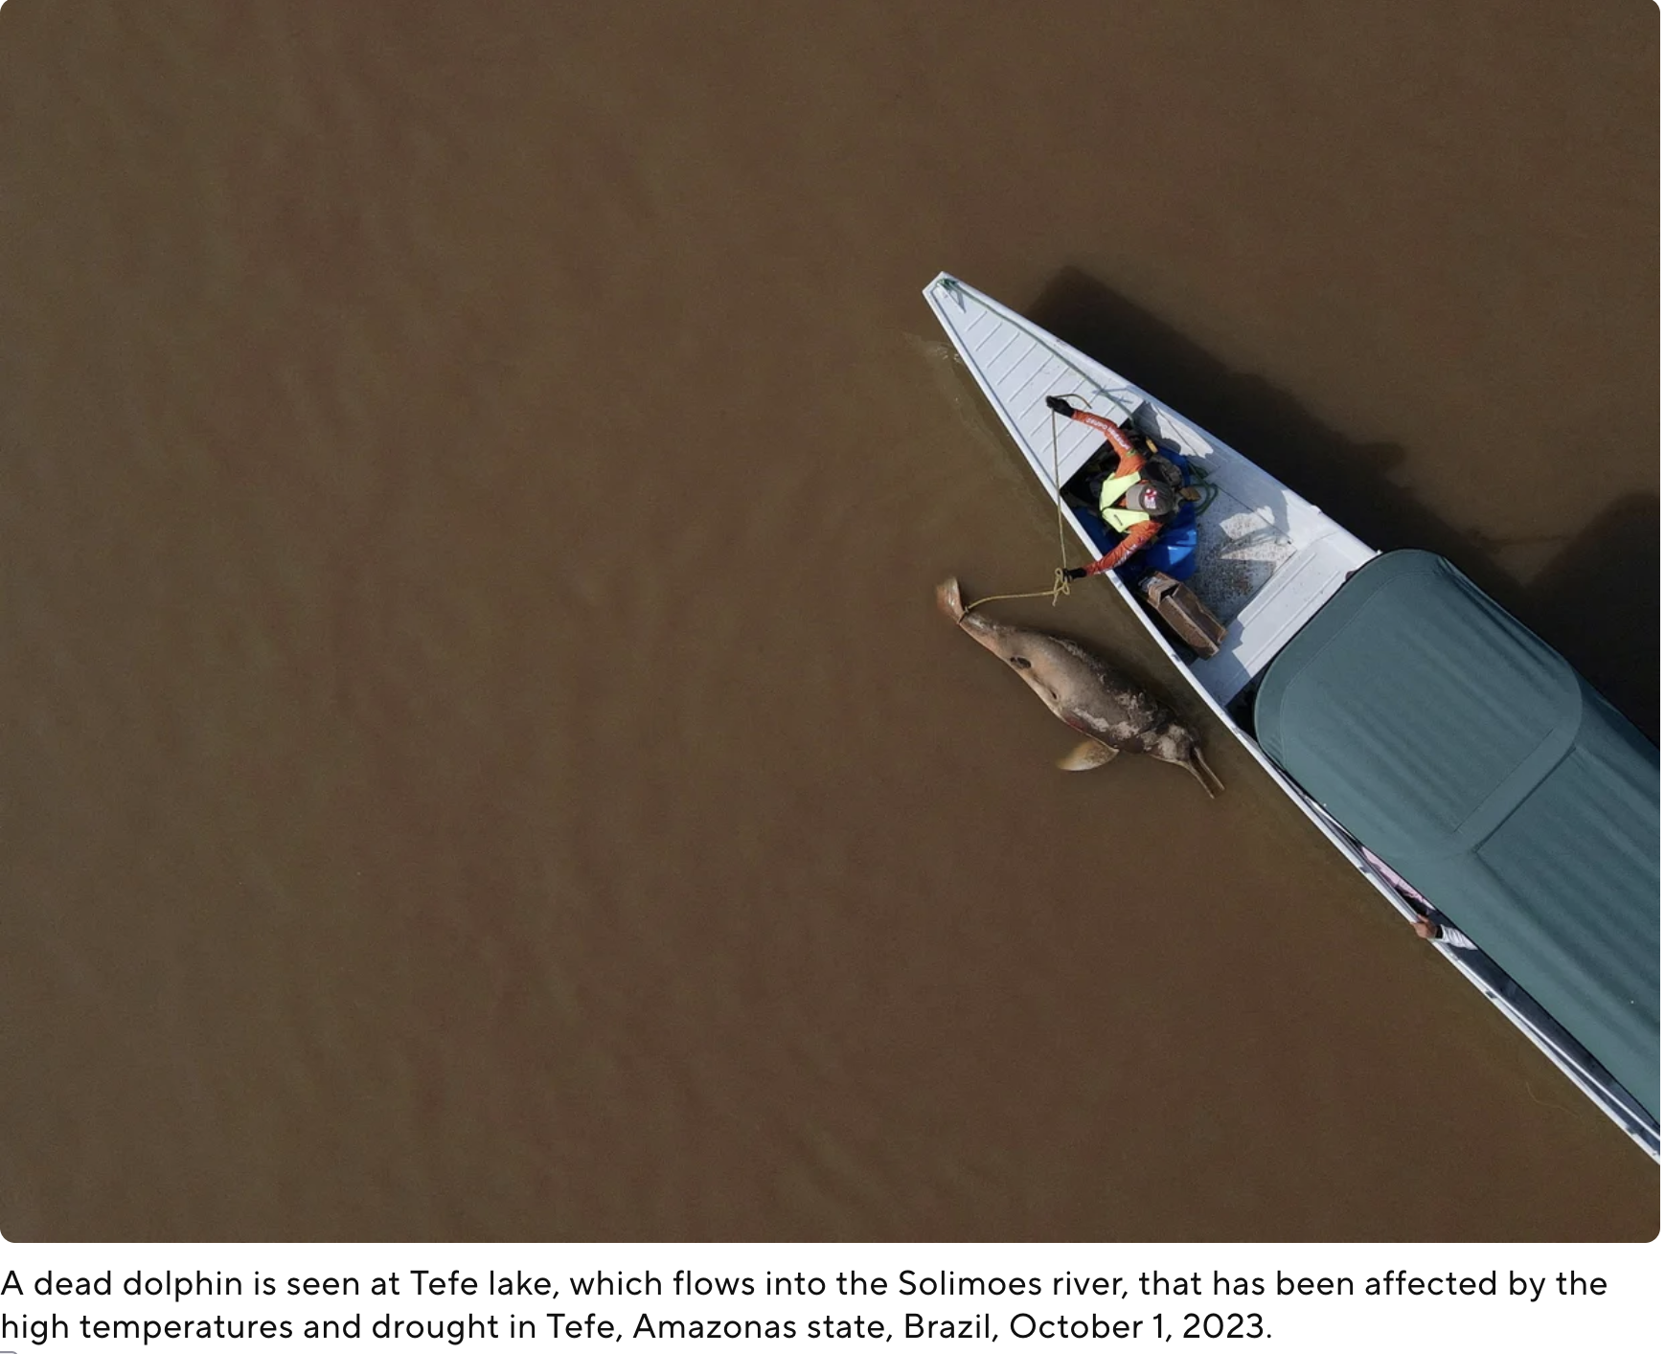
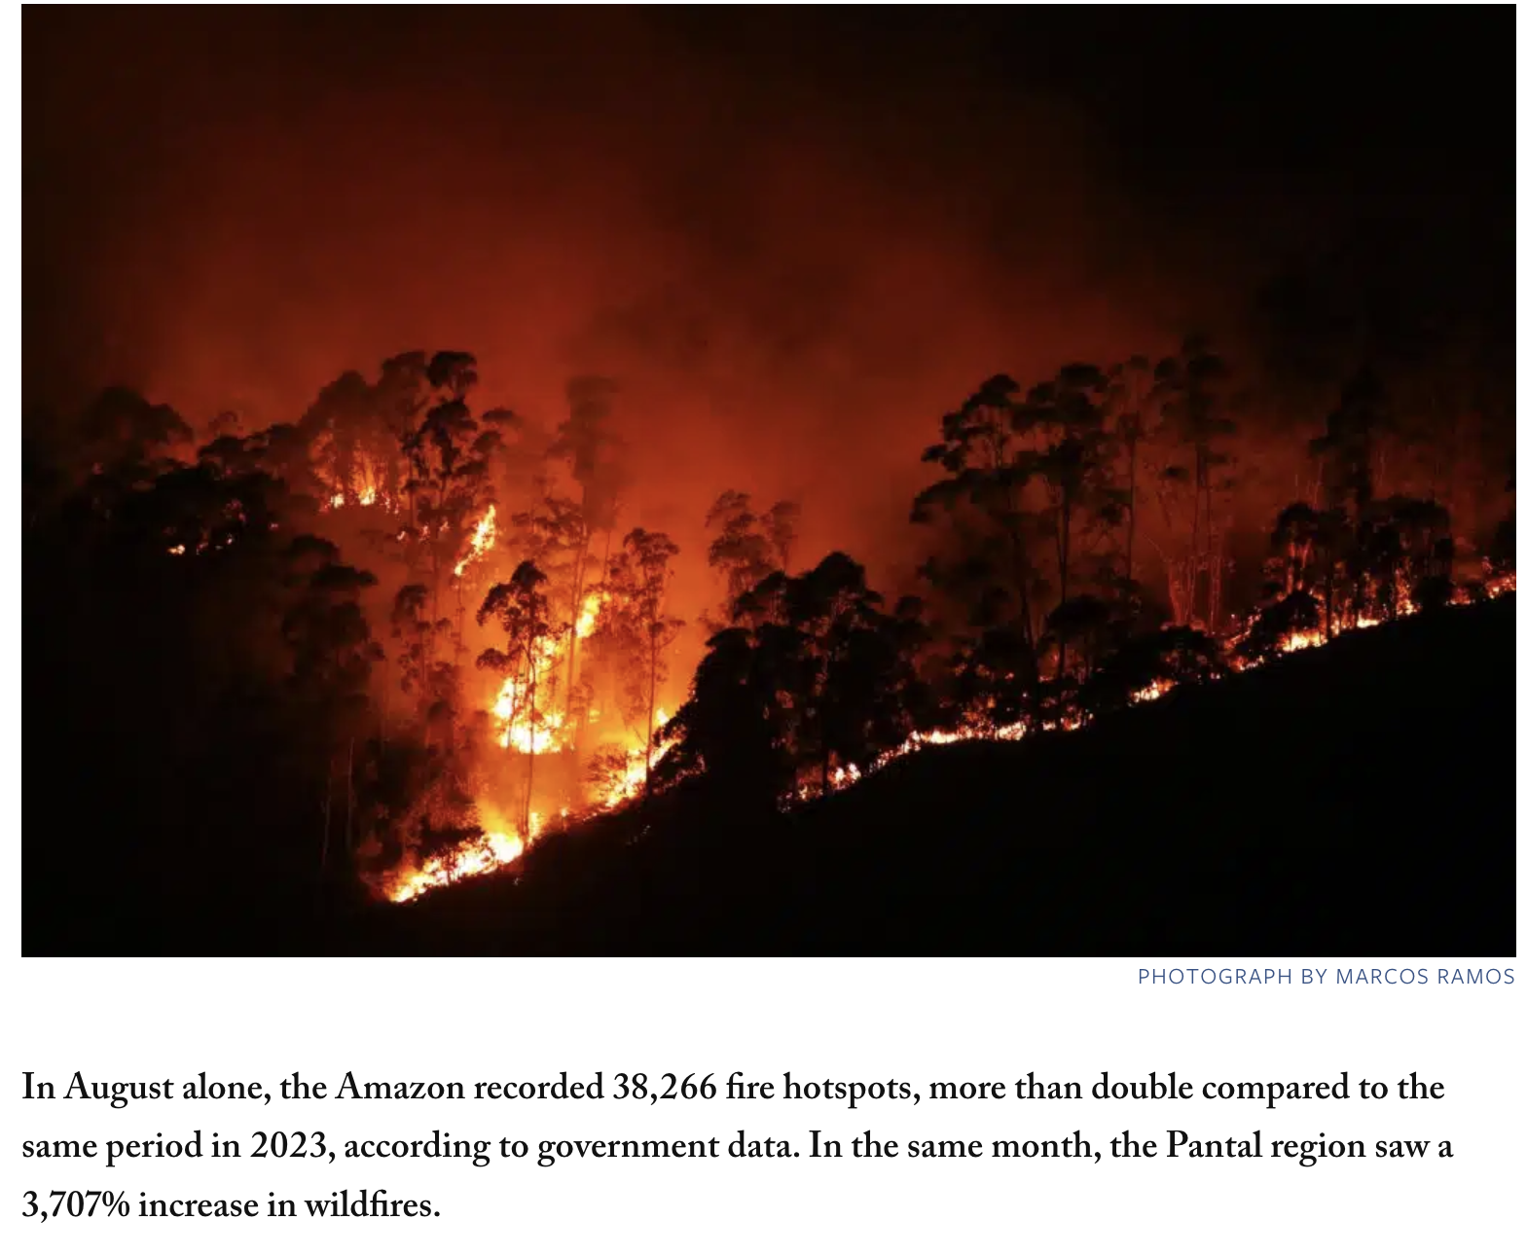
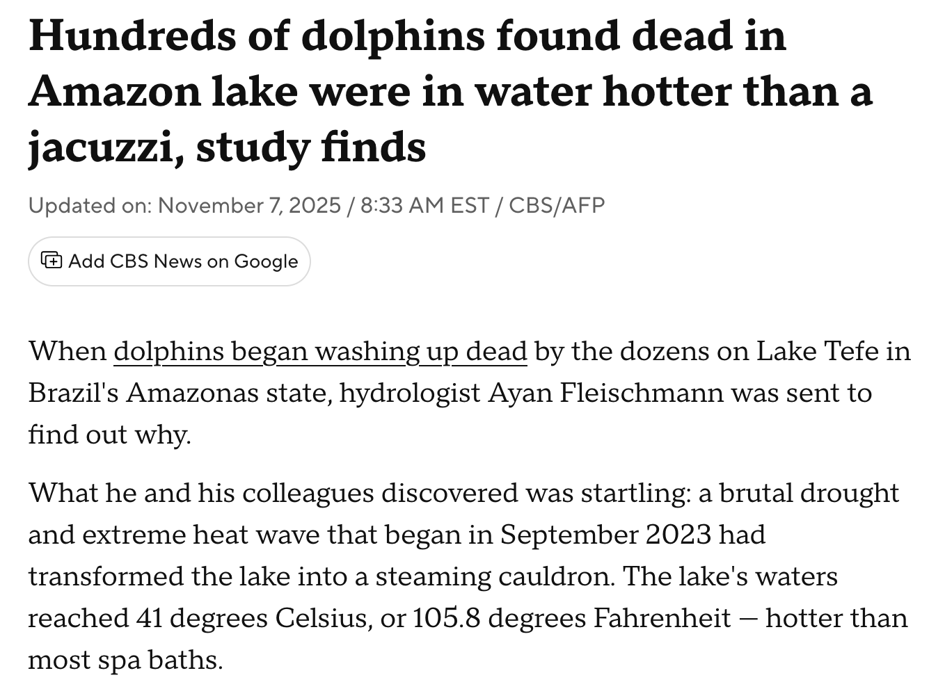
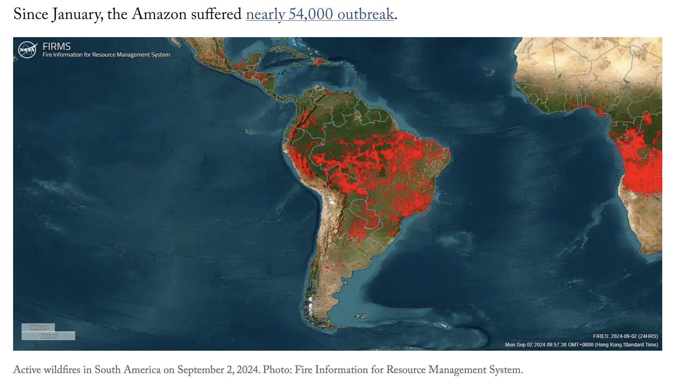
Cascading effects of drought in Amazonia: Fire and biodiversity impacts

Slide 11
Simplified cascade pathway
Climate change + El Niño + N. Atlantic warming
↓
Meteorological drought
↓
Soil moisture deficit
↓
Tree stress and mortality
↓
Increased fire risk
↓
Forest degradation
↓
Reduced evapotranspiration
↓
Less regional rainfall
↓
More severe drought
↓
Impacts on biodiversity, rivers, communities, agriculture, and carbon storage
This cascading sequence is why Amazon droughts are increasingly viewed not simply as hydrological hazards but as systemic risks affecting ecosystems, climate regulation, economies, and societies across South America.

Slide 12
