Slide 1


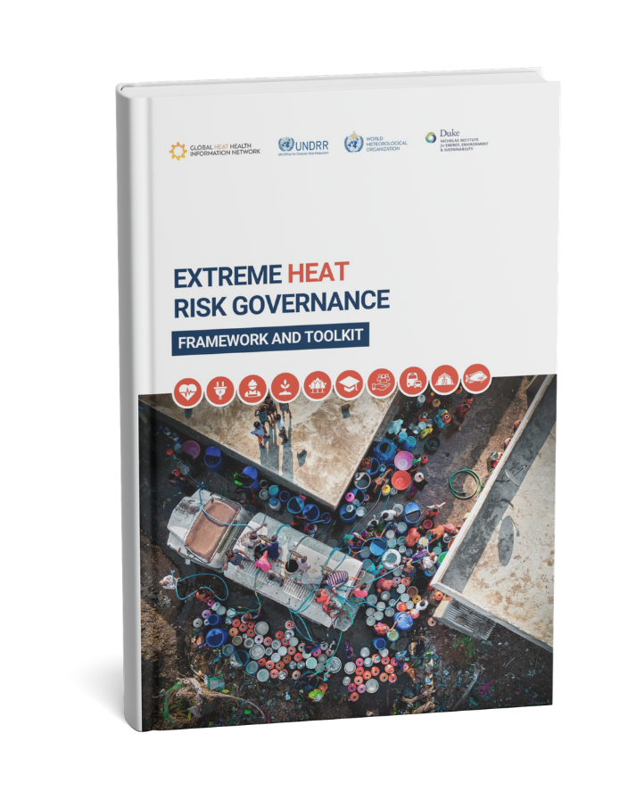

EXTREME HEAT
RISK GOVERNANCE
FRAMEWORK AND TOOLKIT
Alejandro Saez Reale
Coordinator Global Heat Health Information Network
16 June 2026

Slide 2
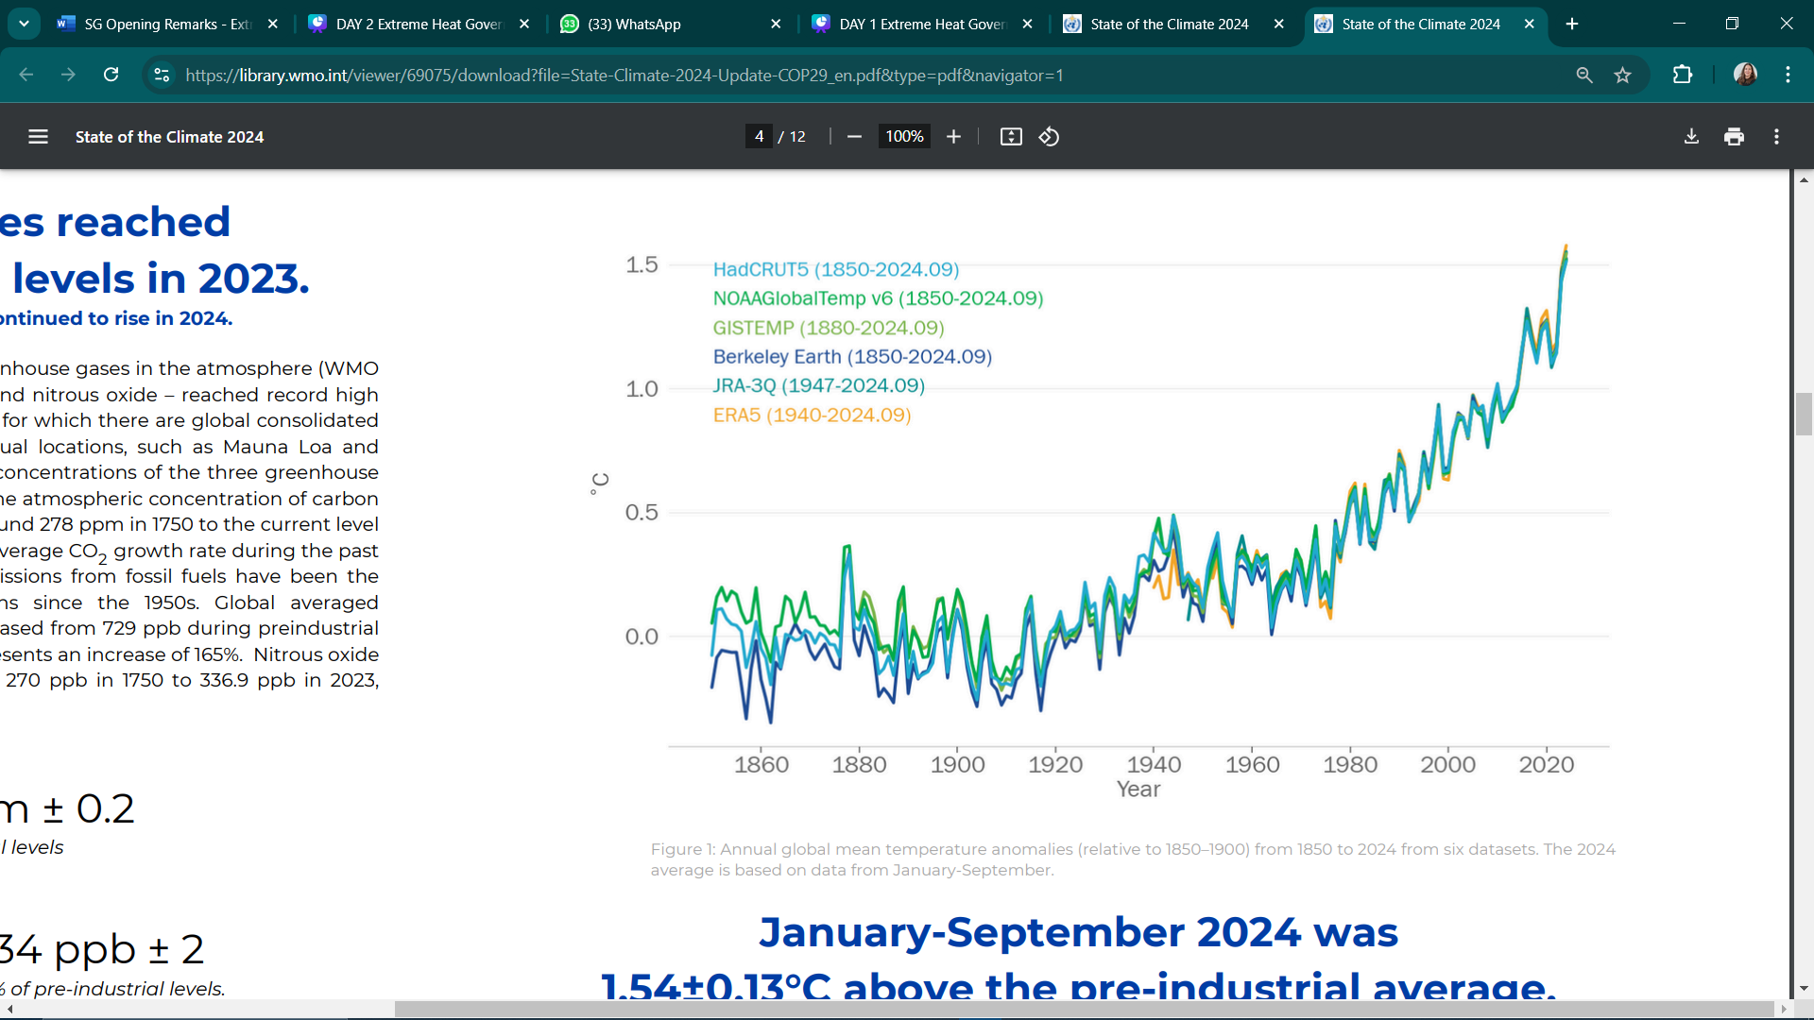



Global mean temperature Jan- Sept 2024 1.54±0.13°C
The world is warming at a faster rate than at any point in recorded history.
The past 11 years are the 11 warmest years on the 175-year observational record.
WMO Press Release 2026
CLIMATE AND HEALTH JOINT PROGRAMME
www.heathealth.info
www.climahealth.info

Slide 3
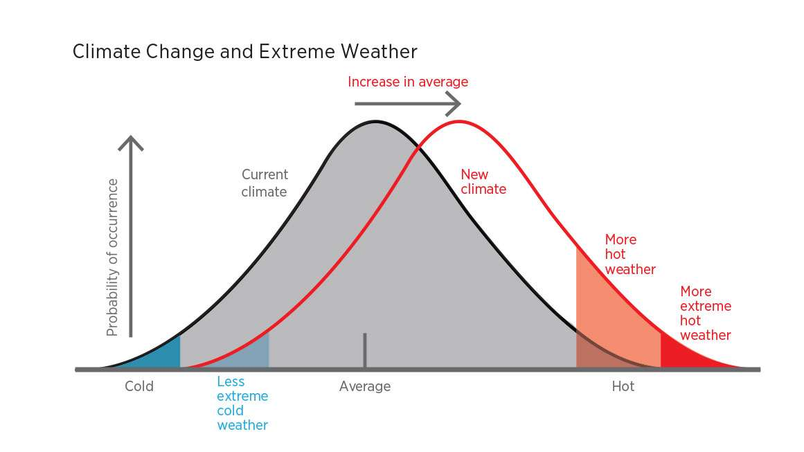
As global temperatures continue to rise,
the character of extreme heat is shifting towards more hotter extremes.
CLIMATE AND HEALTH JOINT PROGRAMME
www.heathealth.info
www.climahealth.info

Slide 4



The world is warming at a faster rate than at any point in recorded history.
Increased exposure, morbidity and mortality.
Growing risks, particularly for older and urban populations.
Unequal impacts across the world.
IPCC AR6
Photo: Kyle Lam / GHHIN - EJN Photo Contest 2025
www.heathealth.info
www.climahealth.info

Slide 5


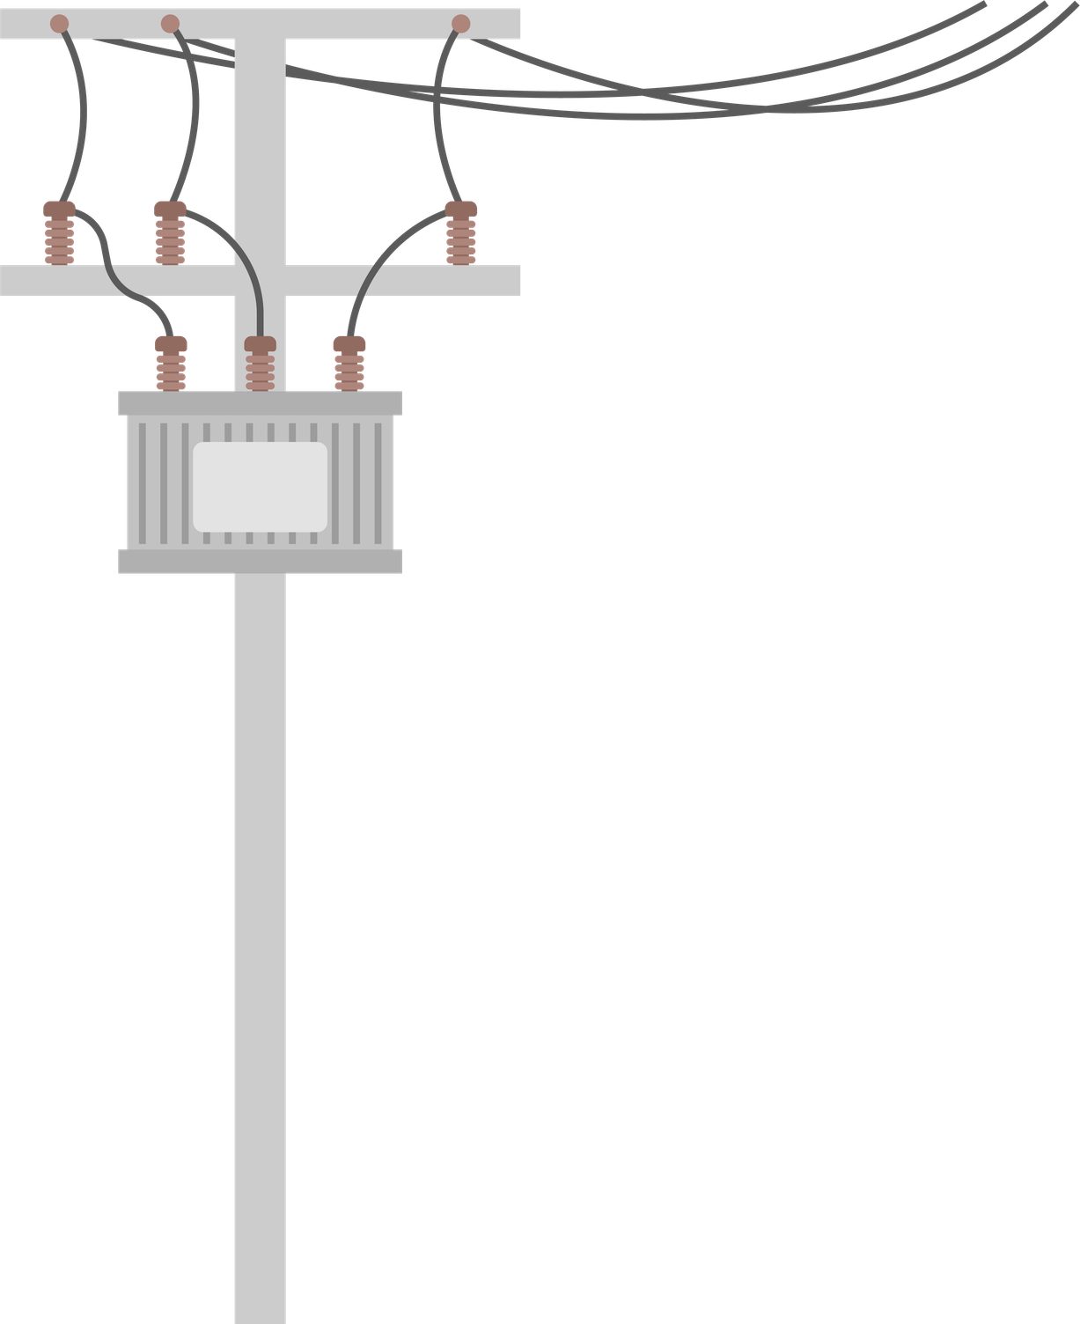


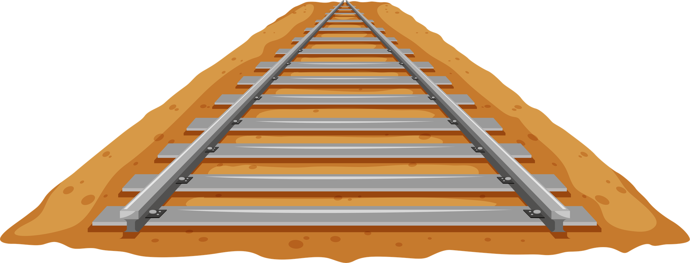




Natural & Built Environment
Economy
Labour
Stability
Extreme heat impacts are multi-sectoral
and cascading
Direct and compounding impacts through sectors, systems and geographies threaten the economic viability of many businesses, industries, and thus livelihoods and functioning societies.
Extreme heat impacts rural & urban workers and lowers productivity across many sectors.
Extreme heat can amplify humanitarian crises, societal fragilities & instability, stress democracies, and may drive violence & migration.
Increased risk of fires, poor air & soil quality, water scarcity & drought, urban heat island, flash flooding and cyclones.
Education
Agriculture
Health
Transport
Social services
Extreme heat can cause school closures and reduces attendance and learning outcomes.
Extreme heat can lead to crop failure and reduced yields, through drought, pests, fire, and wilt, with impacts that can disrupt food systems and provoke food insecurity.
Extreme heatwaves stress healthcare systems. Exposure to high temperatures increases risk of illness and death, including from some infectious diseases.
Extreme heat can disrupt transportation systems, supply and cold chains through impacts to infrastructure and the workforce.
Vulnerable persons face heightened risk, which can place additional strain on social services. Service delivery can be disrupted by heat impacts on personnel and infrastructure.
Energy, utilities & technology
Utilities and technology can fail under high temperatures, leaving people and industry without electricity, including for cooling.
www.heathealth.info
www.climahealth.info

Slide 6
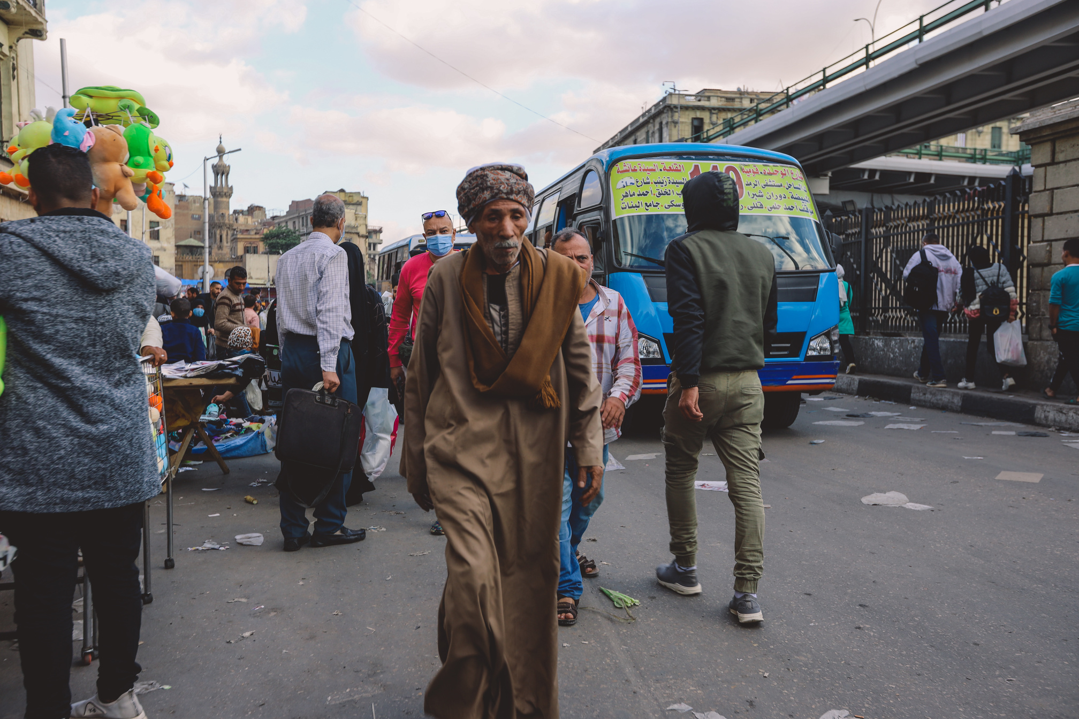
HEAT RISK TOO OFTEN FALLS THROUGH GOVERNANCE CRACKS
Heat risks and impacts often falls across the missions, mandates, and authorities of various government agencies and policies, making responsibility challenging to assign.
  Climate Change
  Disaster Management
  Urban Development
  Public Health
  Infrastructure & Housing
  Environment
www.heathealth.info
www.climahealth.info

Slide 7
The world’s foremost network of experts on extreme heat and human health.
Connect and empower people and institutions to form multi-disciplinary partnerships to reduce heat risks.
The Global Heat Health Information Network is a dynamic community of policymakers, scientists, practitioners, working together for a world where extreme heat is no barrier to lives and livelihoods.
The Network accelerates heat action through three goals:
Accelerate the generation of evidence, actionable knowledge, and standardized guidance and risk metrics.
Catalyse global, national and local policy and action to minimize societal consequences of heat impacts.
www.heathealth.info
www.climahealth.info

Slide 8
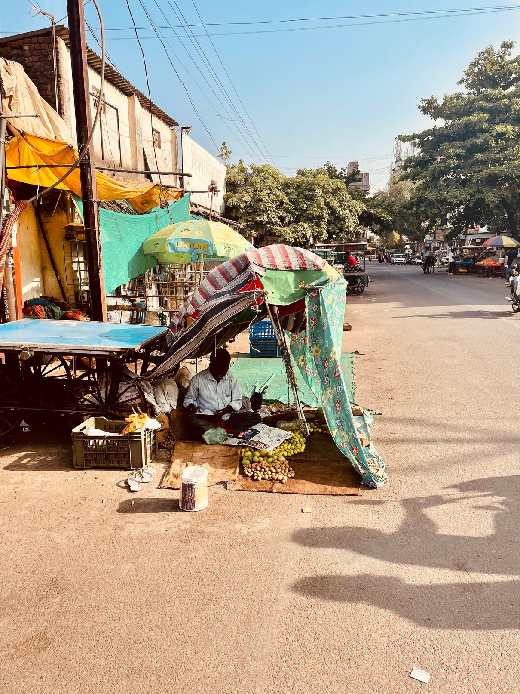
COMMONLY REPORTED CHALLENGES
BY PRACTITIONERS AND POLICYMAKERS
1
2
3
4
5
6
Low awareness prevents individual and policy-level action.
Insufficient locally relevant information is available for evidence based decision-making.
Social safety nets and heat-readiness efforts are nascent, siloed, with limited & fragmented coverage in healthcare, labor, education, agriculture, water, and critical infrastructure.
The most vulnerable communities have limited green and blue spaces and heat-ready infrastructure.
Limited access to lifesaving cooling, water, and medical care is not available for the most vulnerable during extreme events.
Legislative frameworks and policy mechanisms for heat-centered cross-sectoral planning are lacking and uncoordinated.
Photo: Aveek Ghosh / GHHIN - EJN Photo Contest 2025
www.heathealth.info
www.climahealth.info

Slide 9
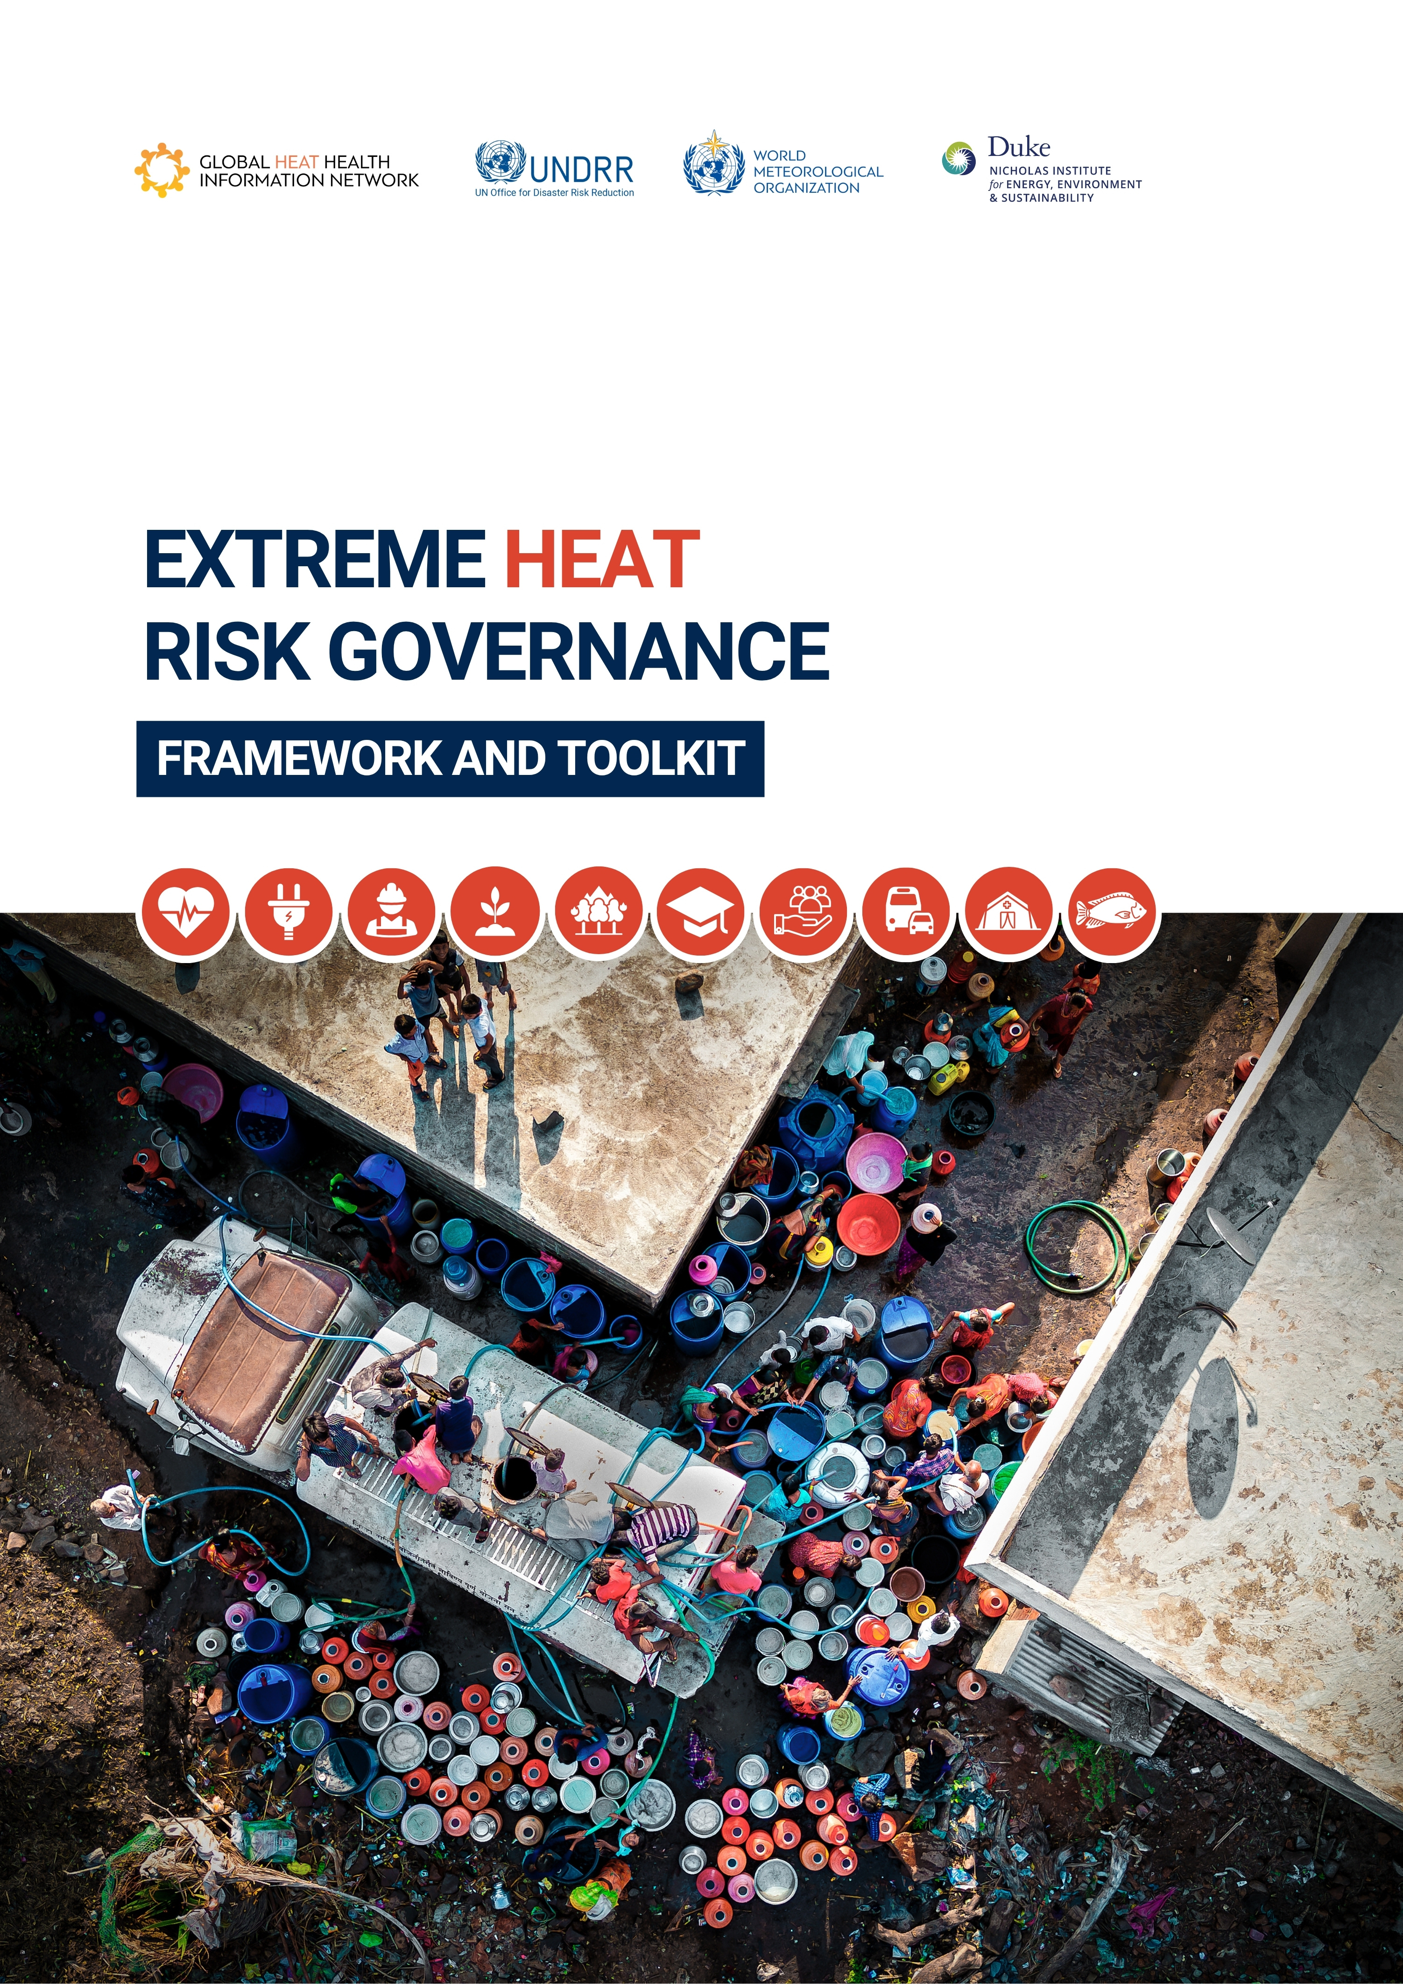
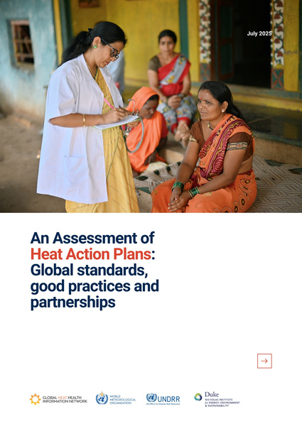
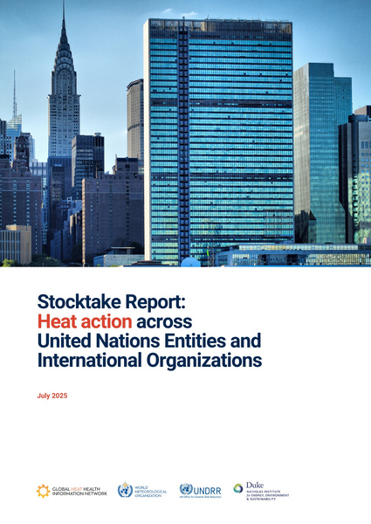
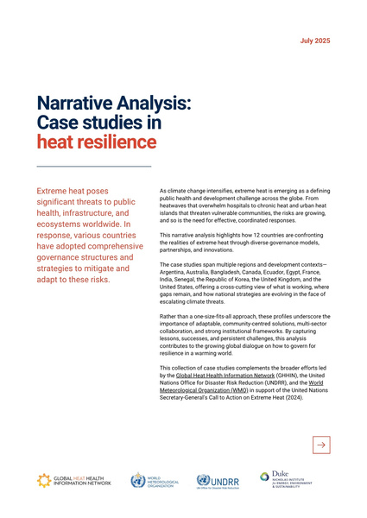
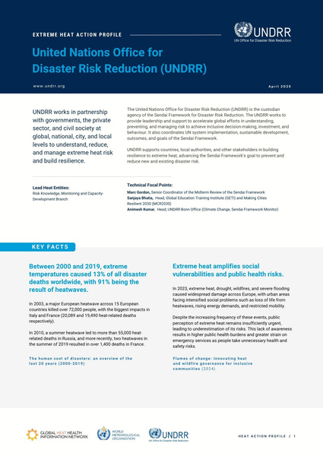
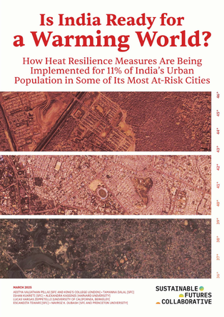
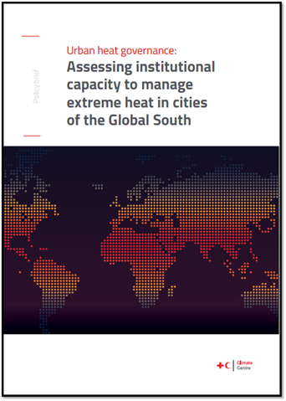
KEY LESSONS FROM OUR HEAT RISK GOVERNANCE WORK
Most HAPs lack Vulnerability Assessments
HAPs tend to focus on the short-term response
Single-sector governance limits comprehensive heat response
Implementation of HAPS requires clearly defined governance architecture
Others arrived to similar findings
www.heathealth.info
www.climahealth.info

Slide 10
DEFINING EXTREME HEAT RISK GOVERNANCE
Extreme heat governance operationalizes the full,
multi-sectoral ecosystem,
Actors
Institutions
Assets
across timescales,
Long-term resilience & risk reduction
Seasonal preparedness
Early warning systems & emergency response
towards heat action.
To guide, coordinate and oversee heat risk reduction efforts
www.heathealth.info
www.climahealth.info

Slide 11
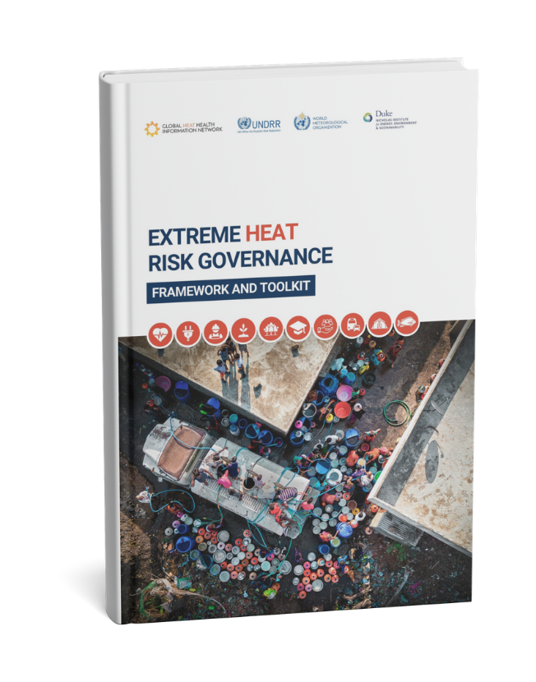



EXTREME HEAT
RISK GOVERNANCE
FRAMEWORK & TOOLKIT
Assess governance maturity – Identify strengths and gaps across leadership, response and collaboration.
Cooperate across health, environment, energy, agriculture, and other sectors.
Plan for Heat Action – Build strong, cross-sector Heat Action Plans.

Slide 12
HEAT RISK GOVERNANCE AIMS
FROM
TO
Fragmented and uncoordinated policies
Multi-Sector, Multi-Scale Approaches
Reactive, short-term crisis management
Proactive, Long-Term Extreme Heat Risk Reduction
Lack of clear roles and responsibilities
Defined Institutional Leadership & Accountability
Data gaps and lack of integration
Data-Driven Decision-Making and Risk-Informed Policies
Limited investment steer and financial mechanisms
Heat Risk-Informed Investments and Targeted Funding
Inequitable impact on vulnerable populations
Inclusive, Community-Driven Solutions
www.heathealth.info
www.climahealth.info

Slide 13
TOOLKIT COMPONENTS
Tool 1
Assess the Maturity of your Extreme Heat Risk Governance
Identify strengths and gaps across leadership, response and collaboration.
Tool 2
Operationalize Extreme
Heat Risk Governance
Cooperate across health, environment, energy, agriculture, and other sectors.
Tool 3
Plan for Heat Action
Build strong, cross-sectoral Heat Action Plans.
www.heathealth.info
www.climahealth.info

Slide 14
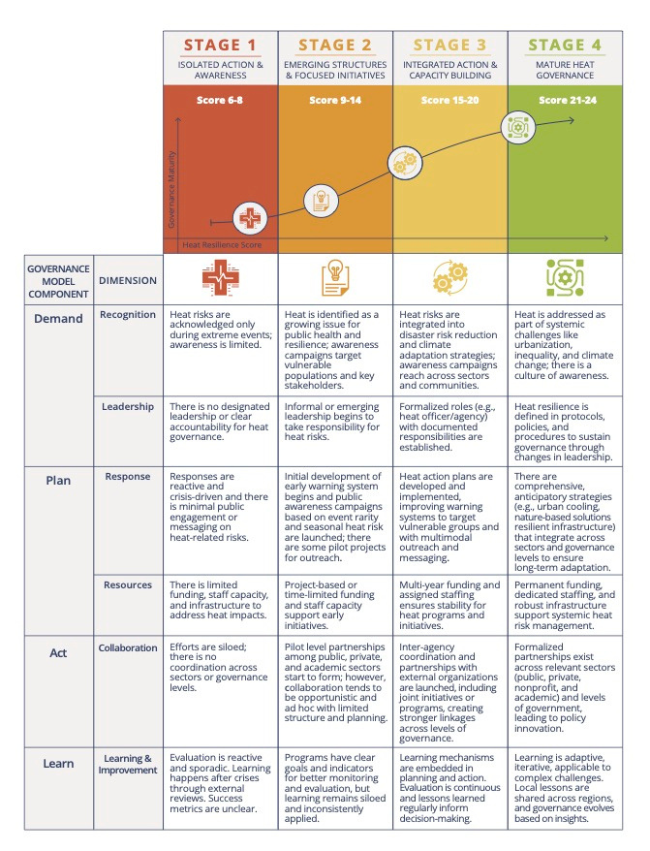
TOOL 1: MATURITY MODEL FOR HEAT GOVERNANCE
www.heathealth.info
www.climahealth.info

Slide 15


TOOL 2: 4 COMPONENTS TO OPERATIONALIZE EXTREME HEAT RISK GOVERNANCE
2. PLAN
Outputs:
  Problem identification
  Political attention from mandated authority and stakeholders
  Executive order from mandated authority
Mechanisms: Political processes and civil society engagement
Outputs:
  Stakeholder identification and consultations
  Mission / vision
  Goals and targets for action
  Approved budget
  Strategies and plans (e.g. HAPs)
  Governing agreements
Mechanisms: Cross-sectoral planning exercises
DATA & ANALYTICS
Critical enabler to define demand, inform planning, guide action and communications, and
aid learning.
4. LEARN AND IMPROVE
3. ACT
Outputs:
  Monitoring and evaluation
  Capturing and sharing best practices
  Advocacy and communication
  Technical support
Mechanisms: Integrated monitoring efforts
Outputs:
  Iterative processes
  Communication channels and rhythms
  Measurement and data gathering
Mechanisms: Cross-sectoral coordination systems
www.heathealth.info
www.climahealth.info

Slide 16
TOOL 3: HEAT ACTION PLANNING ELEMENTS
1
2
3
4
5
Mapping and engaging with Stakeholders and the Public
Define Heat Risk
Vulnerability Assessment and Risk Mapping
Coordination
Prevention, Mitigation, Adaptation and Long term Planning
6
7
8
9
Integration
Preparation & Early Warning Systems
Response
Implementation
www.heathealth.info
www.climahealth.info

Slide 17
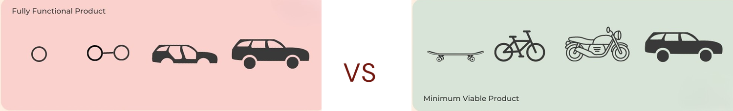
Final thoughts
Let’s not trip over the same stones. Whenever there’s a plan, think of the mechanism for implementation. What does the governance behind the plan look like?
Heat Gov can sound complicated, but doesn’t have to. Let’s not make perfect the enemy of good. Focus on “good enough” process that enables action. MVP for heat governance
CLIMATE AND HEALTH JOINT PROGRAMME
www.heathealth.info
www.climahealth.info

Slide 18

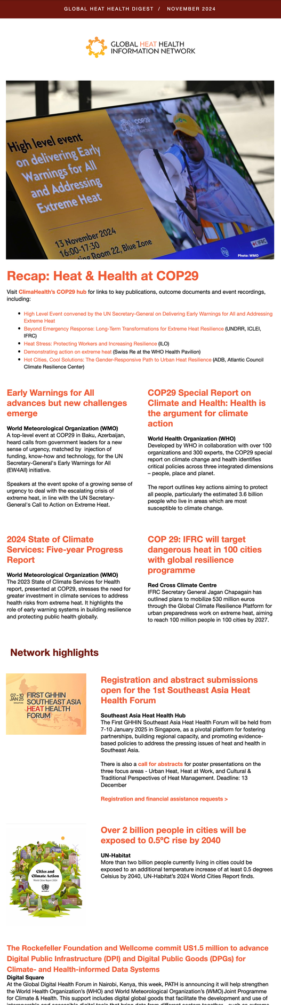
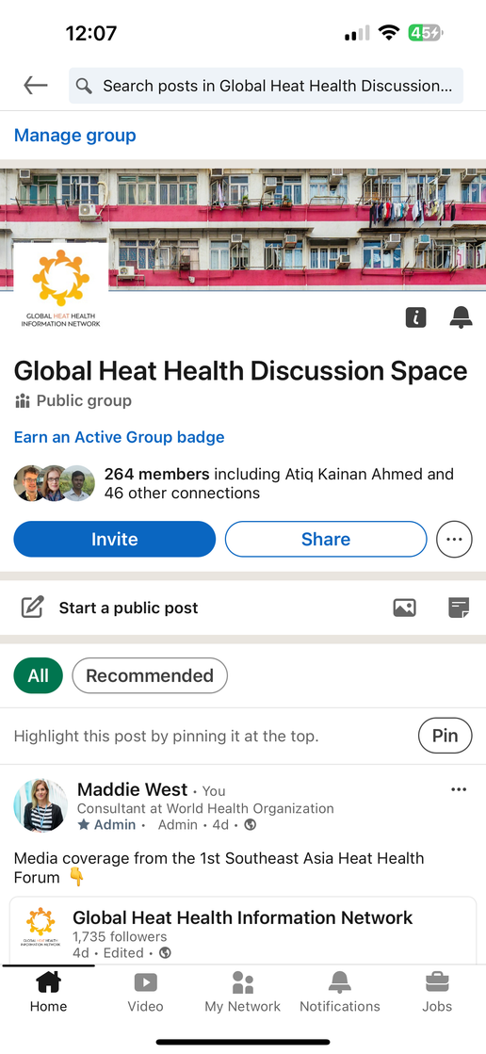

Get involved
Subscribe to our monthly heat health digest
Join our global database of heat experts
Join the conversation on LinkedIn
CLIMATE AND HEALTH JOINT PROGRAMME
www.heathealth.info
www.climahealth.info

