Slide 1
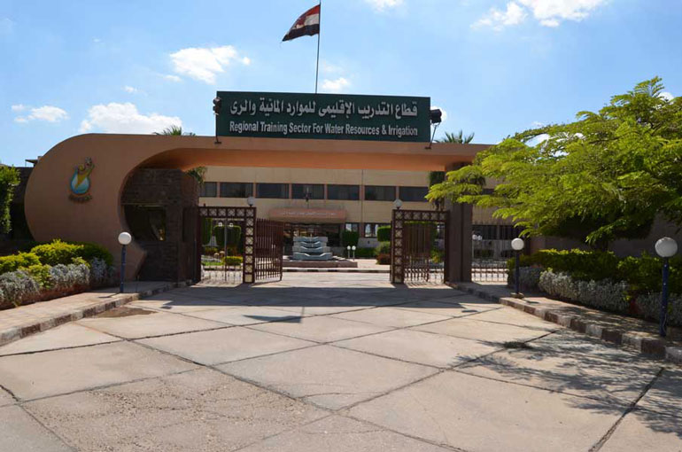
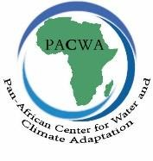


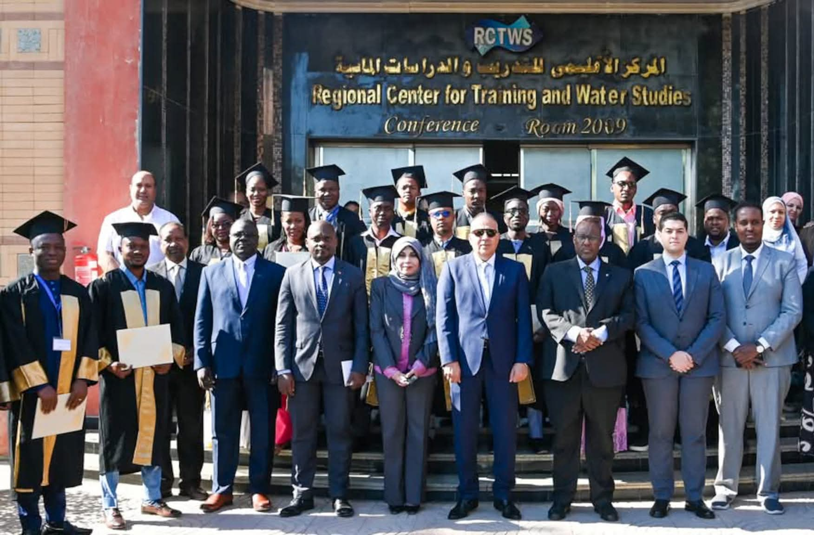
Regional Center for Training and water Studies
Pan African Center for water and climate Adaptation

Slide 2

RCTWS History: Since 42 years :24 years under UNESCO Auspices
PACWA :Pan-African Center for Water and Climate Adaptation,AWARe,COP27
National
Governmental
Capacity development and training arm ,To Support MWRI Water Policy and Strategy
MWRI
Regional
International
Cat II center ,To Support UNESCO Objectives Framework in Region
UNESCO
Regional
Continental
AWARe
To Support African Regions in Climate Change Adaptation
ADVANCING KNOWLEDGE AND SHAPING THE PATH FORWARD

Slide 3
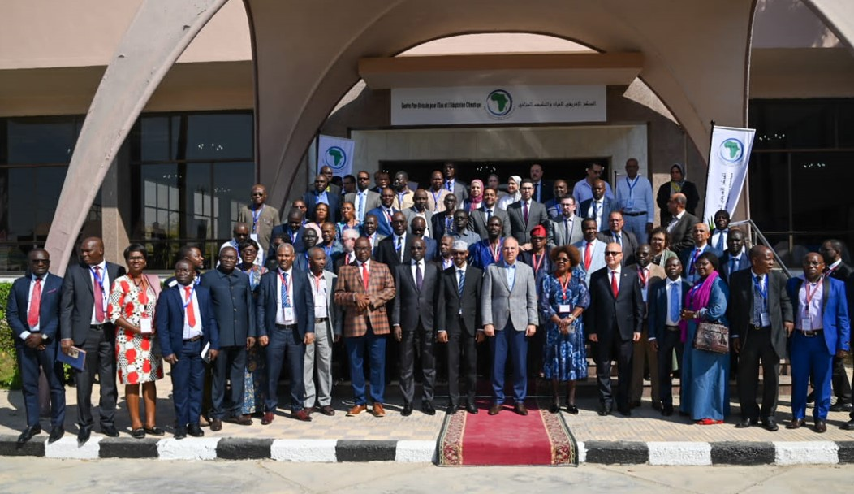
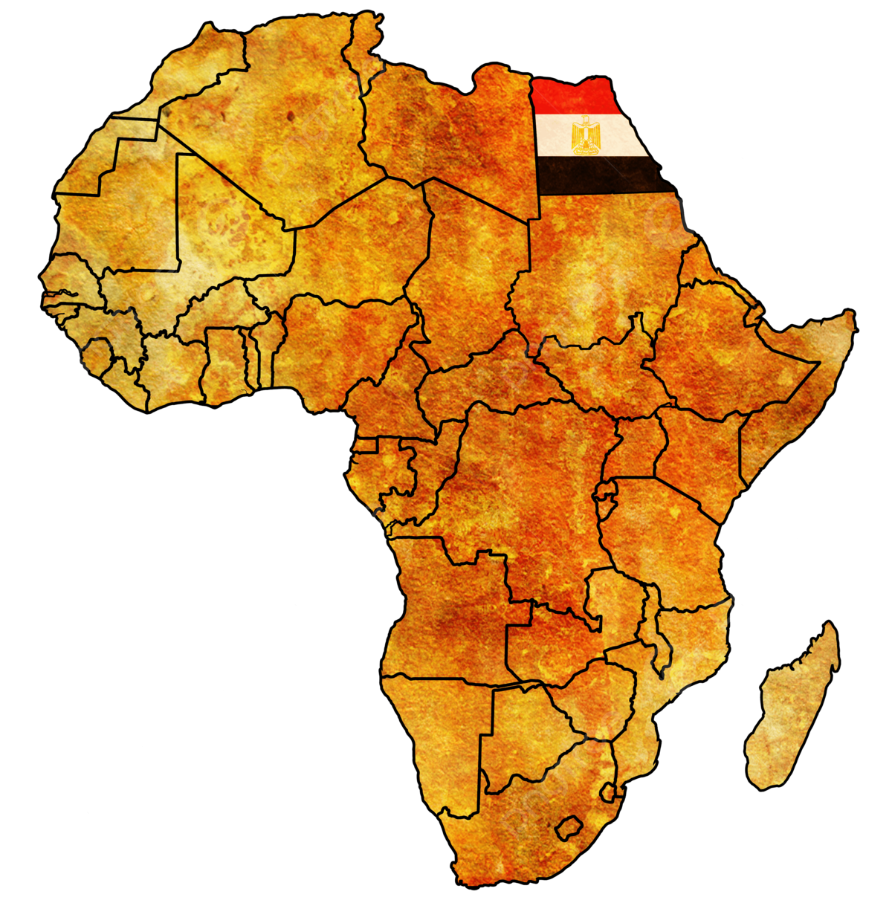
Introduction
The Pan African Center for Water and Climate Adaptation (PACWA) was established as part of the International Water Sector Adaptation Initiative (AWARe), focusing on building capacity within the water sector to enhance climate change training opportunities across African nations.
Objectives of (PACWA)
To serve as a hub for training, knowledge-sharing, and fostering development collaboration among African nations in response to the urgent challenges posed by climate change.
To train African countries with the knowledge and skills necessary to adapt to climate change challenges.
To support African countries in managing their water resources sustainably.
To strengthen the capacity of African professionals to address the impacts of climate change.

Slide 4



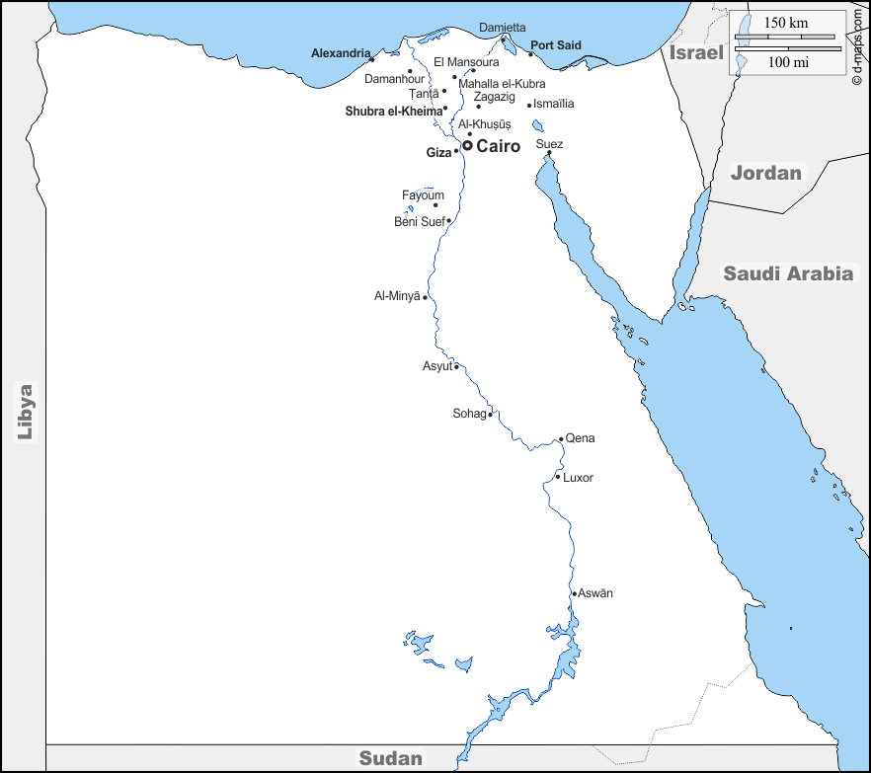



Branches/Sub-Centers
Kafr Elsheikh
Al Mansoura
Zagazig
Damanhour
Kafr Elsheikh
Head Quarter in 6th October City
6th October
New Capital
Menya
Fayoum
Esna
Esna

Slide 5
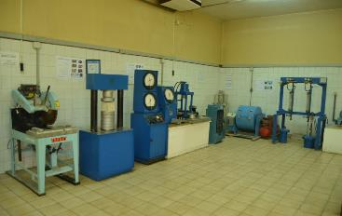
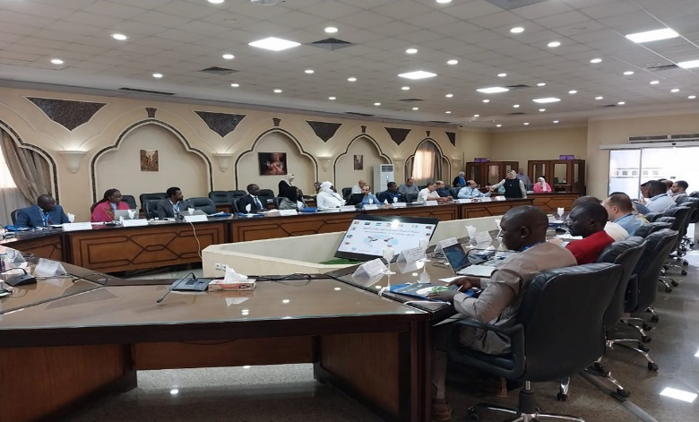
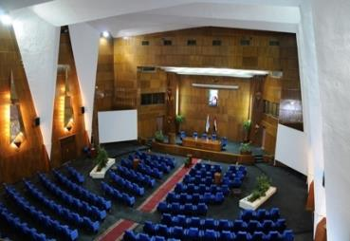
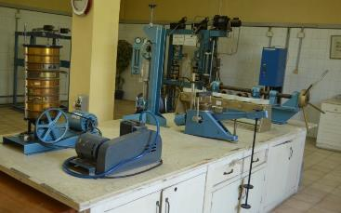

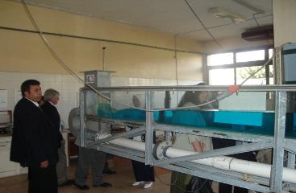

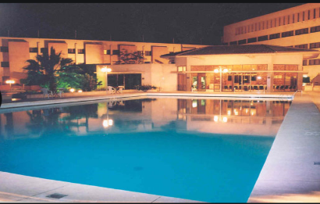
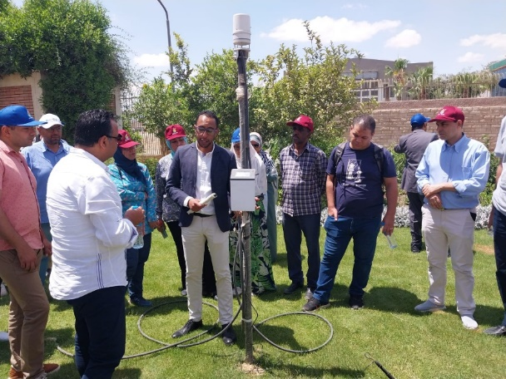
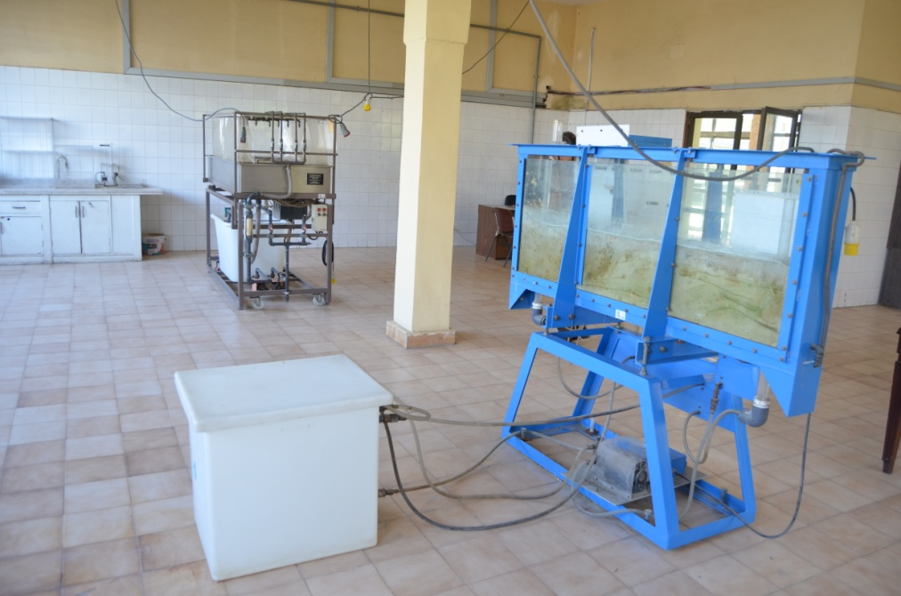
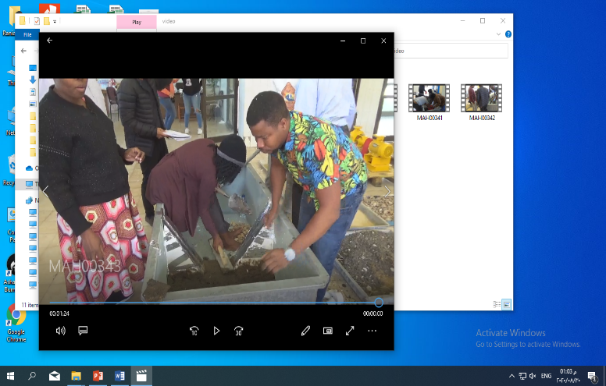
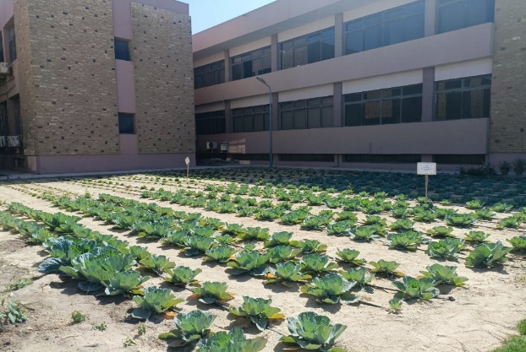
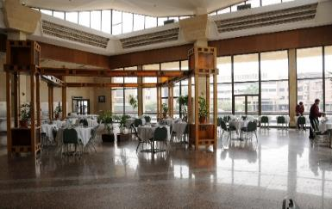
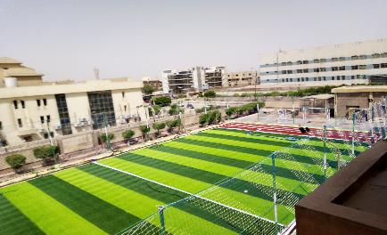
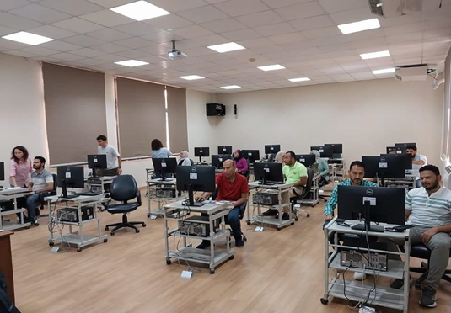
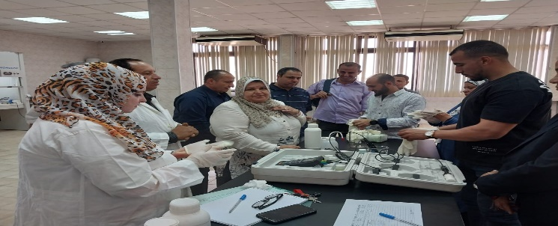
Infrastructure & Facilities
5 Technical Labs
Water Quality
Soil Mechanics
Hydraulic
Materials And Concrete
Water Resources Management
8 Training Classrooms Various Capacities (20 – 80 Participants)
Conference Room
(300 Participants)
3 Well Equipped Hotels
  160 Single Room
  18 Executive Room
  10 Suites
Swimming Pool
Smart Irrigation farm
5 Computer Labs
Equipped With Most Recent H/W, S/W
Two Restaurants
Playground

Slide 6



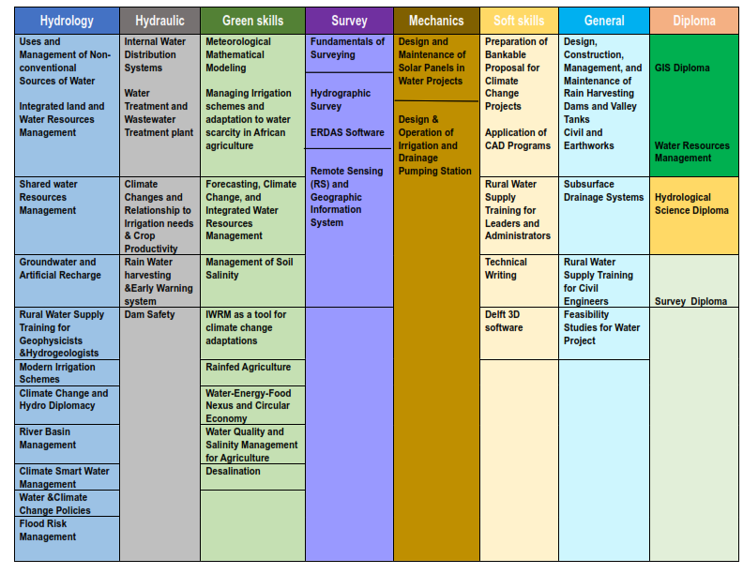
RCTWS Training programs

Slide 7
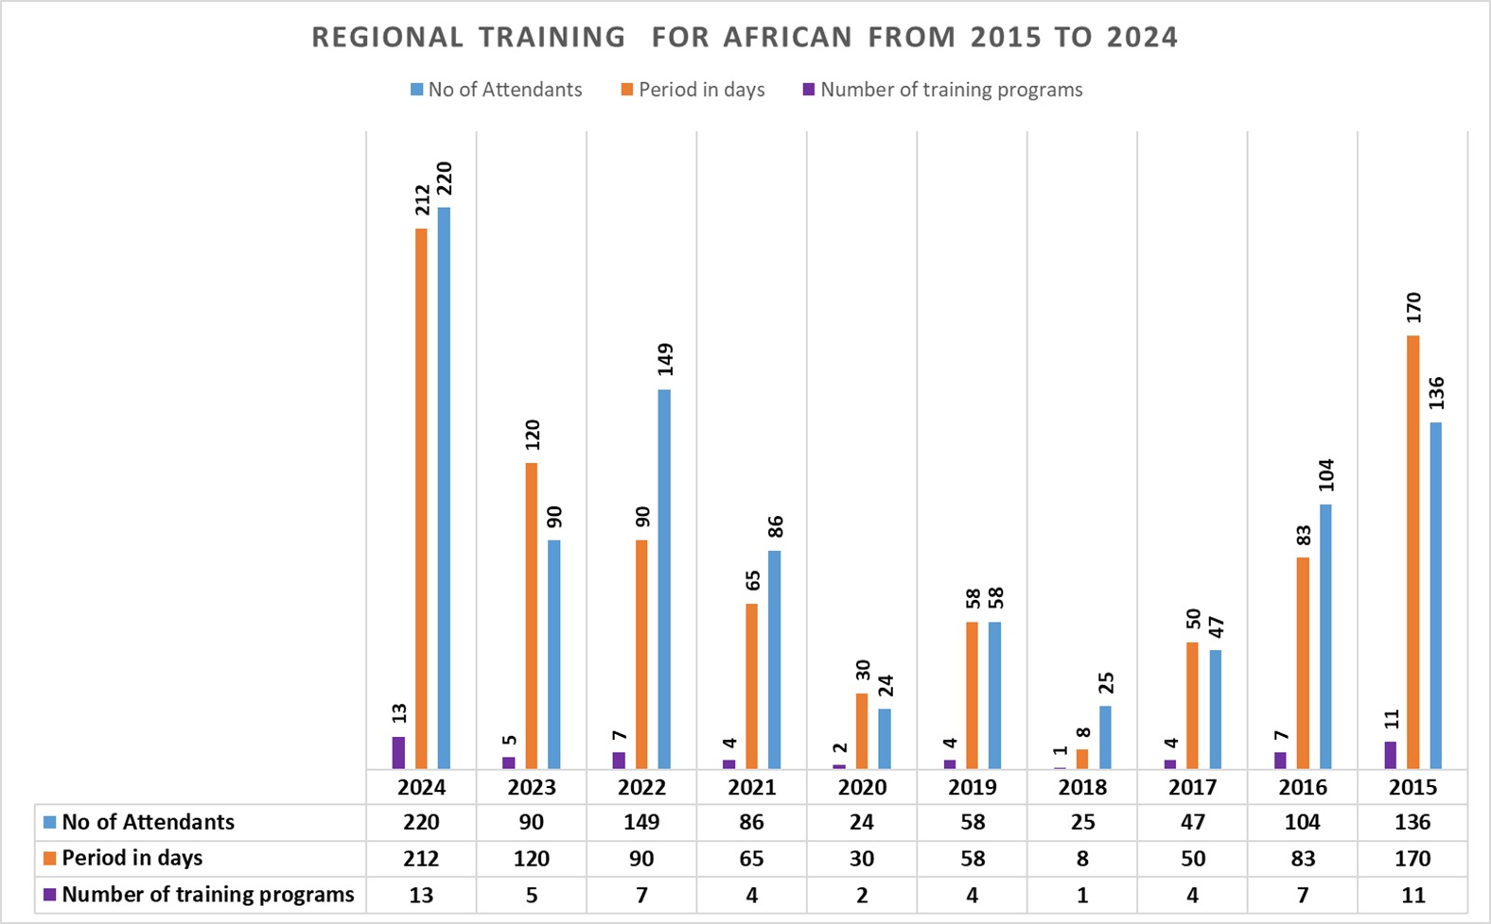
Past Programs

Slide 8
Work stream of PACWAs’ Activities and IHP IX Strategy Priority Area Linkage
IHP IX Priority Area | Matching Proposed work stream Training Programs
P1:Scientific Research and Innovation | WS 4.1: Water Quality and Salinity Management for Agriculture
 | WS 4.2: Modern Irrigation Schemes
 | WS 4.3: Water Treatment and waste water treatment plant
 | WS 6.1: IWRM as a tool for adaption to climate change
 | WS 1.3:Groundwater Recharge
P2:Water Education in forth Industrial Revolution Including sustainability | WS 5.1: Remote Sensing (RS) and Geographic Information System (GIS)
 | WS 5.2: Flood Risk Management
 | WS 5.3: Rainwater Harvesting Systems & Early Warning System
 | WS 5.4: Dam Safety
P3:Bridging Data –Knowledge gap | WS 3.1: Climate Change and Hydro Diplomacy
 | WS 3.2: River Basin Management
P4:Integrated water management under condition of global change | WS 2.1: Integrated land and water resources management
 | WS 2.2: Integrated and Sustainable Management of Shared Aquifer Systems
 | WS 2.3: Rainfed Agriculture
 | WS 2.1: Integrated land and water resources management
 | WS 1.1: Management and Uses of Non-Conventional Water Resources
P5:Water governance based on science for mitigation ,adaptation and resilience | WS 2.4:Soil Management
 | WS 6.2: Climate Smart Water Management (CSWM)
 | WS 6.3: Climate Changes and relationship to irrigation needs & crops productivity
 | WS 6.4: Water & Climate Change Policies
 | WS 1.2: Water-Energy-Food Nexus and circular economy

Slide 9
Need Assessment for training programs from African Countries
The training needs assessment was conducted across 41 African countries.

Slide 10









Collaboration with Partners

Slide 11
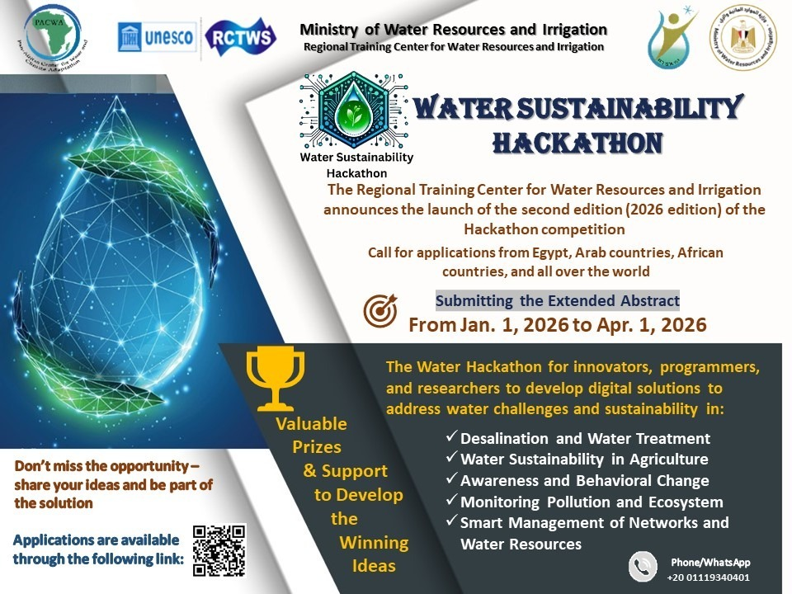
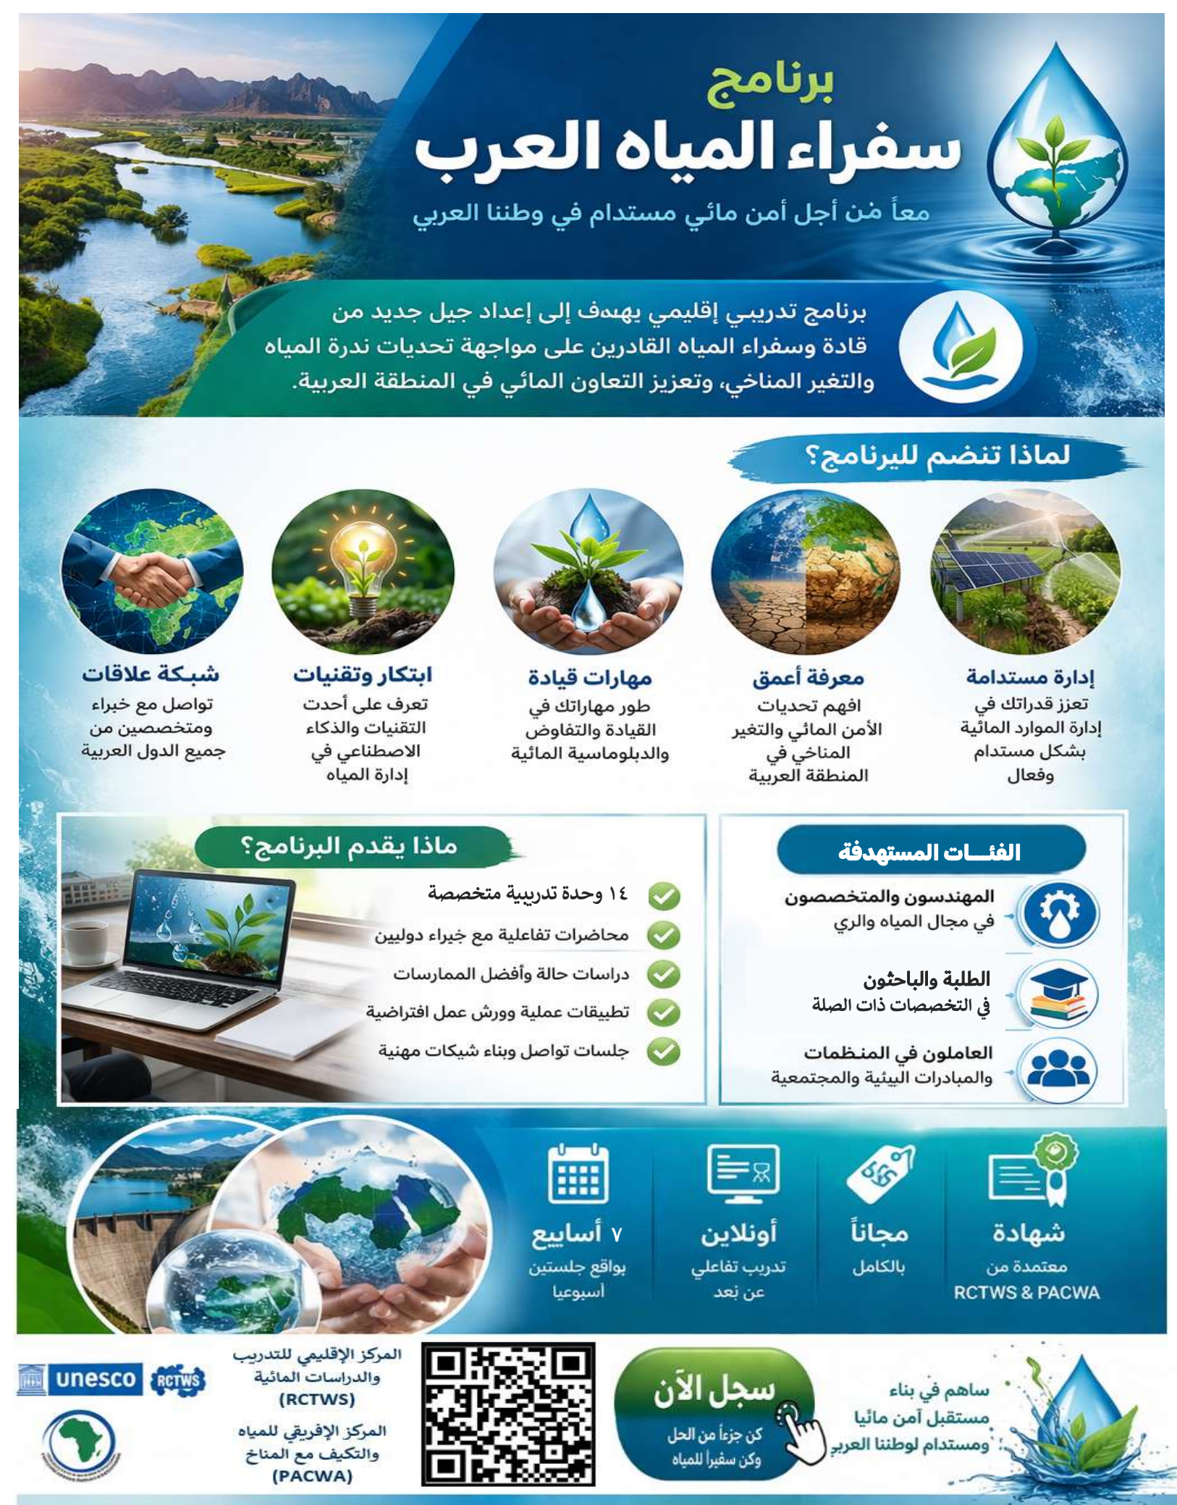

Slide 12
Thank you

