Slide 1
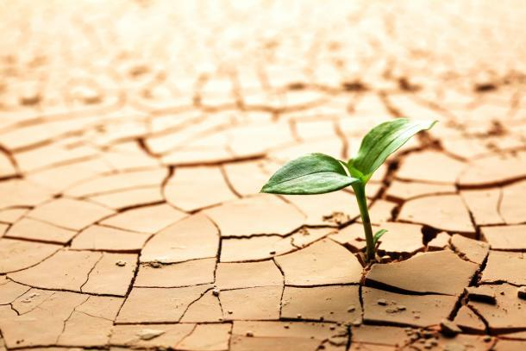


The complexity of drought:
Cumulative risks, compounding events, and cascading impacts
Dr. Roger S. Pulwarty
U.S. National Oceanic and Atmospheric Administration
WMO/IDMP, UNCCD, UN Disaster Risk Reduction, EU-Joint Research Center, Caribbean Institute for Meteorology and Hydrology and many others
?
HMNDP+10

Slide 2
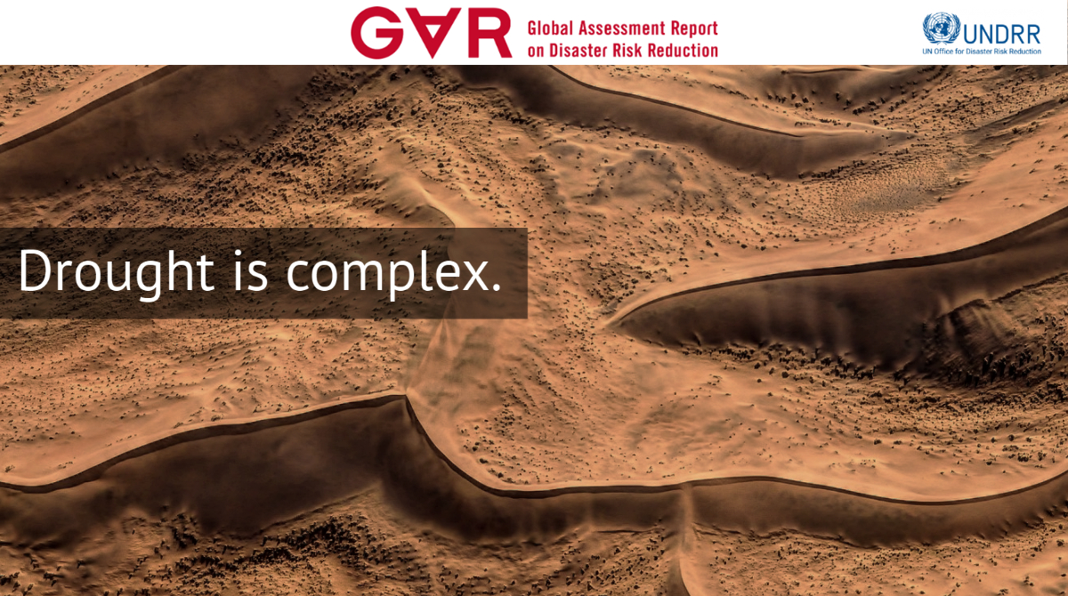
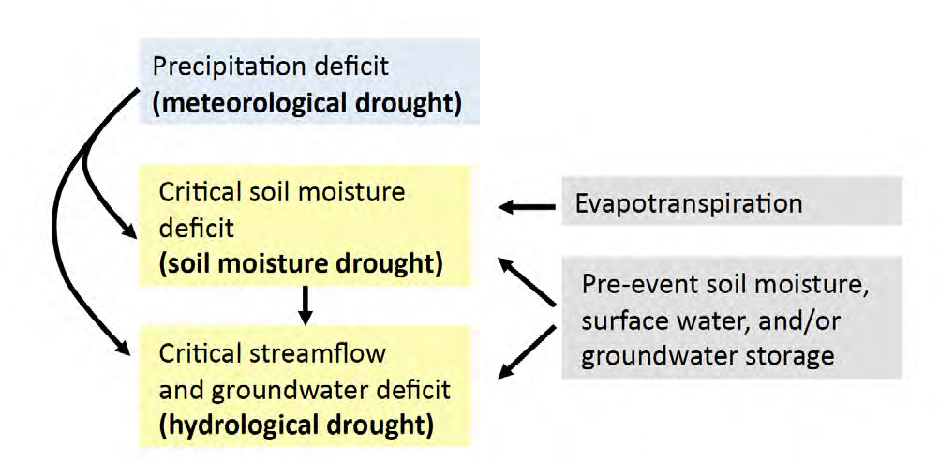
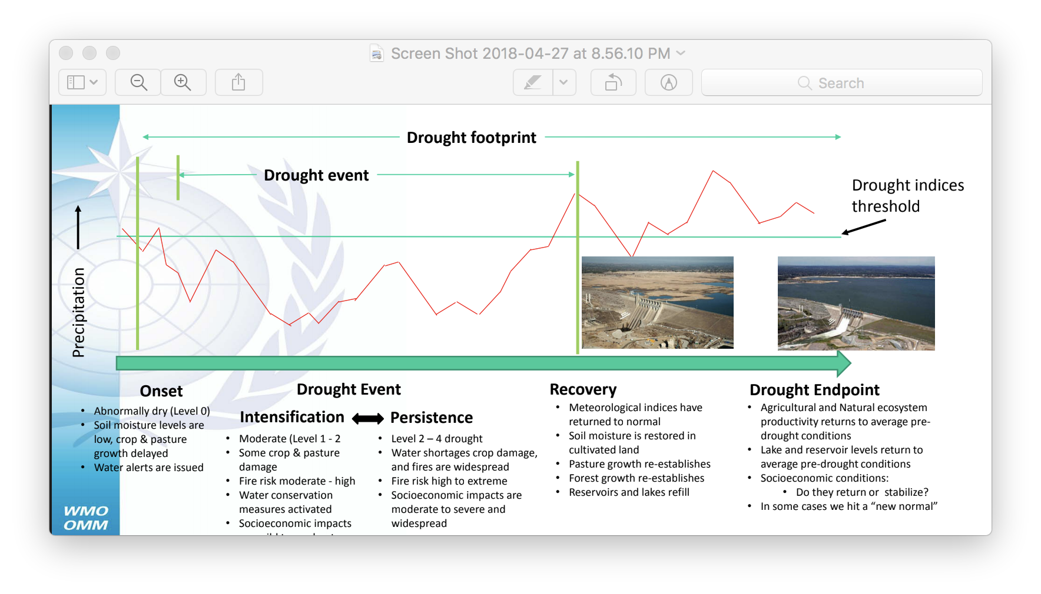
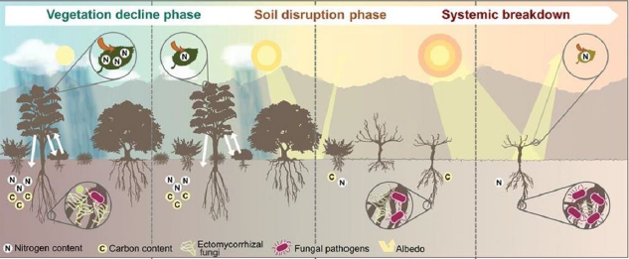
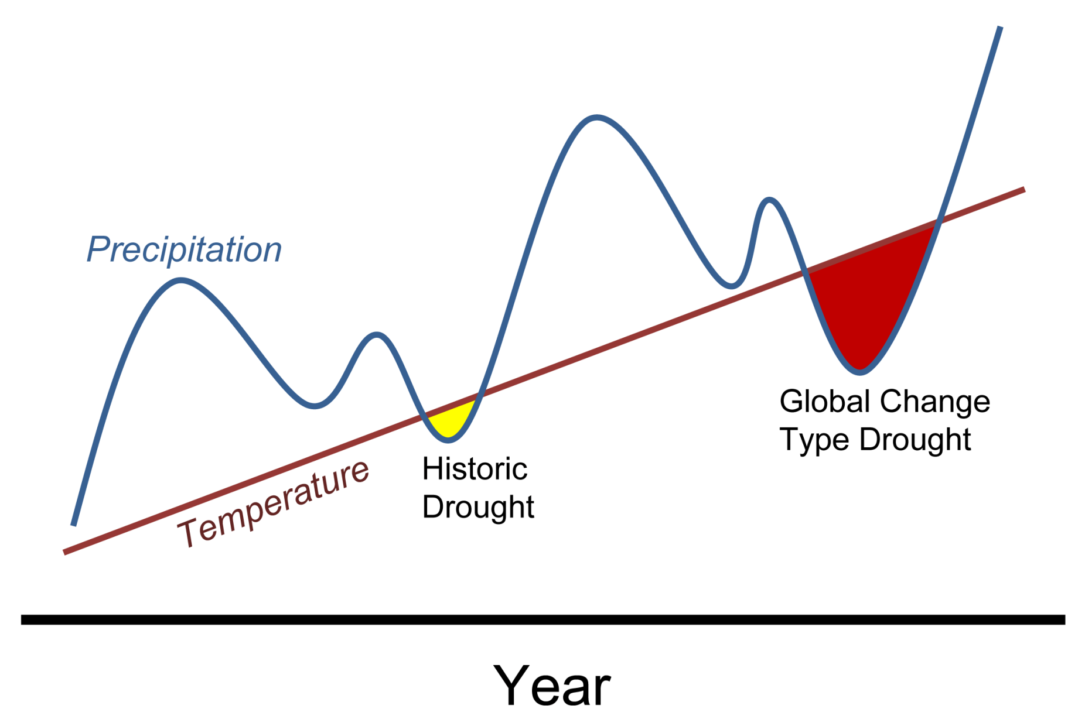
WMO CAgM
WMO CAgM
Increasingly
Meteorological Drought
Reduced precipitation and increased variability
Increased temperatures and evaporative demand
Drying plants, increased forest and rangeland fires
Increased water req. and demands (agric., society)
Impacts on biodiversity balance, fauna and flora
Food and Water Insecurity
Reduced agricultural production
Reduced animal production
Reduced proper Nutrition
Reduced transport capacity
Hydrological Drought
Reduced surface fresh water and ground water recharge
Reduced hydroelectric production and industry output
Negative effects on tourism
Reduced Water quality
Impacts on fish production
Livelihood Levels
Reduced income
Increased unemployment
Decreased coping capacity
Loss of ecosystem services
Direct Impacts of Drought
Complex interactions
Indirect Impacts of Drought
Economical, Social and Environmental Stresses
Agricultural/Soil Moisture Drought
Impacts on rain-fed agriculture
Demands on irrigated agriculture
Degradation of natural flora
Losses in rangeland carrying capacity
Increased soil- and land degradation
Social Vulnerability
Human security & community instability
Gender-based and intergenerational impacts
Migration, displacements and conflicts
Heat stress, vector-borne diseases, dust, nutrition

Slide 3
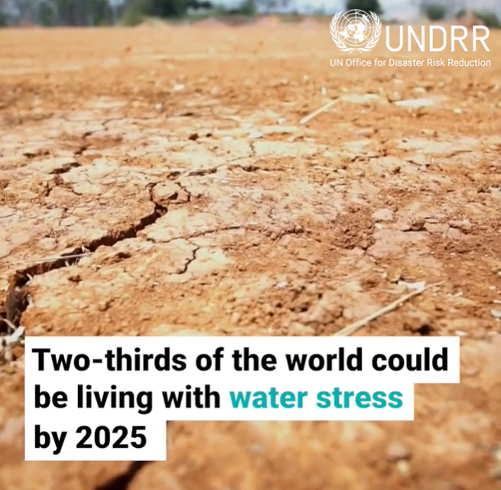
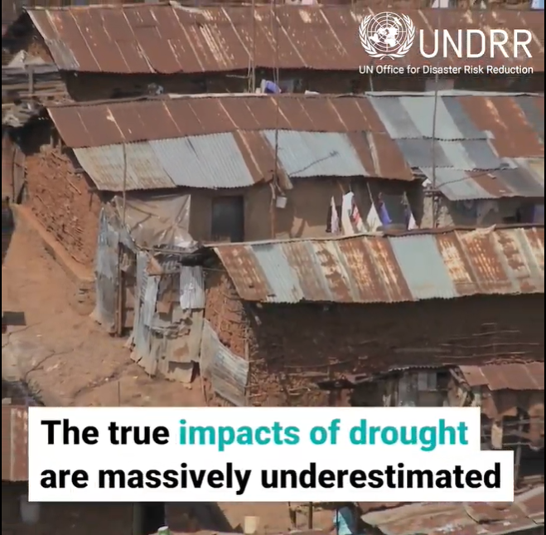
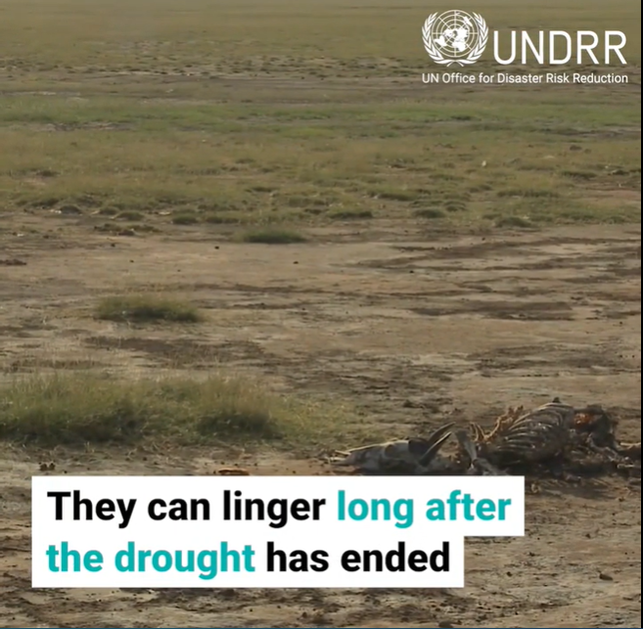
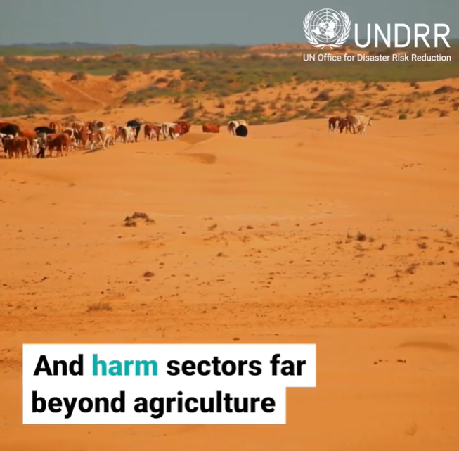
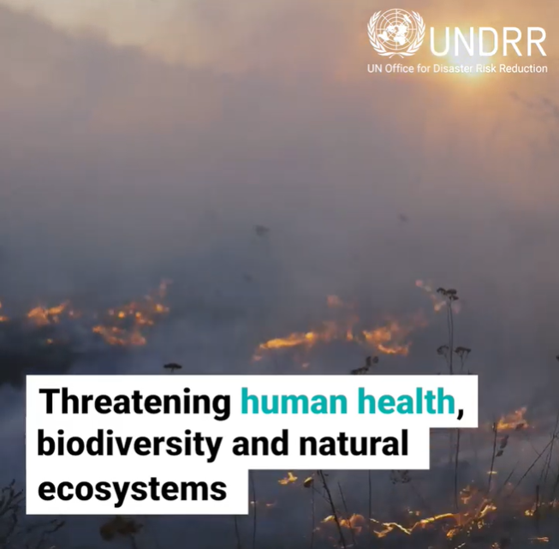
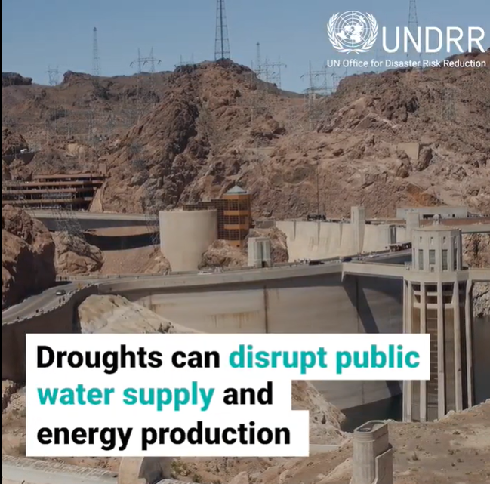
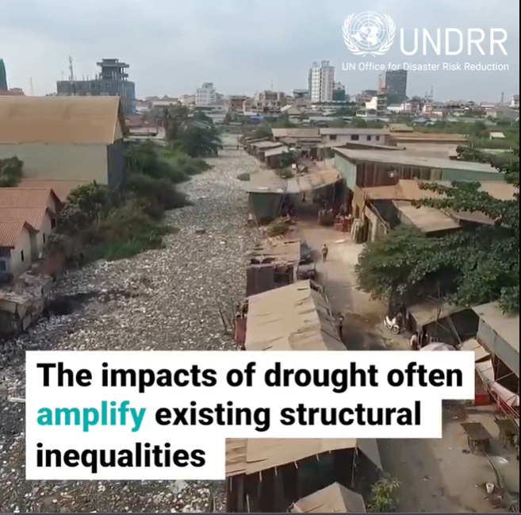
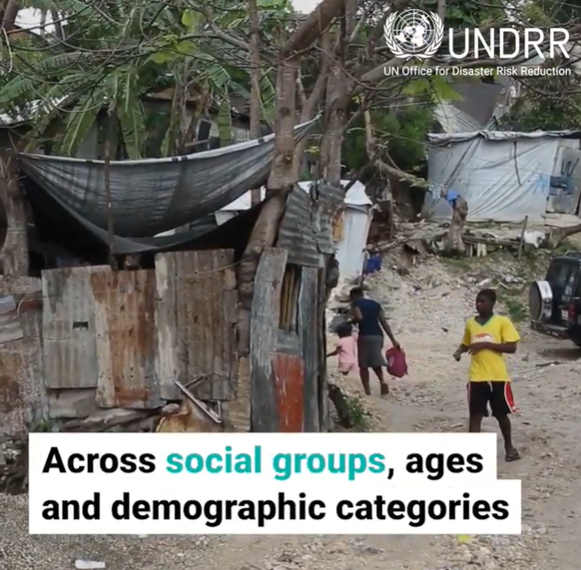
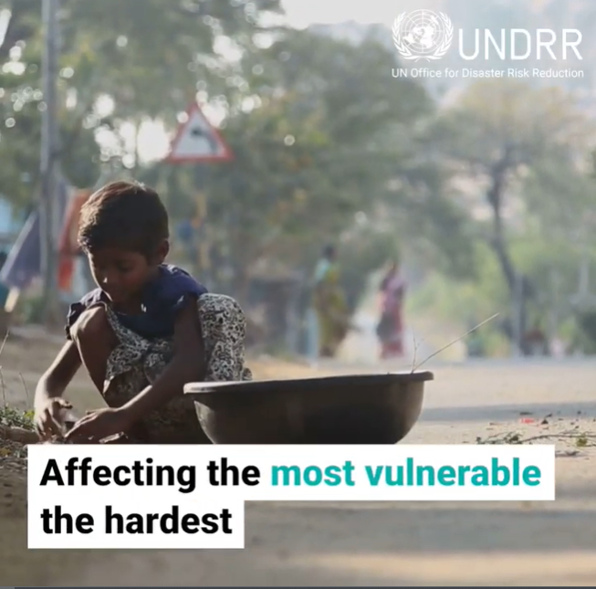
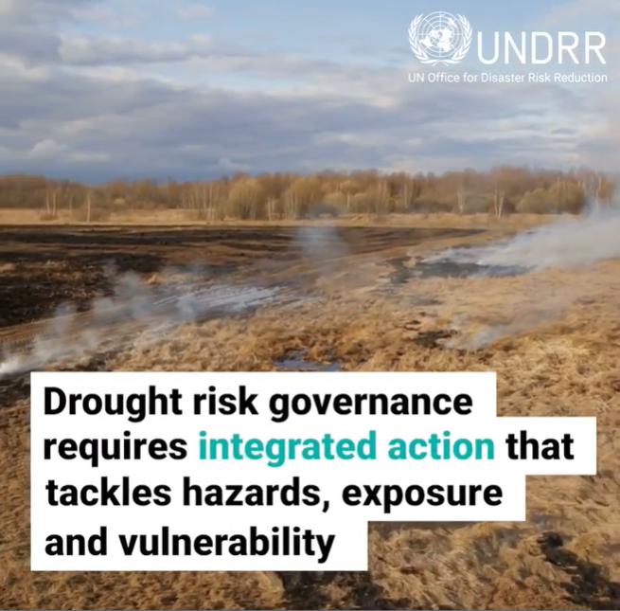
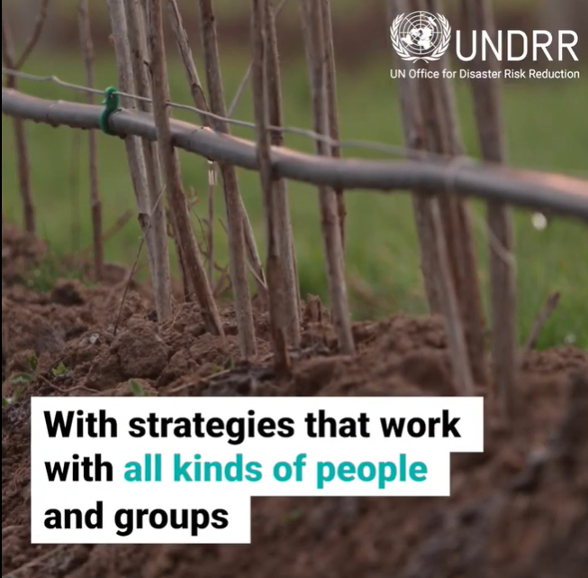
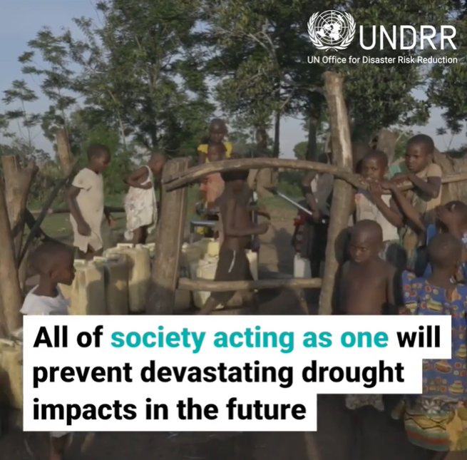
For many parts of the world
drought still remains a “hidden” risk…….
…….until it becomes a crisis

Slide 4
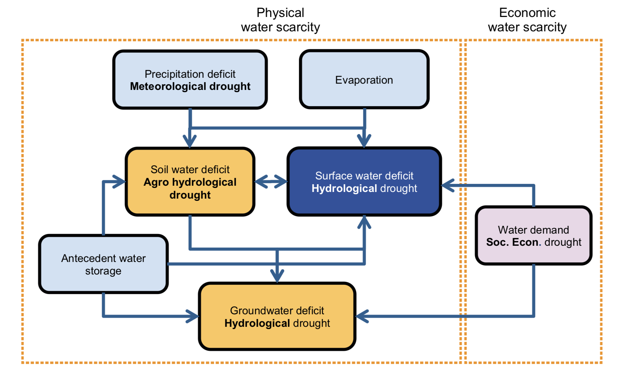
When does it start? Will it intensify?
When does it end?
Multiple definitions
WMO CAgM
Interconnected and cumulative impacts on different sectors at different times
Ecological Drought

Slide 5
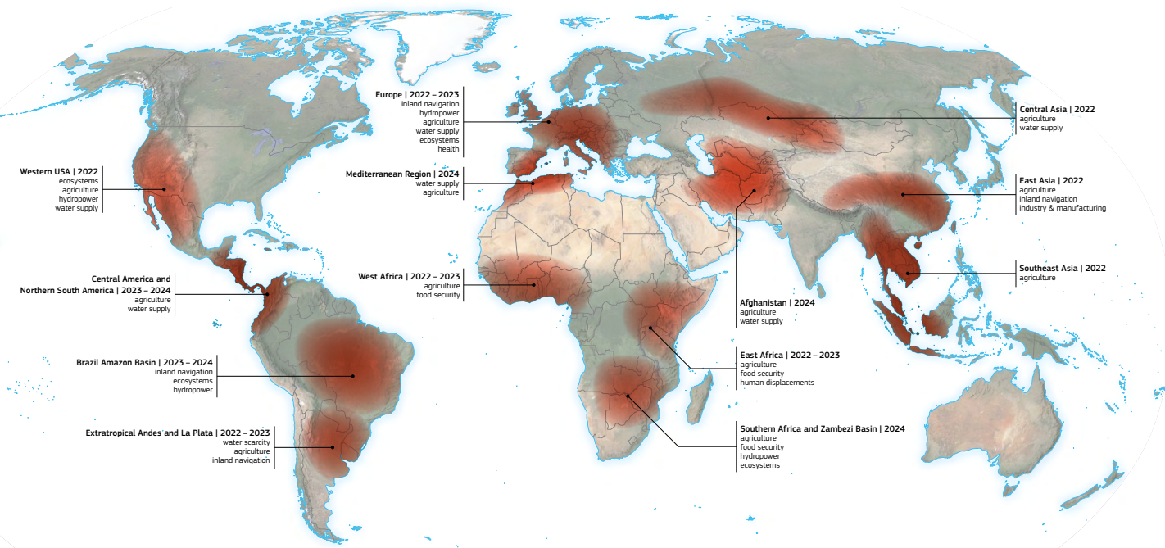
There is no reliable prediction system for multiyear droughts
UNCCD Drought Atlas 2024

Slide 6
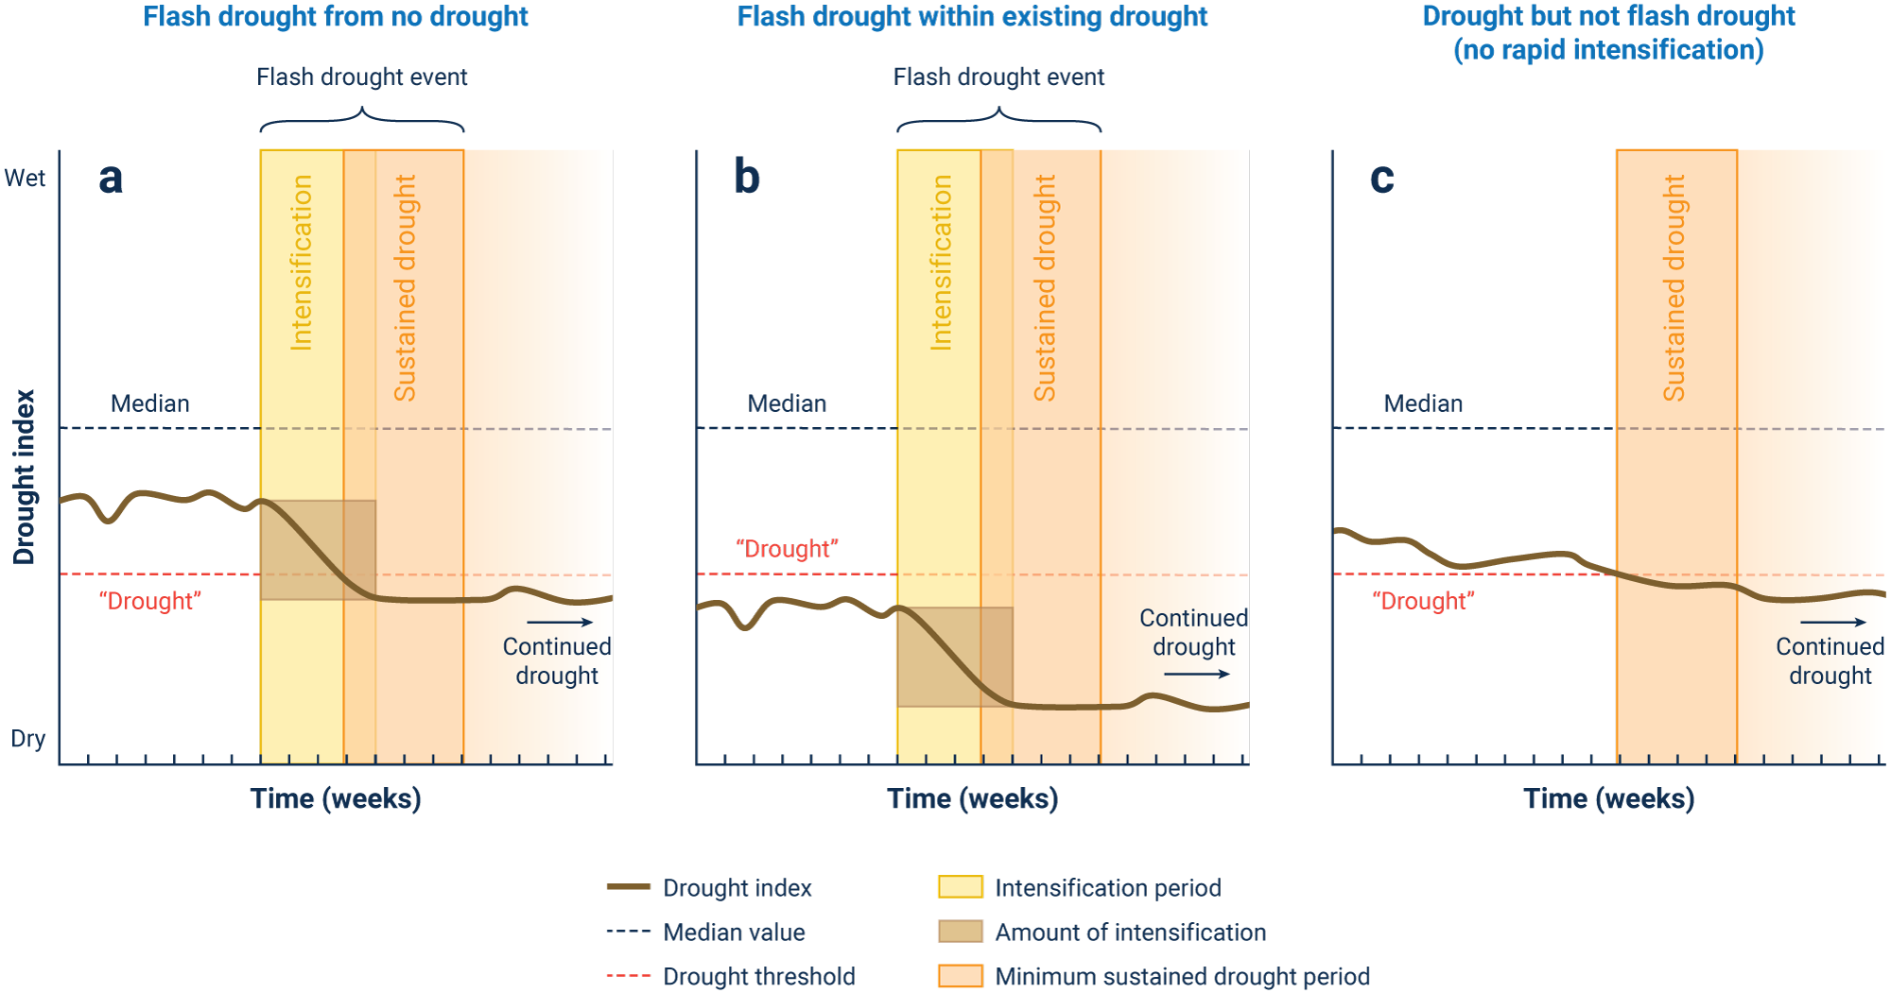
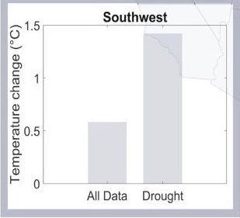
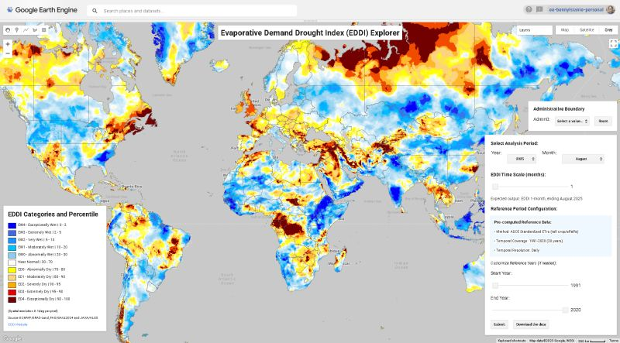
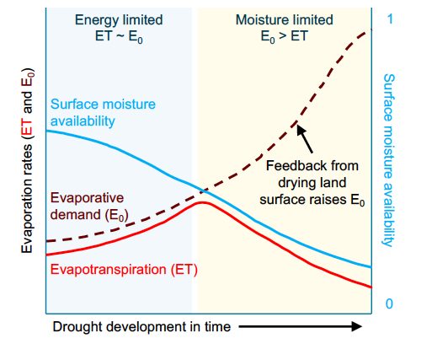
Flash drought with
no background drought
Flash drought
on existing drought
No Flash drought
Or rapid intensification
Flash drought : shorter-term
(< 3months) but during a critical period of demand or normally” peak” precipitation (usually combined with strong evaporative demand)
US MidWest and Southeast 2008, 2012, 2017
Central Europe 2015
Mediterranean Basin
Pendergrass, Meehl, Pulwarty et al 2020
Hobbins , Huntingtonet al 2018

Slide 7

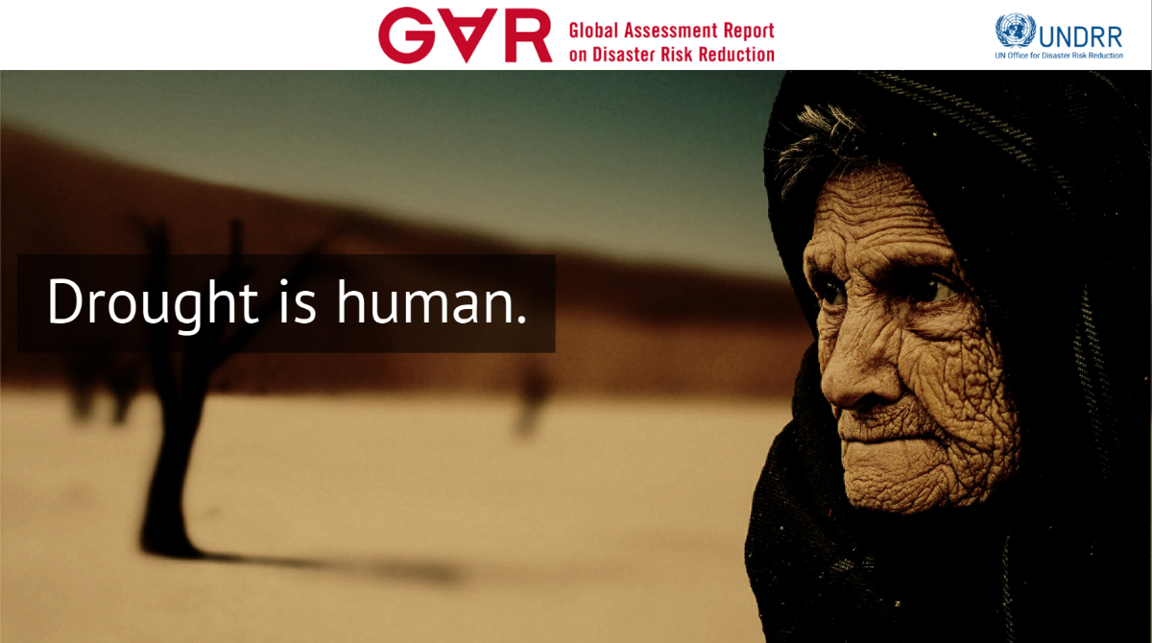
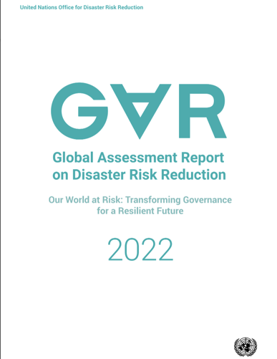
Complicated Risks
Complex, compounding and cascading risks
Calculated
risk
Perceived
risk
Simple Risk
Cascading and compounding risks, local imbalances, and global and regional network disruptions are overwhelming traditional drought risk management and reduction

Slide 8
What are Cascading and Compounding Risks?
Cascading risks – represent a chain reaction of impacts propagating through interconnected systems (e.g. food, water, energy networks etc), often amplifying the initial impact, triggering a series of related failures or problems that extend beyond the initial incident (see Pescaroli et al 2018; 2024; UNDRR 2021)
Aghakouchak et al 2023)
Compounding risks develop when multiple risks combine at the same time, amplifying the overall impact and making it significantly greater than the sum of its individual parts such as drought, heat, wildfires occurring together (see UNESCO, 2019; UNDRR 2021; Aghakouchak et al 2023)

Slide 9
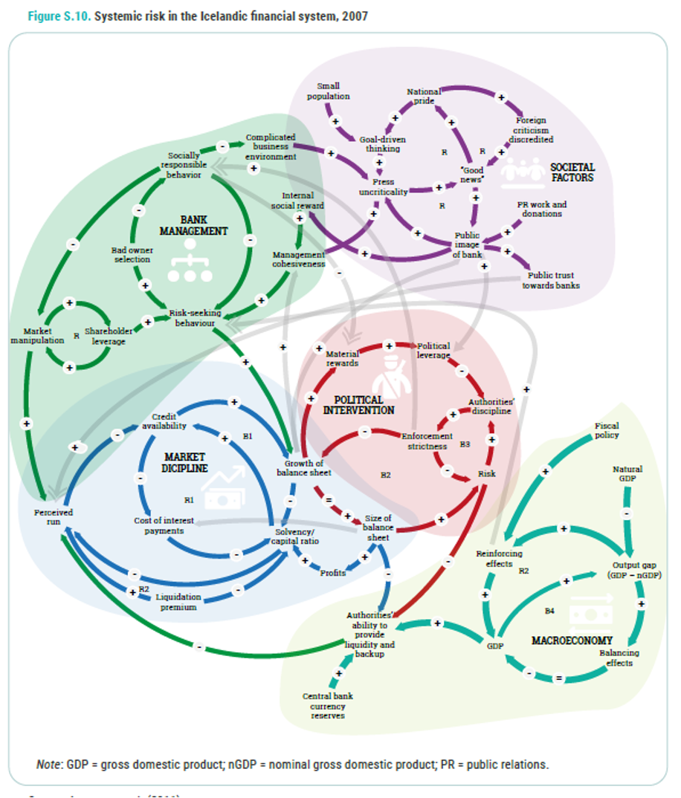
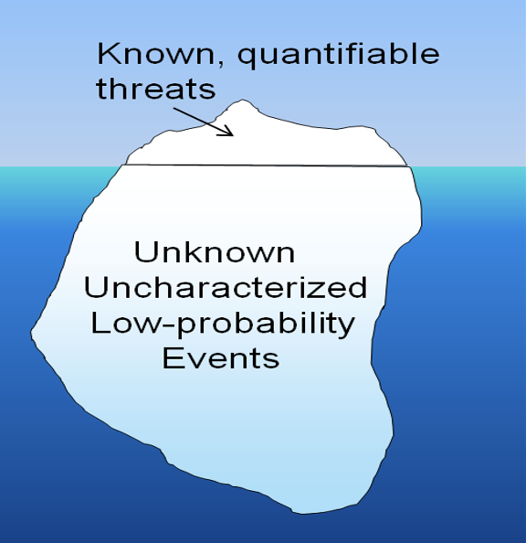
Systemic risk
Cascading impacts have their own submerged vulnerabilities (e.g. land degradation, health, water, infrastructure, and food sectors) via the movement and networks of people, goods, capital and information within and across boundaries including communities, regions, countries and continents.
(UNDRR, 2023)
Managing Risk
Managing for Resilience
Monitoring and early warnings that include information on compound risks and cascading impacts across scales offer a clearer picture of the systemic risks associated with drought than traditional hazard-focused indicators alone
(UNDRR 2021; Aghakouchak et al 2023)
(Linkov et al 2018)

Slide 10
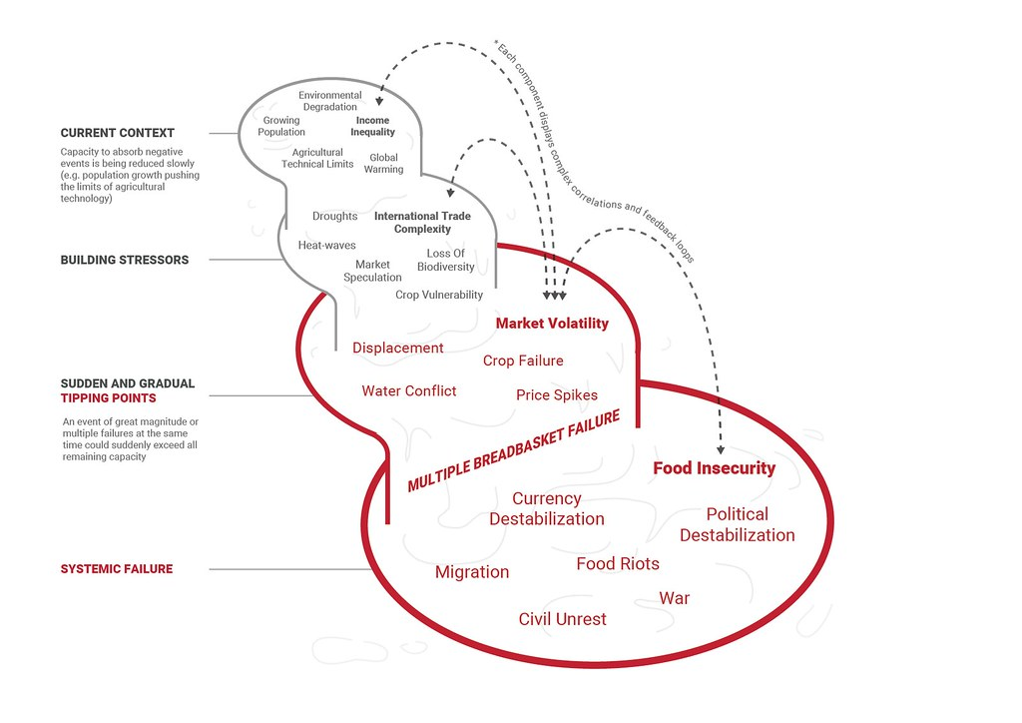
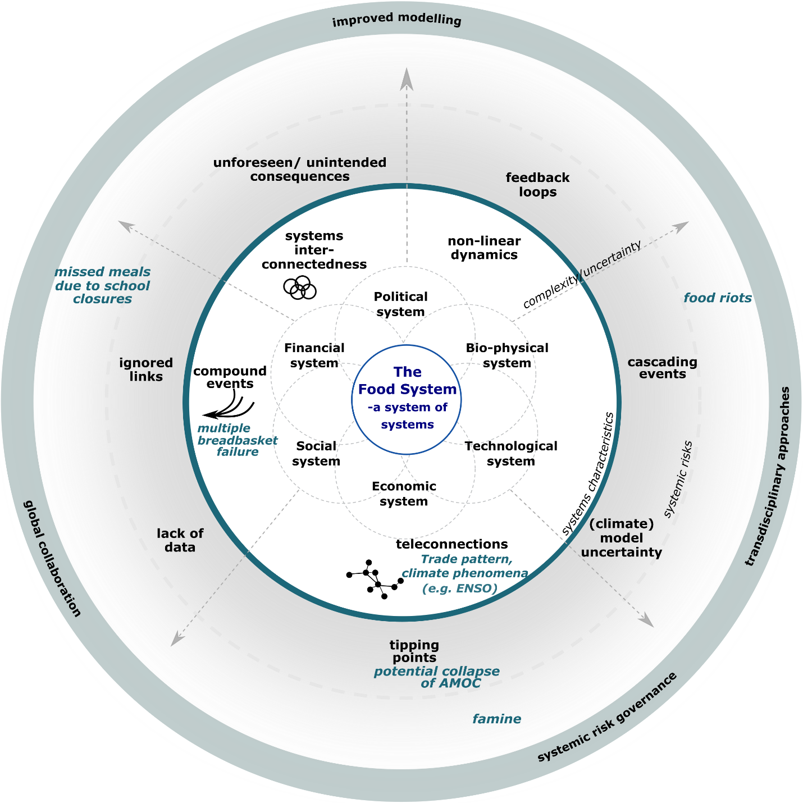
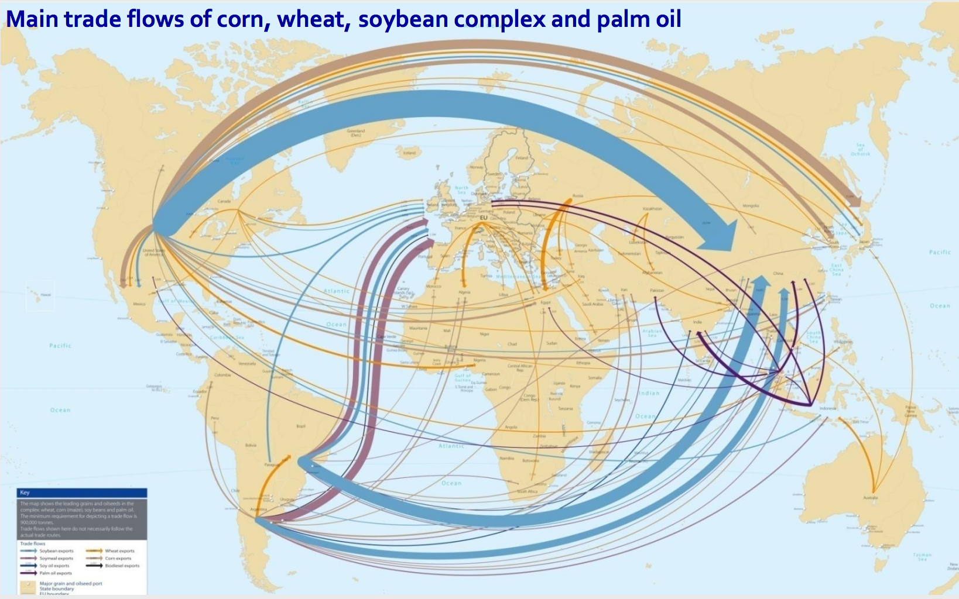
Globally-networked risks
Example: Modern food systems highly dynamic, complex, formal and informal
Rabobank, 2012
Optimized for
globalized trade regimes,
efficiency, peace time and a
Assumes a relatively stable environment (therefore Fragile)
Idealized schematic of globally-networked, compounding and cascading risks interacting with drought that can result in multiple concurrent breadbasket failures
(UNDRR, 2019)
The multi-scale nature of drivers and
of institutions affecting food systems
(Gaupp, UNDRR 2021)

Slide 11
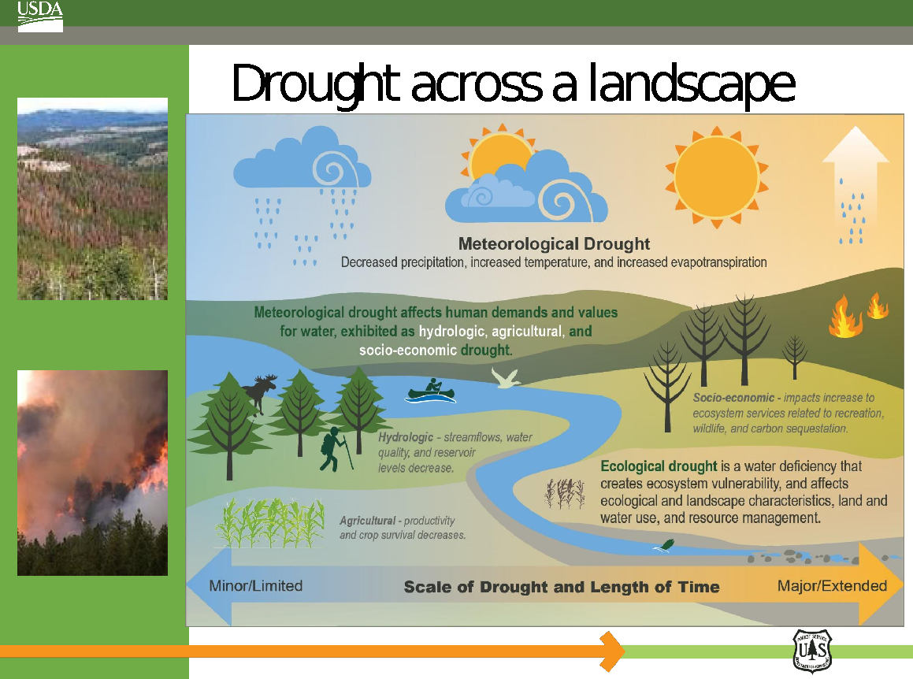
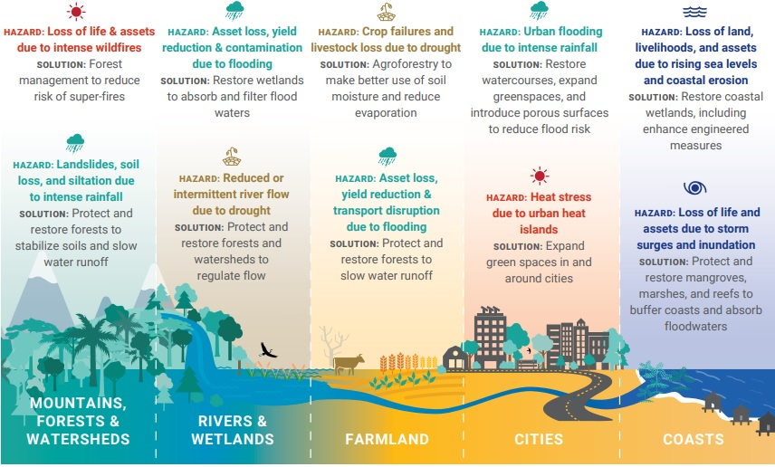
Drought across a landscape
Different nature-based solutions can work together across landscapes to build
resilience (USDA, 2017; Global Commission on Adaptation, 2019)

Slide 12
Causal map of drivers of food insecurity and crises in East Africa
  Robust early warning and
  decision support services
  Social safety nets
  Conflict did not become an major issue
Hoell, Pulwarty et al 2025

Slide 13
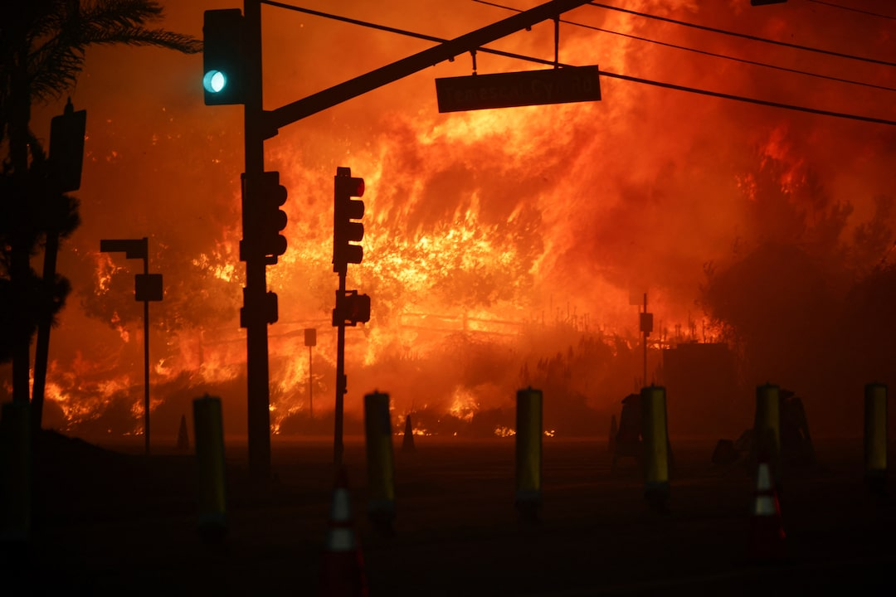
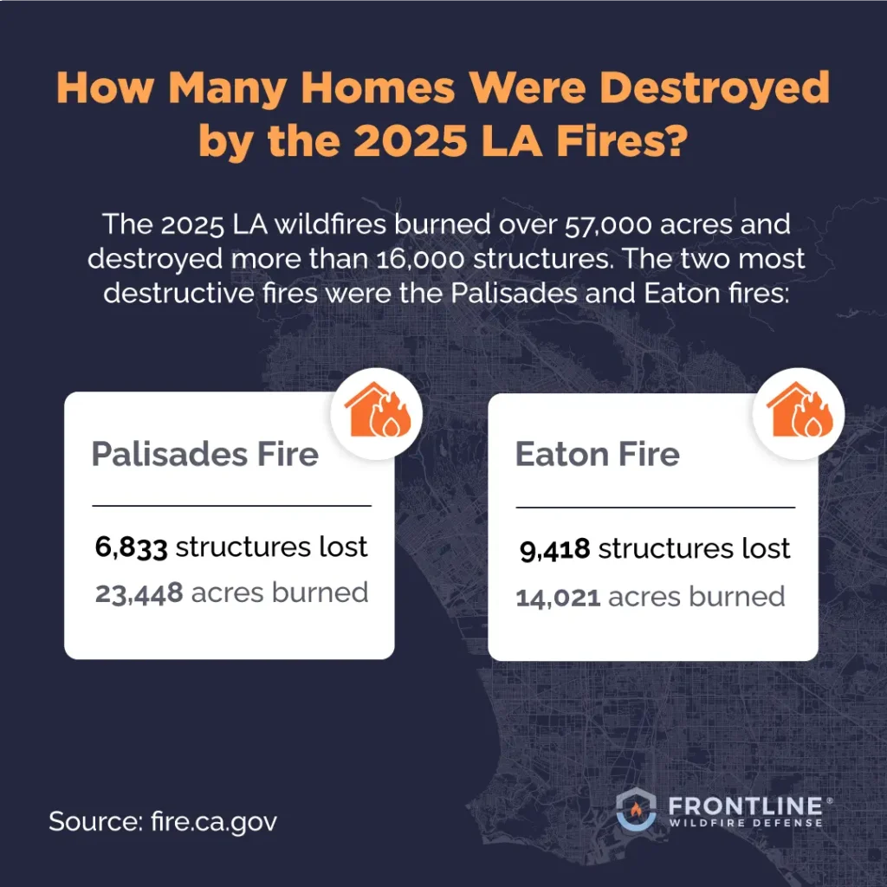

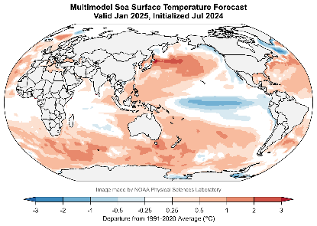
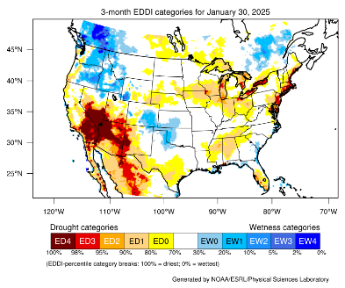

Drought Early Warning
Improving drought early warning: Cumulative risks, compounding events, and
impacts-based forecasts
Southern California Wildfires in January 2025
Decision Support
Monitoring
Breaking Points
Extreme Impacts
Decision Pathways
La Niña Forecast
High Evaporative Demand
Excess dead fuels.
Reduced capacity to fight fires due to budget constraints.
Electric grid unable to withstand strong winds.
Water systems unable to fully respond to fighting fast-moving fires.
57,000 acres burned.
18,000 structures destroyed.
$20B USD in insurance losses.
9 billion pounds of toxic ash left behind.
Prolonged periods of poor air quality.
Conduct timely prescribed burns to remove excess fuels.
Unify preparedness and response systems across Southern California.
Conduct firefighter staffing and training.
Update building codes.
La Niña Related to Late Start of Wet Season and Above-Average Temperatures
Late Start of 2024-25 Wet Season and Above-Average Temperatures

Slide 14
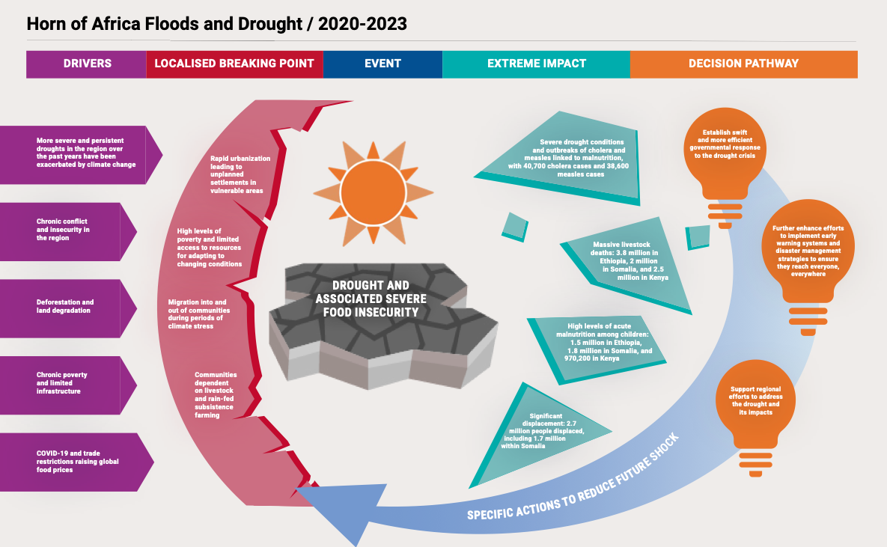
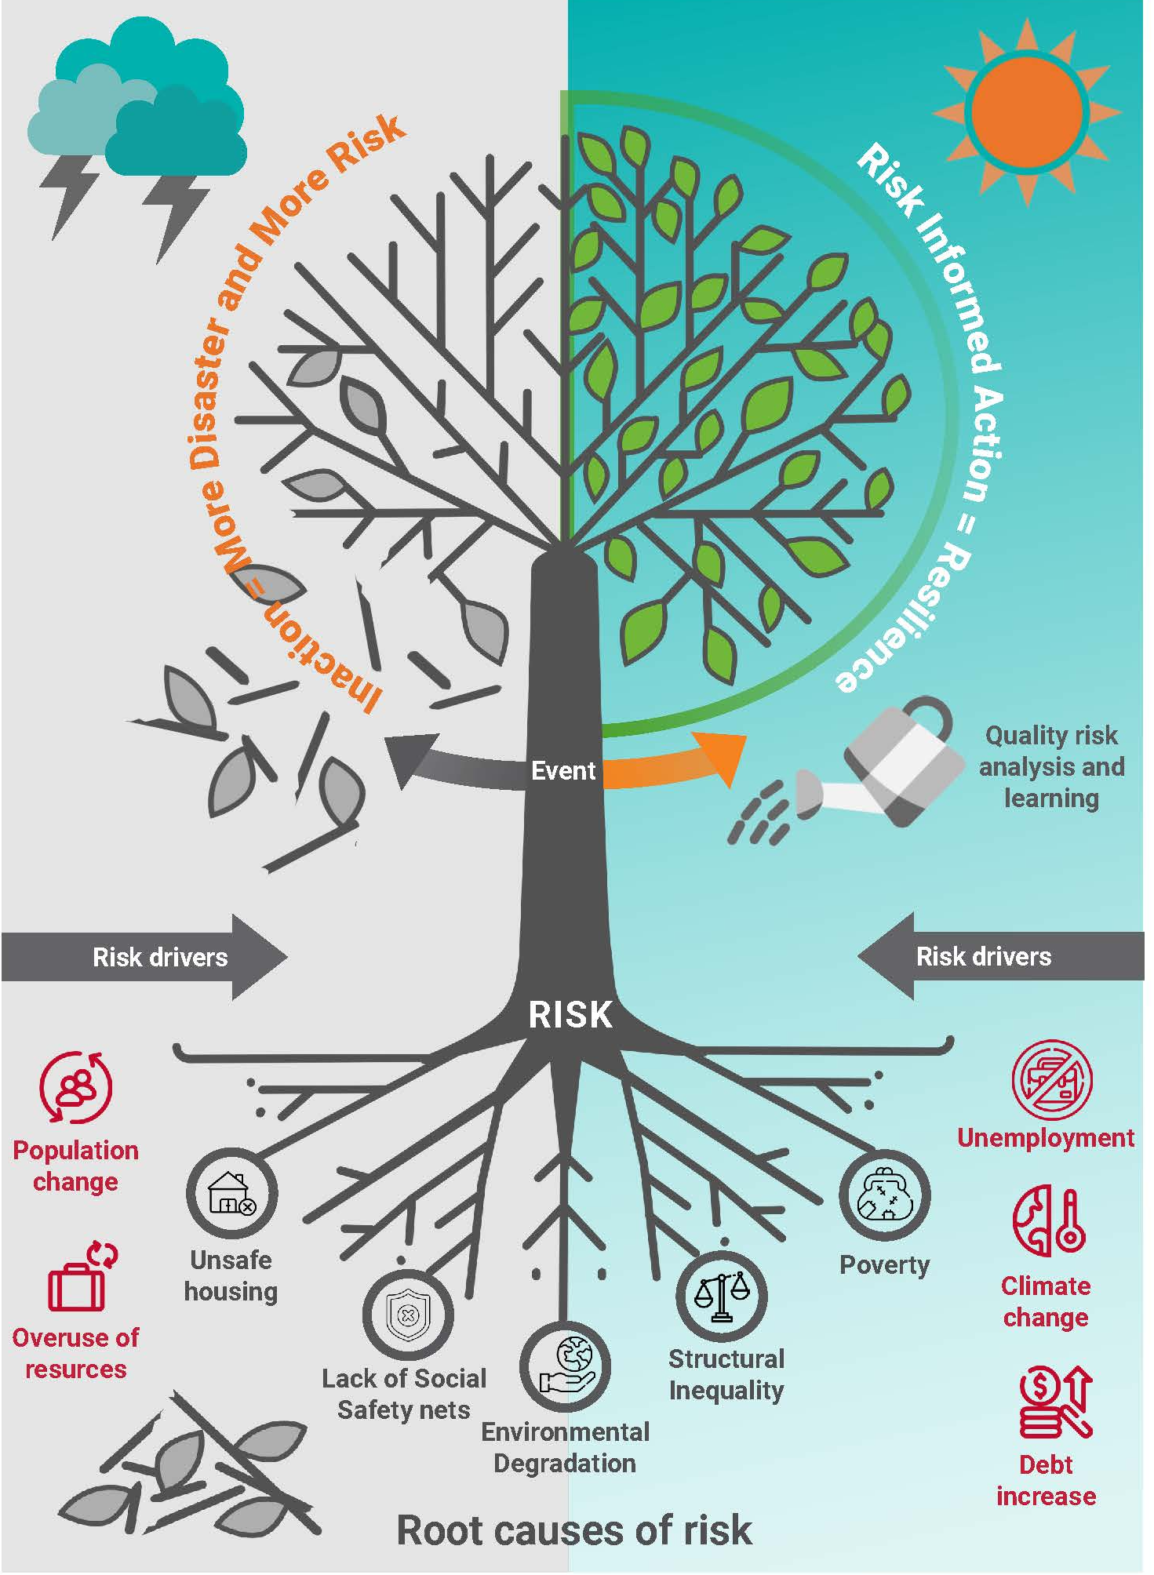
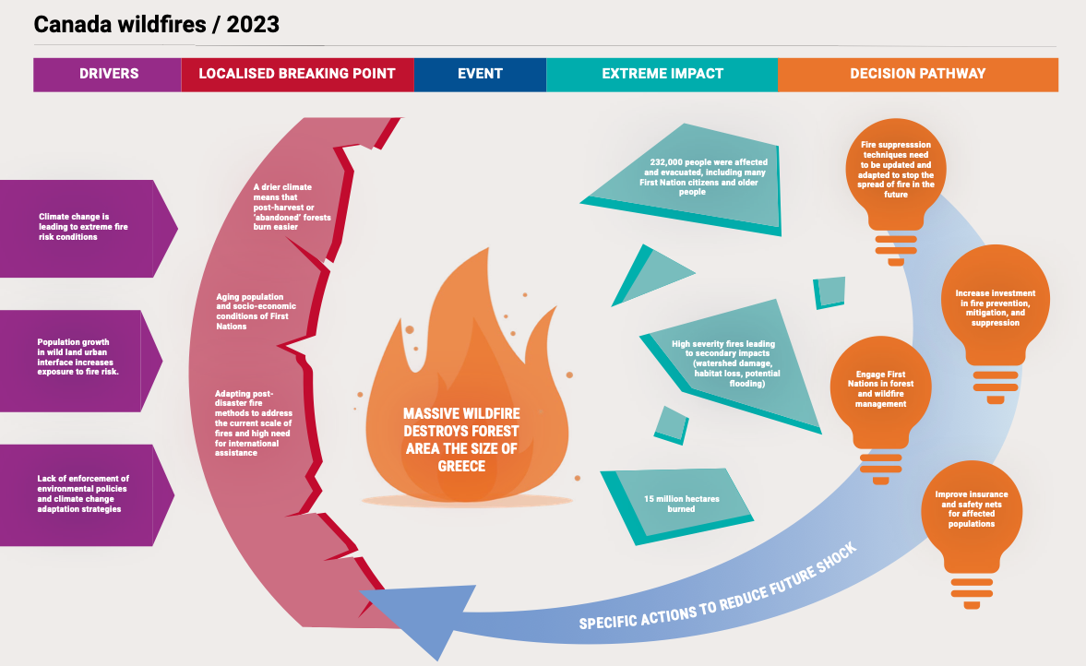
Assess the Forensics of Drought multiple events. Across temporal and spatial scales, identify
the cumulative drivers and interactions that
lead to significant events and
entry points, partnerships and resources for
prospective and proactive risk reduction
ahead of future events

Slide 15
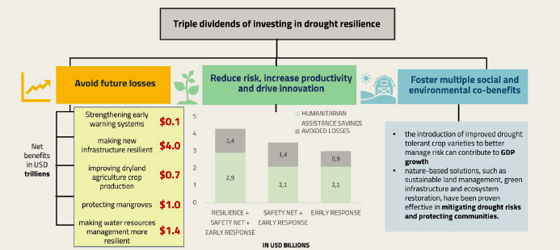
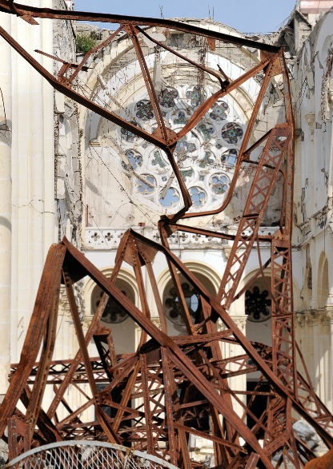

2. Understanding and measurement of the economic co-benefits across proactive and prospective drought risk management and financing- (Sendai, Kunming-Montreal, EWS4ALL, SDGs)
Draws on multiple disciplines to support a comprehensive agile approach
Climate Finance
Agricultural Finance
Infrastructure Finance
Environmental Finance
Financial Inclusion
Disaster Risk Finance
Investing in assets for mitigation and preparation
Ensuring resources are available for response, recovery and for advancing resilience
UNCCD Guidance Note on
Drought Finance

Slide 16
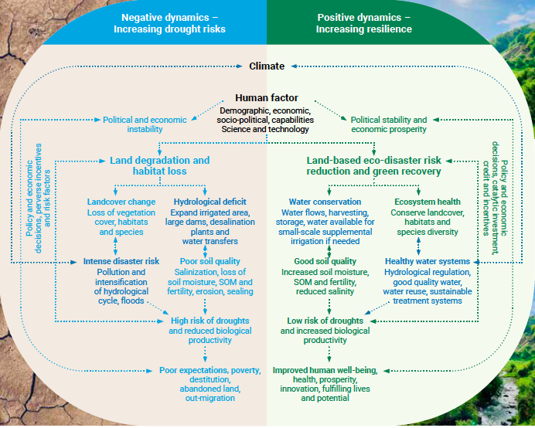
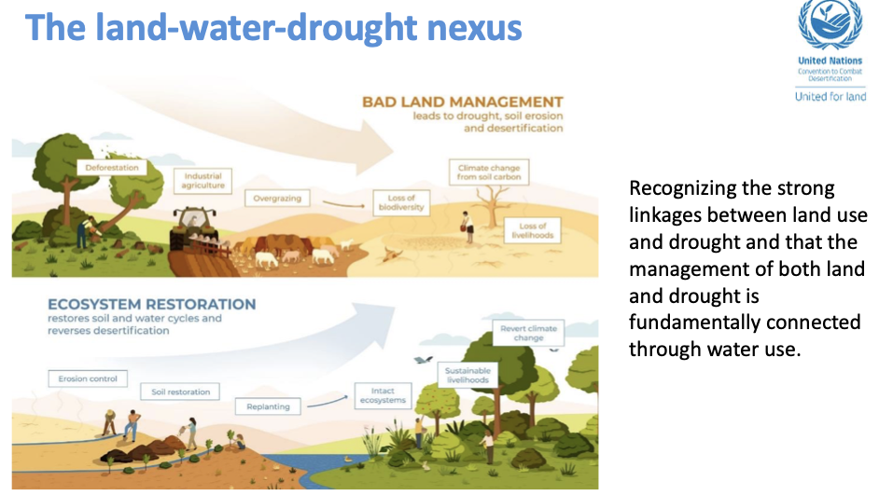
Cascading actions and outcomes-
Negative dynamics: increasing drought risks
Positive dynamics increasing drought risks
Shift from responding on an event by event alone to addressing the propagation and accumulation of risk and cascading impacts.
King et al UNCCD 2021;
IPCC 2023)

Slide 17
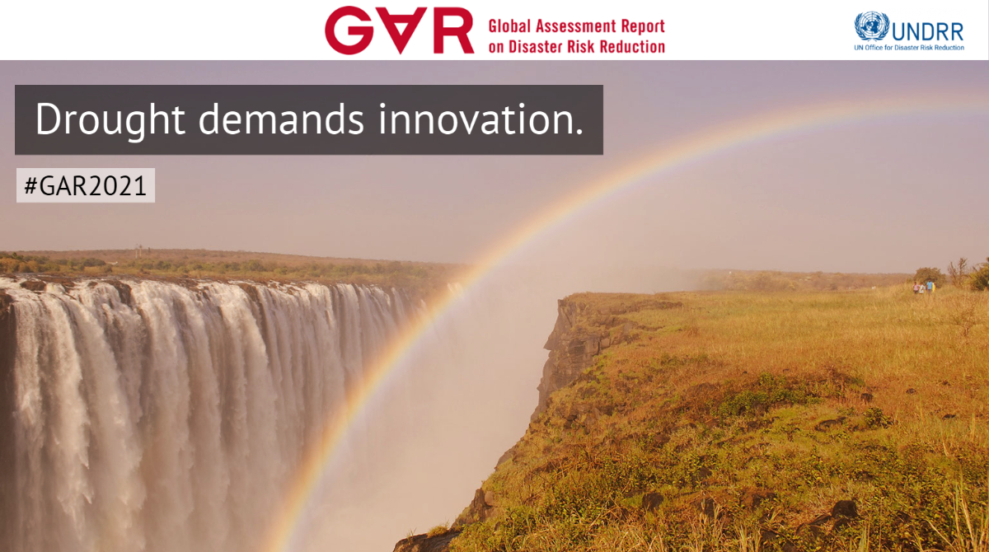
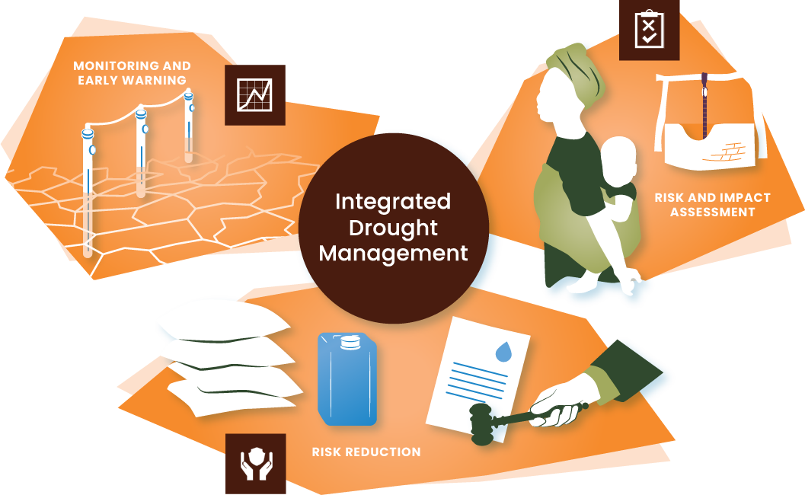
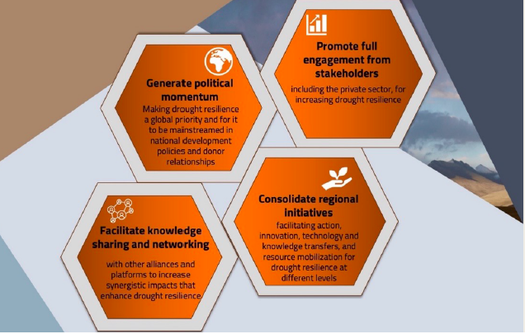
Reducing propagation and stocks of cumulative drought -desertification risks through proactive and prospective measures
Monitoring and early warning
Risk and impact assessment
Risk Reduction
Information hub:
droughtmanagement.info

Slide 18
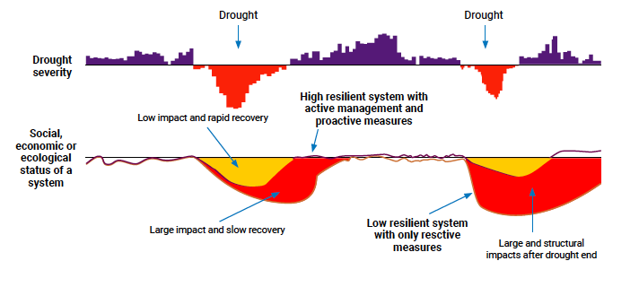
3. Promote vertical and horizontal coordination across global, regional, and local governance networks
………..managing for resilience is different than managing for efficiency
Understanding and addressing risk as a vertically and horizontally
cumulative process
(Fakhruddin et al 2020
UNDRR 2021; International Science Council 2023)

Slide 19
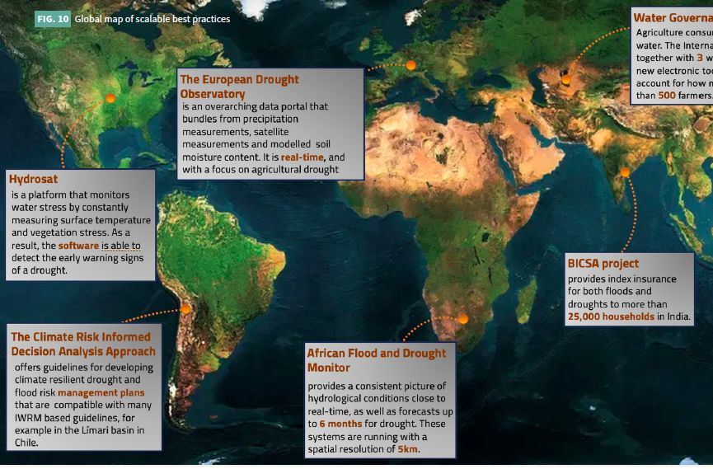
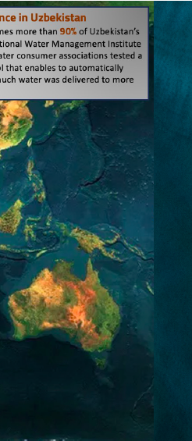

4. Active learning from existing experience: Many valuable examples around the world, from which much can be learned (UNCCD 2023-present)
Northern Rangelands Trust Kenya
Peoples of Africa Coordinating Committee (IPACC), a network of 135 Indigenous peoples’ organizations in 21 African countries
Namibian Association of Community-Based Natural Resource Management Support Organization
(UNCCD 2023, FAO 2024, IDMP Examples as well)

Slide 20







Redsteer, 2011
(Redsteer, 2011)
(UNDRR, 2021)
Euronews.com
Thank you

