Slide 1
Subnational drought monitoring observatory
MSc Mario López Pérez
Senior water resources consultant
June 17, 2026

Slide 2
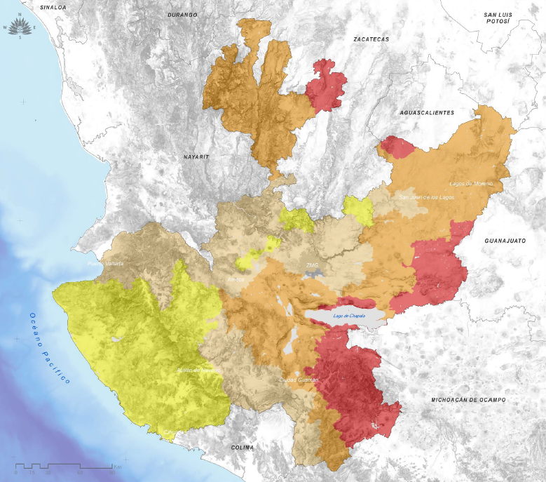

Component 4. Water and Environment
Land-use planning, water risk management and resilience to climate change
Goal 8.
Increasing water resilience.
To face droughts, floods and climate change; improve and implement prevention, adaptation and risk management.
Strategies
8.1. Implement preventive planning and integrated drought management. Monitoring, reserves, and alternative sources.
8.2. Strengthen stormwater infrastructure. Maintenance, expansion, and nature-based solutions.
8.3. Incorporate climate adaptation into infrastructure planning and design. Scenario information and financing.
Source of information: 2025, National Meteorological Service. Statistical record of droughts by municipality 2003-2025

Slide 3
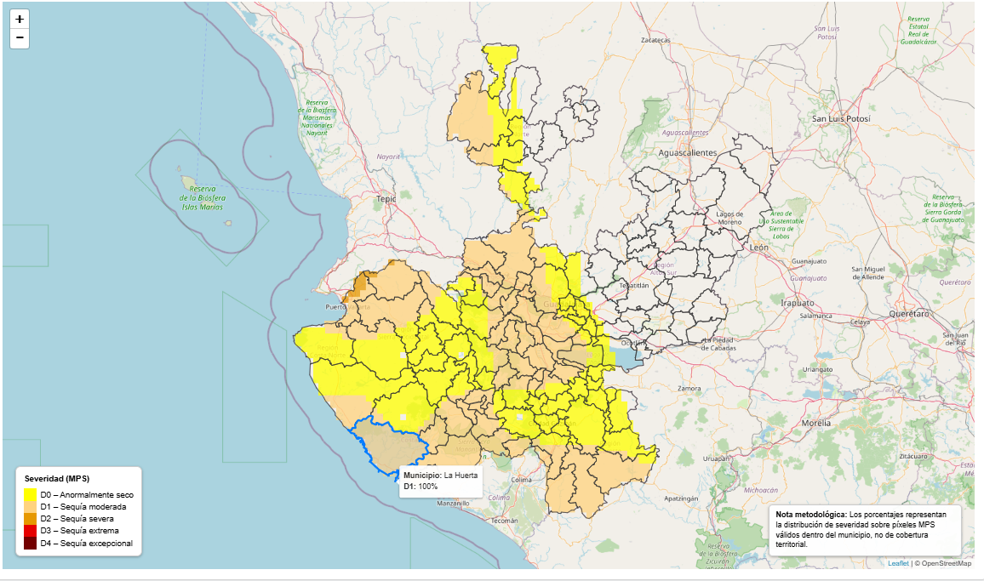
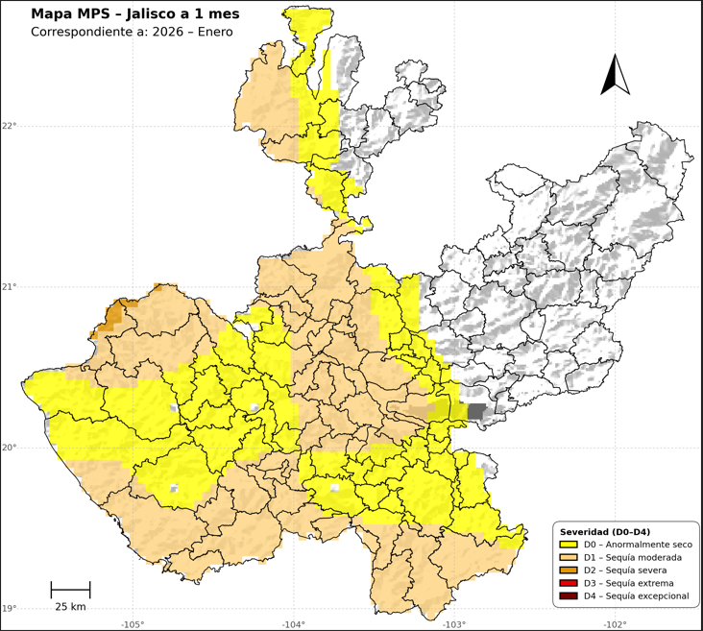
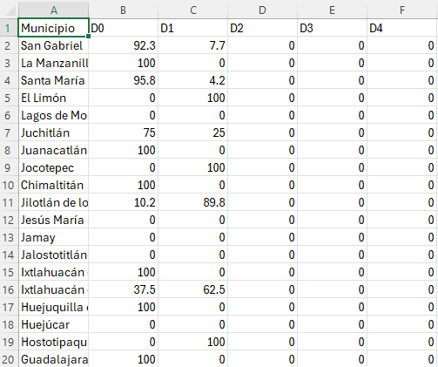
Strategy 8. 1. Drought observatory
Higher resolution compared to the Mexican Drought Monitor
MPS per regional and municipality scales provides processed climate information in accessible formats and at different time scales. The geospatial files have a defined resolution and standardized projection, guaranteeing accuracy, technical compatibility, and reliable support for decision-making.
Regional and municipal resolution
HTML
PNG
CSV
Temporal scales: 1, 3, 6, 9, 12, 24 y 48

Slide 4
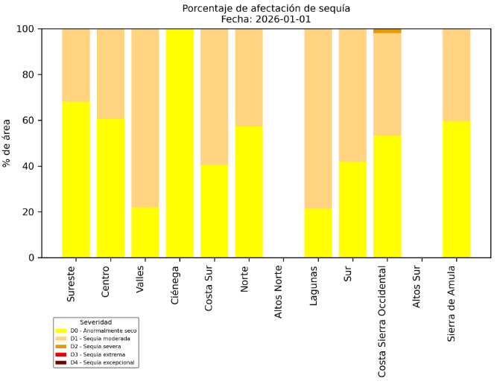
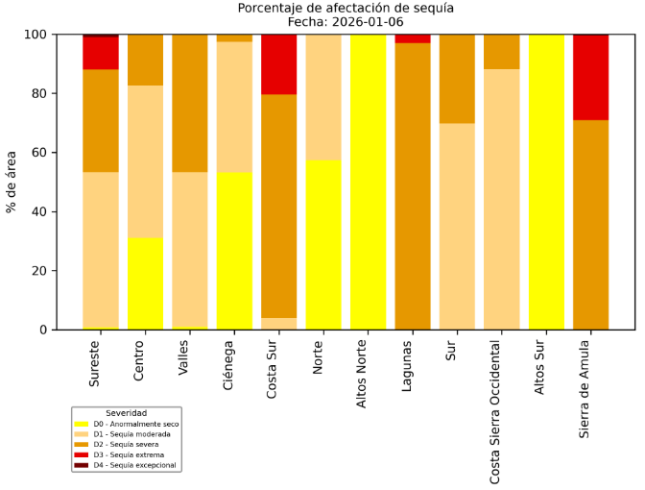
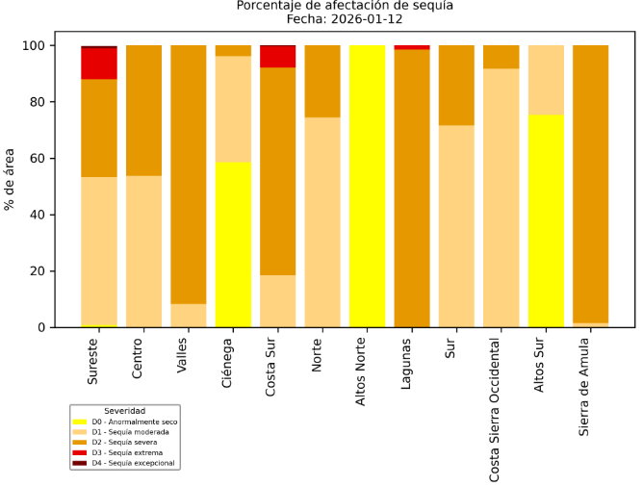
Strategy 8. 1. Drought observatory
Regional and municipal resolution
% de afectación por REA cuantifica la proporción del territorio municipal que presenta condiciones específicas dentro de cada región o categoría climática, permitiendo dimensionar con claridad la magnitud espacial del fenómeno. Este indicador facilita comparar regiones, priorizar zonas de atención y orientar acciones sectoriales con base en evidencia territorial objetiva.
1 month
3 months
6 months
Temporal scales : 1, 3, 6, 9, 12, 24 y 48

Slide 5
Strategy 8. 1. Drought observatory
https://www.ceajalisco.gob.mx/contenido/plantilla/seguimiento.html
Impact Report Map
This section presents a map developed through an ongoing process of citizen participation. This map visualizes how the community perceives the drought, using the same classification system employed by the Drought Persistence Monitor.
The information is gathered through a survey tool that includes questions grouped into different themes: soil condition, vegetation condition, perceived rainfall, rainfall timing, observed temperatures, and water availability for livestock. Based on these responses, an indicator is generated that reflects the community's perception of the drought, complementing technical data with the lived experiences of those who are directly affected by its effects in the area.

Slide 6
Subnational drought monitoring observatory
MSc Mario López Pérez
Senior water resources consultant
June 17, 2026

