Slide 1
Robert Stefanski
Applied Climate Services Division,
World Meteorological Organization
Valentin Aich
Senior Water and Climate Specialist, Global Water Partnership
Overview on Monitoring and Early Warning Systems: Pillar 1
Regional Training Workshop on Implementation of Integrated Drought Management (IDM): Challenges and Solutions
8-9 October 2025 | RCUWM –Tehran, Iran

Slide 2
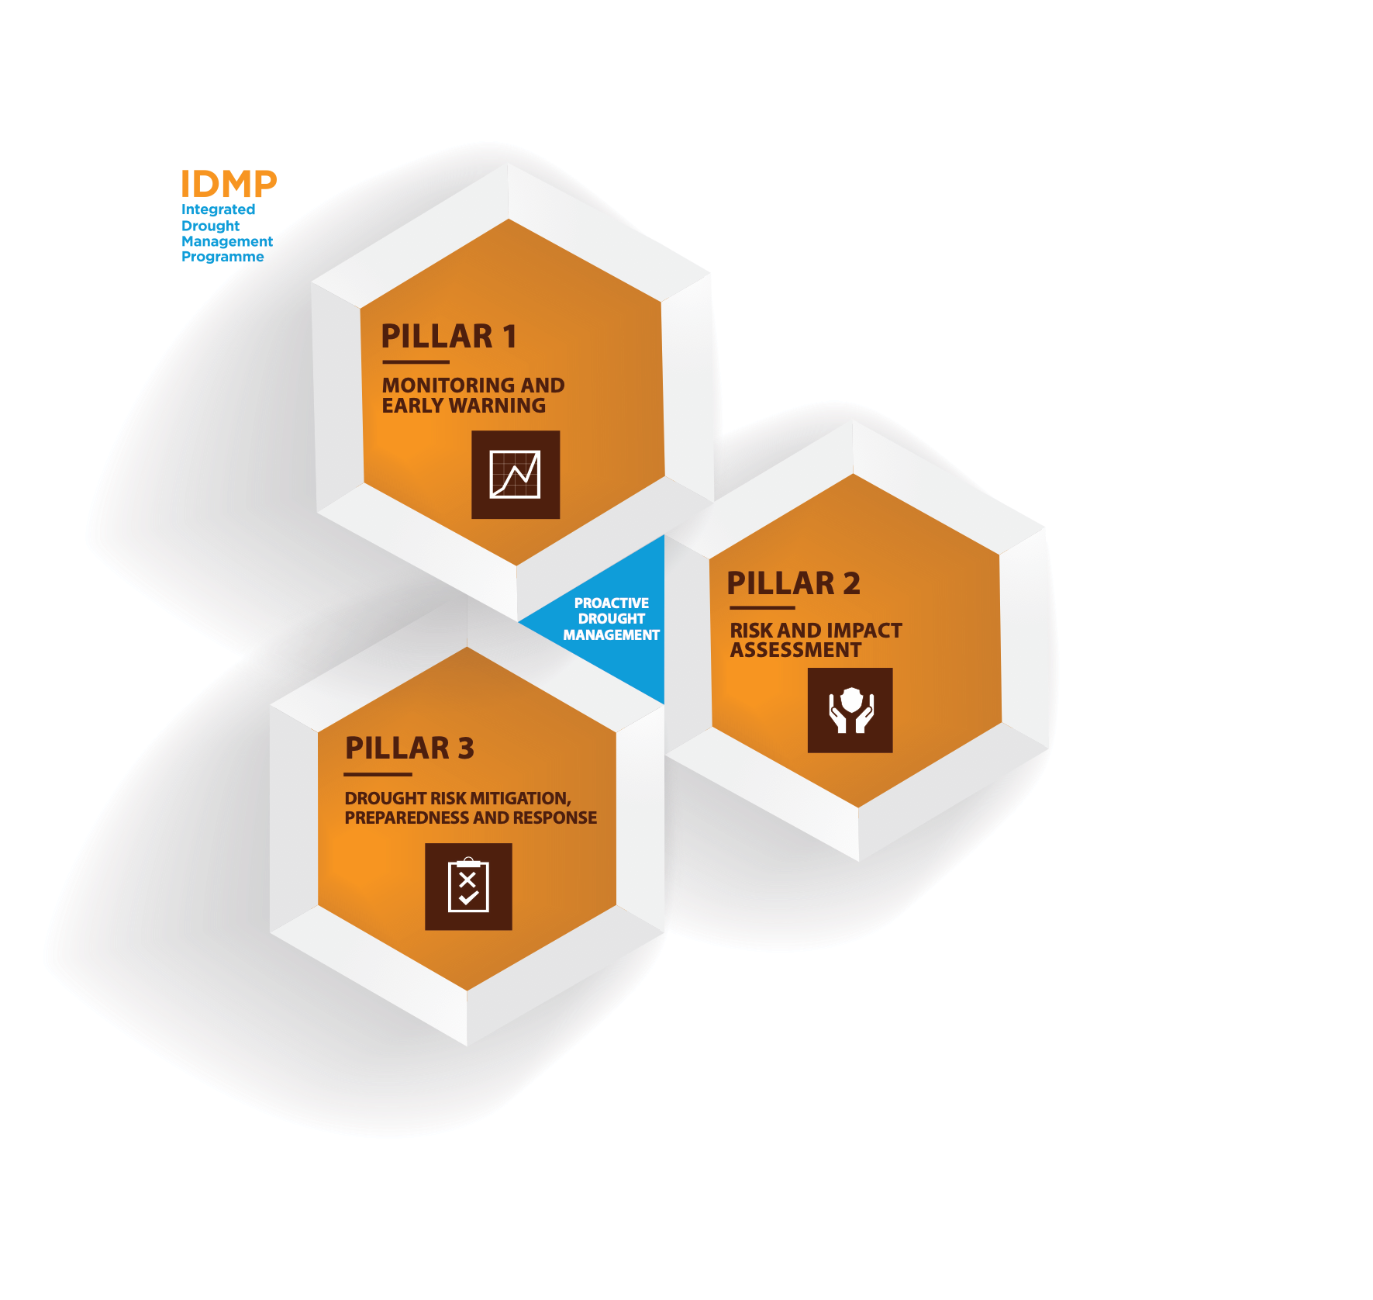
Monitoring/Early Warning as part of Integrated Drought Management
Pillar 1:
Integrated monitoring of key indicators
Precipitation, temperature, soil moisture, streamflow, snowpack, groundwater, impacts, etc.
Use of appropriate indices
Used to trigger actions in drought plans
Reliable seasonal forecasts
Development/delivery of information and sector-specific decision-support tools
Pillar 2:
Monitoring of Impacts

Slide 3
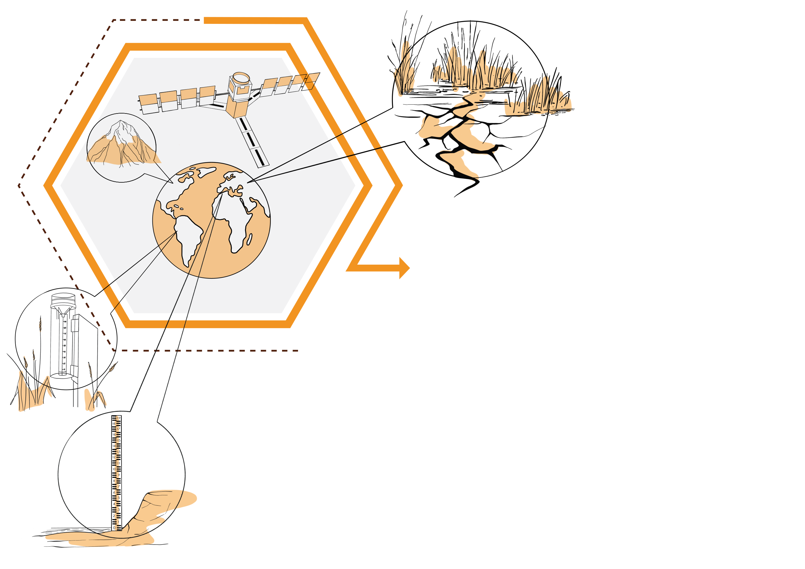
Potential Monitoring System Products and Reports
Historical analysis (climatology, impacts, magnitude, frequency)
Operational assessment/Early Warning (cooperative data, SPI and other indices, automated networks, satellite and soil moisture data, media and official requests)
Predictions/Projections /Early Warning (SPI and other indices, soil moisture, streamflow, seasonal forecasts, SST’s)

Slide 4
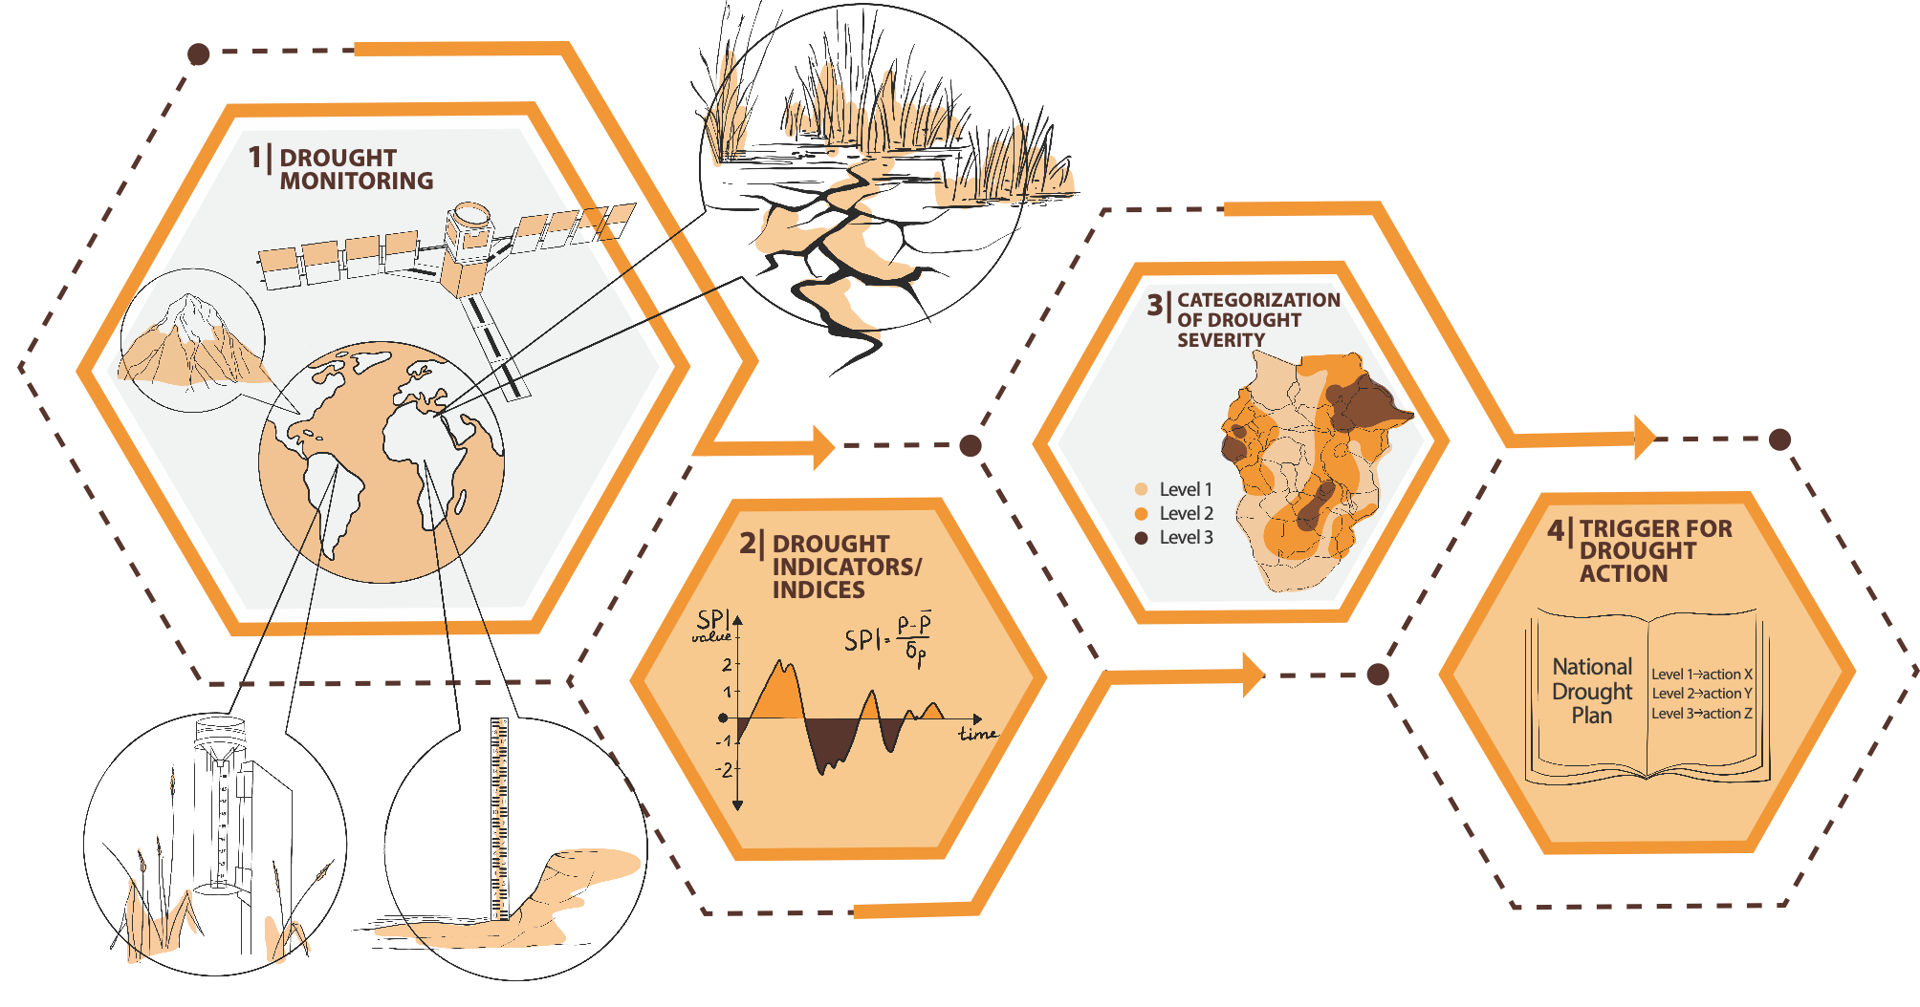
Drought monitoring for Integrated Drought Management
The design and implementation of technical solutions is based on stakeholder engagement at all steps and using an inclusive whole-of-society approach
Notes:
Various means of measuring and monitoring – satellites, raingauges, river gauges, soil moisture sensors, etc
SPI formula = (rainfall for period X – average rainfall for period X over say 30 years)/ SD of rainfall for period X over say 30 years

Slide 5
Importance of a Drought Monitoring System
allows for early drought detection
improves response (proactive)
“triggers” actions within a drought plan
a critical mitigation action
foundation of a drought plan

Slide 6



Components of a Drought Early Warning and Information System
Monitoring AND Forecasting
Tools for decision makers
Drought risk assessment and planning
Education and awareness
Source: Wilhite, 2013

Slide 7
Monitoring, Early Warning & Information Delivery Systems
Monitored variables
Agencies, Ministries, Organizations
Precipitation
Temperature
Surface water supplies
  Stream flow
  Soil Moisture
  Reservoir levels
  Snow pack
  Water use
Ground water
Remotely-sensed data (e.g., plant water stress)
Impacts
  By sector, area
Water
Meteorological & Hydrological Services
Agriculture, Forestry & Fisheries
Environment
Health
Energy
Transportation
Commerce
Social Services
NGOs
Others

Slide 8
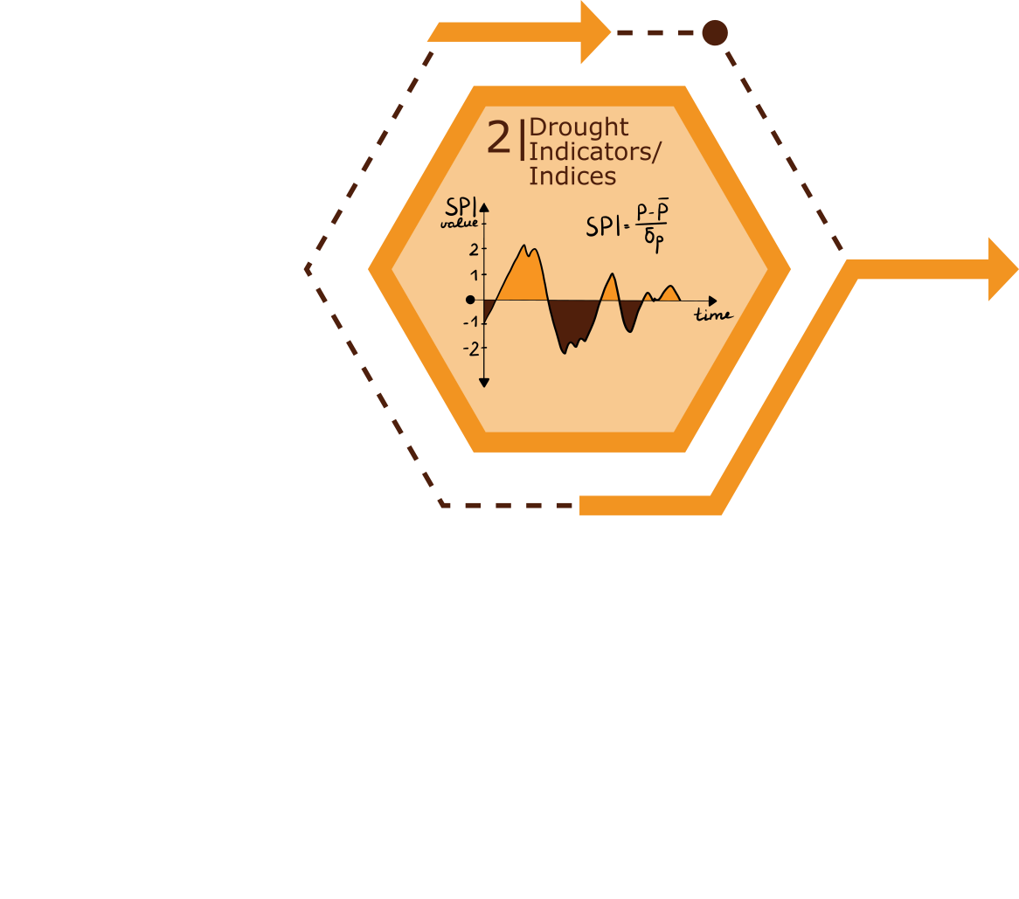
Importance of Drought Indices
Simplify complex relationships and provide a good communication tool for diverse audiences
Quantitative assessment of anomalous climatic conditions
  Intensity
  Duration
  Spatial extent
Historical reference (probability of recurrence)
  Planning and design applications

Slide 9


Handbook of Drought Indicators and Indices
Handbook is a resource to cover most commonly used drought indicators/indices
A starting point to describe and characterize the most common indicators and indices and their applications
Does not recommend a ”best” set of indicators and indices, given research requirements for appropriate application in location in question.

Slide 10
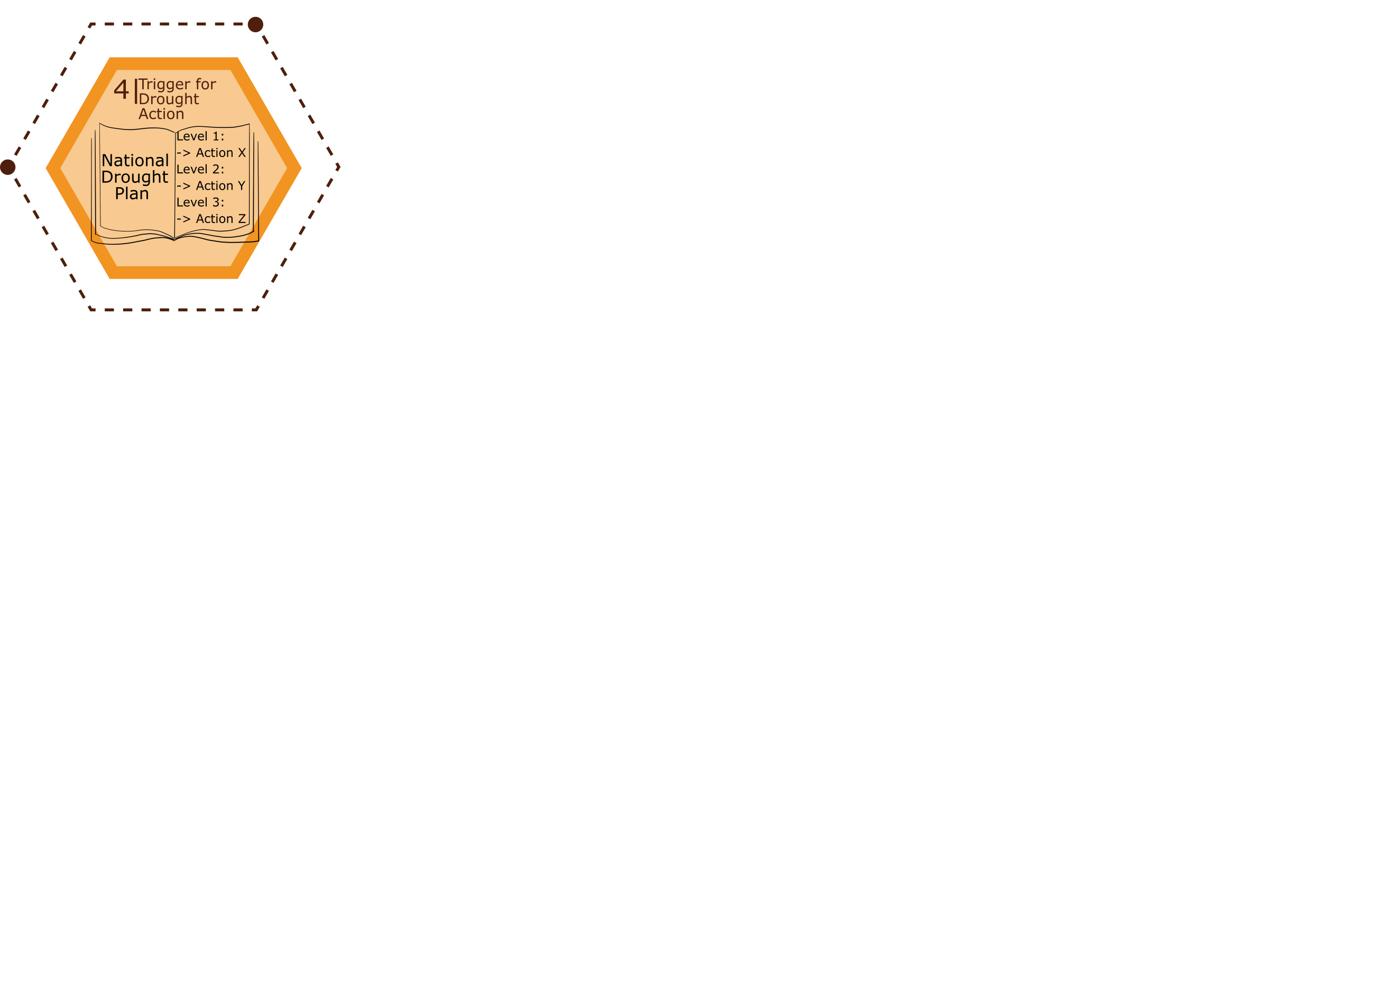
Indicators & Triggers Definitions
Indicators: Variables to describe drought conditions.
Examples: precipitation, streamflows, groundwater,
reservoir levels, soil moisture, Palmer indices, …
Triggers: Specific values of the indicator that initiate and terminate each level of a drought plan, and associated management responses.
Example: precipitation below the 5th percentile for two
consecutive months is a Level 4 Drought.

Slide 11
Development of indices in a national context: example of Afghanistan
 | Description | Possible Impact | Indices >>>>>Thresholds |  |  |  |  |  |  |  |  |  |  | Triggered Actions
 |  |  | SPI | SPEI | NDVI | VHI | SRSI | SSFI | Market Prices | ASI | IDPs | VegDRI | Other (TBD)
D1 | Abnormally Dry | Going into drought: short-term dryness slowing planting. Growth of crops or pastures Coming out of drought: some lingering water deficits pastures or crops not fully recovered
D2 | Moderate Drought | Rainfall / snowfall less than average for the fortnight / month Some damage to crops, pastures Streams, reservoirs, or wells low, some water shortages developing or imminent Reduced water levels (ground water etc)
D3 | Severe Drought | Crop or pasture losses High Water shortages common Water restrictions imposed (use of water ground water etc.)
D4 | Extreme Drought | Major crop/pasture losses Widespread water shortages or restrictions
D5 | Exceptional Drought | Exceptional and widespread crop/pasture losses Shortages of water in reservoirs, streams, and wells creating water emergencies
D0 | No Drought or cessation of Drought | returning of average / normal rainfall and snowfall; or normal / adequate snowpack formation crop production at decadal average/ livestock prices at average levels, etc.

Slide 12
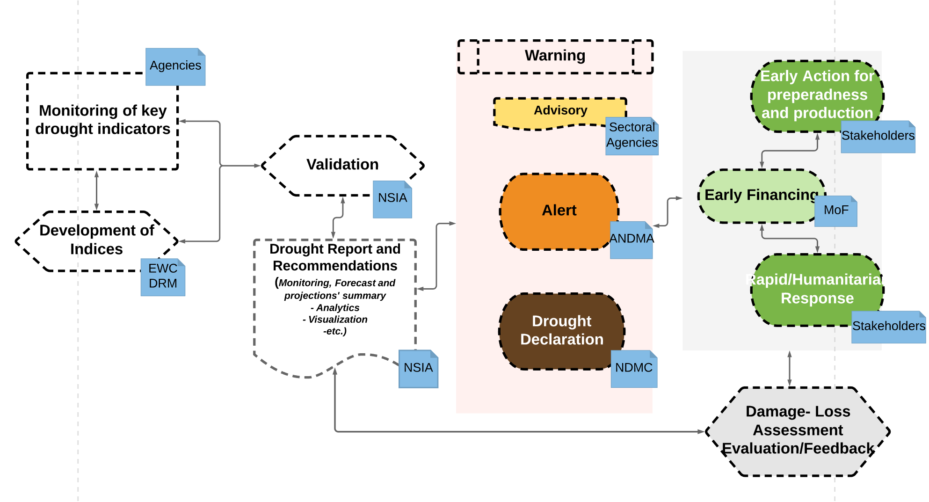
Early Warning, Early Action, Early Finance example from Afghanistan

Slide 13
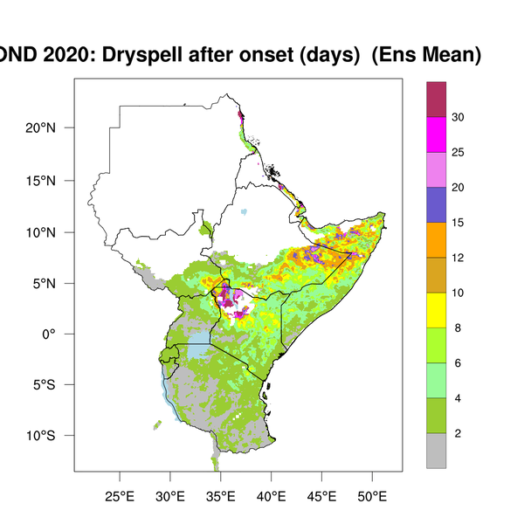
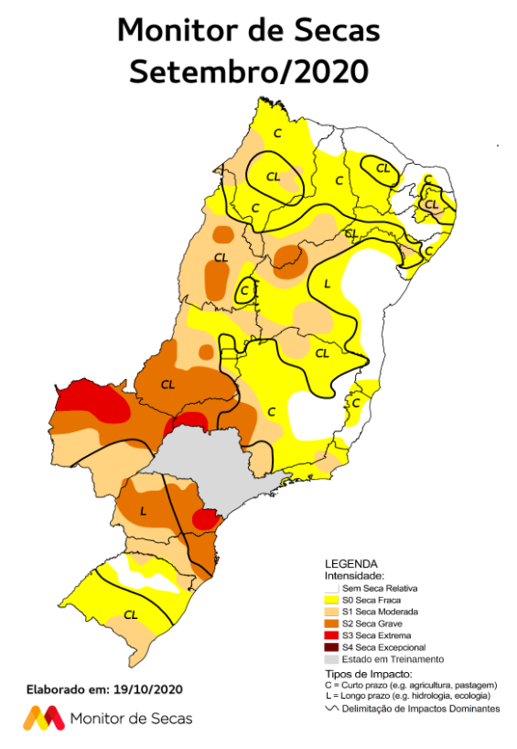
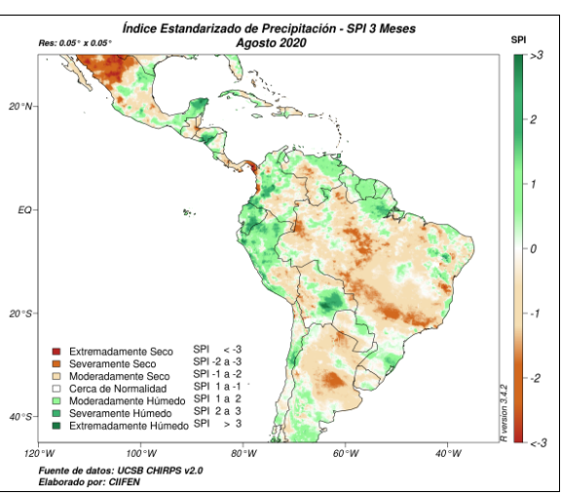
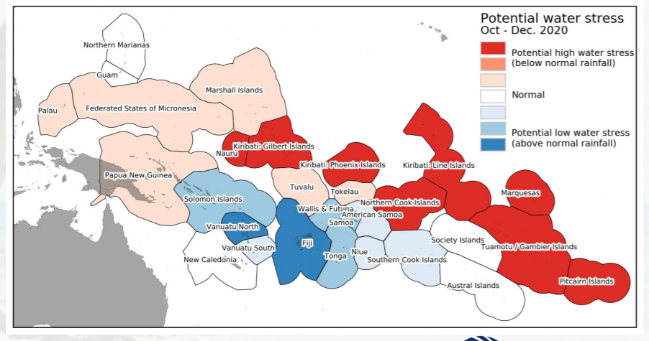
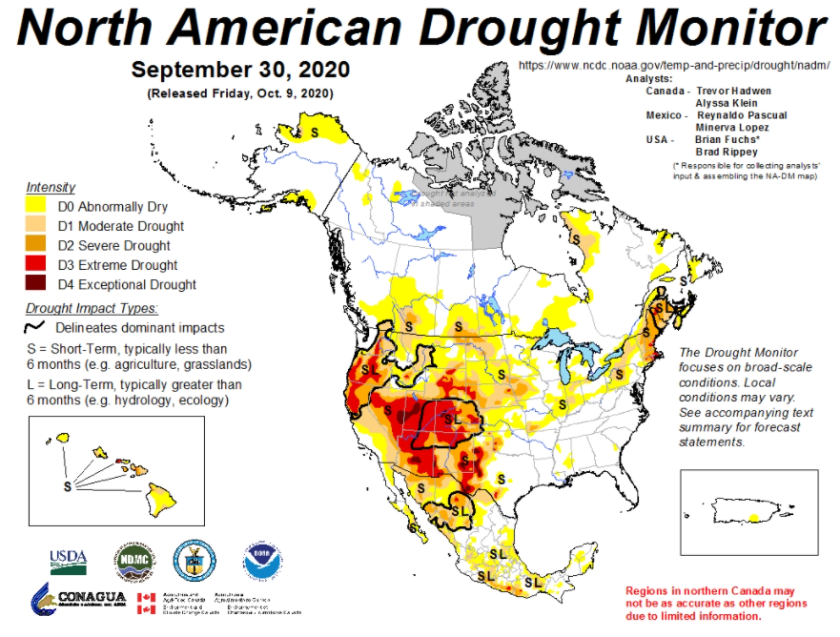
Drought Monitoring and Early Warning Systems (DEWS)
Regional Drought Monitors
ICPAC – East Africa
CIIFEN Drought Monitor
Meso American Drought Monitor
NorthEast Brazil Drought Monitor
North American Drought Monitor
Caribbean Drought Bulletin
Pacific Island Climate Update
European Drought Observatory
Drought monitor for Central Europe
Drought Watch (SouthEastern Europe)
Three Pillars of Integrated Drought Management
Monitoring and early warning systems
Vulnerability and impact assessments
Drought preparedness, mitigation and response
All are need for successful drought plans/polices
Components of DEWS
Monitoring AND Forecasting
Tools or decision makers
Drought risk assessment and planning
Education and awareness
Notes:
The three pillars of Integrated Drought Management are all interconnected. These drought monitoring products are then used for decision-makers and to make drought alerts and warnings with he National Disaster Management Org or related organization.

Slide 14
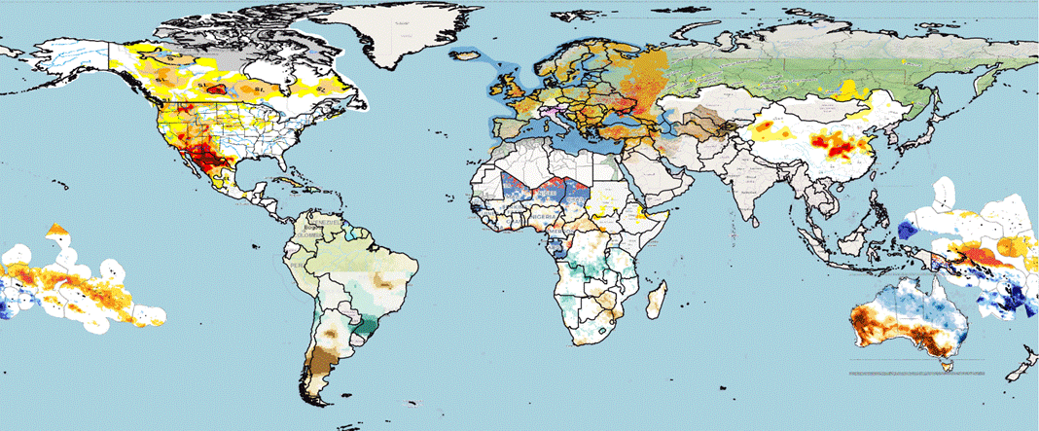


Global Drought Mosaic (May 2025)
  Exploring how to get a global picture of drought occurrence and severity across the world

Slide 15
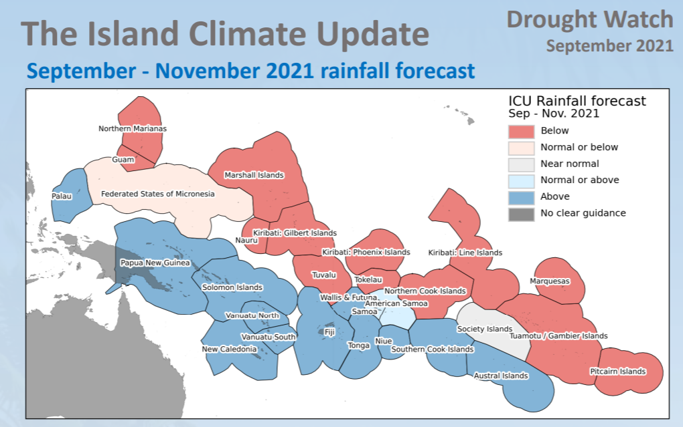
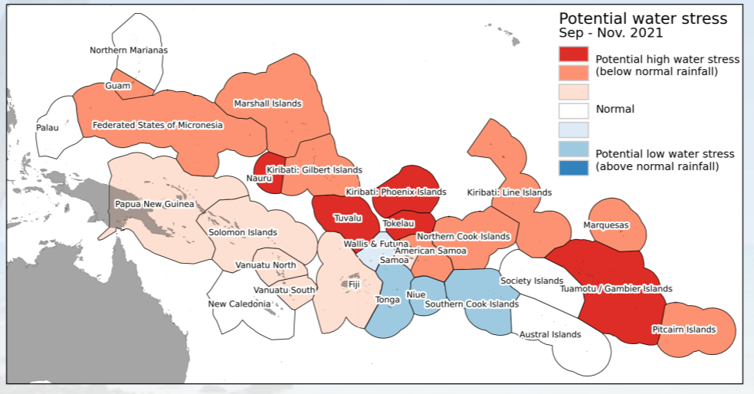
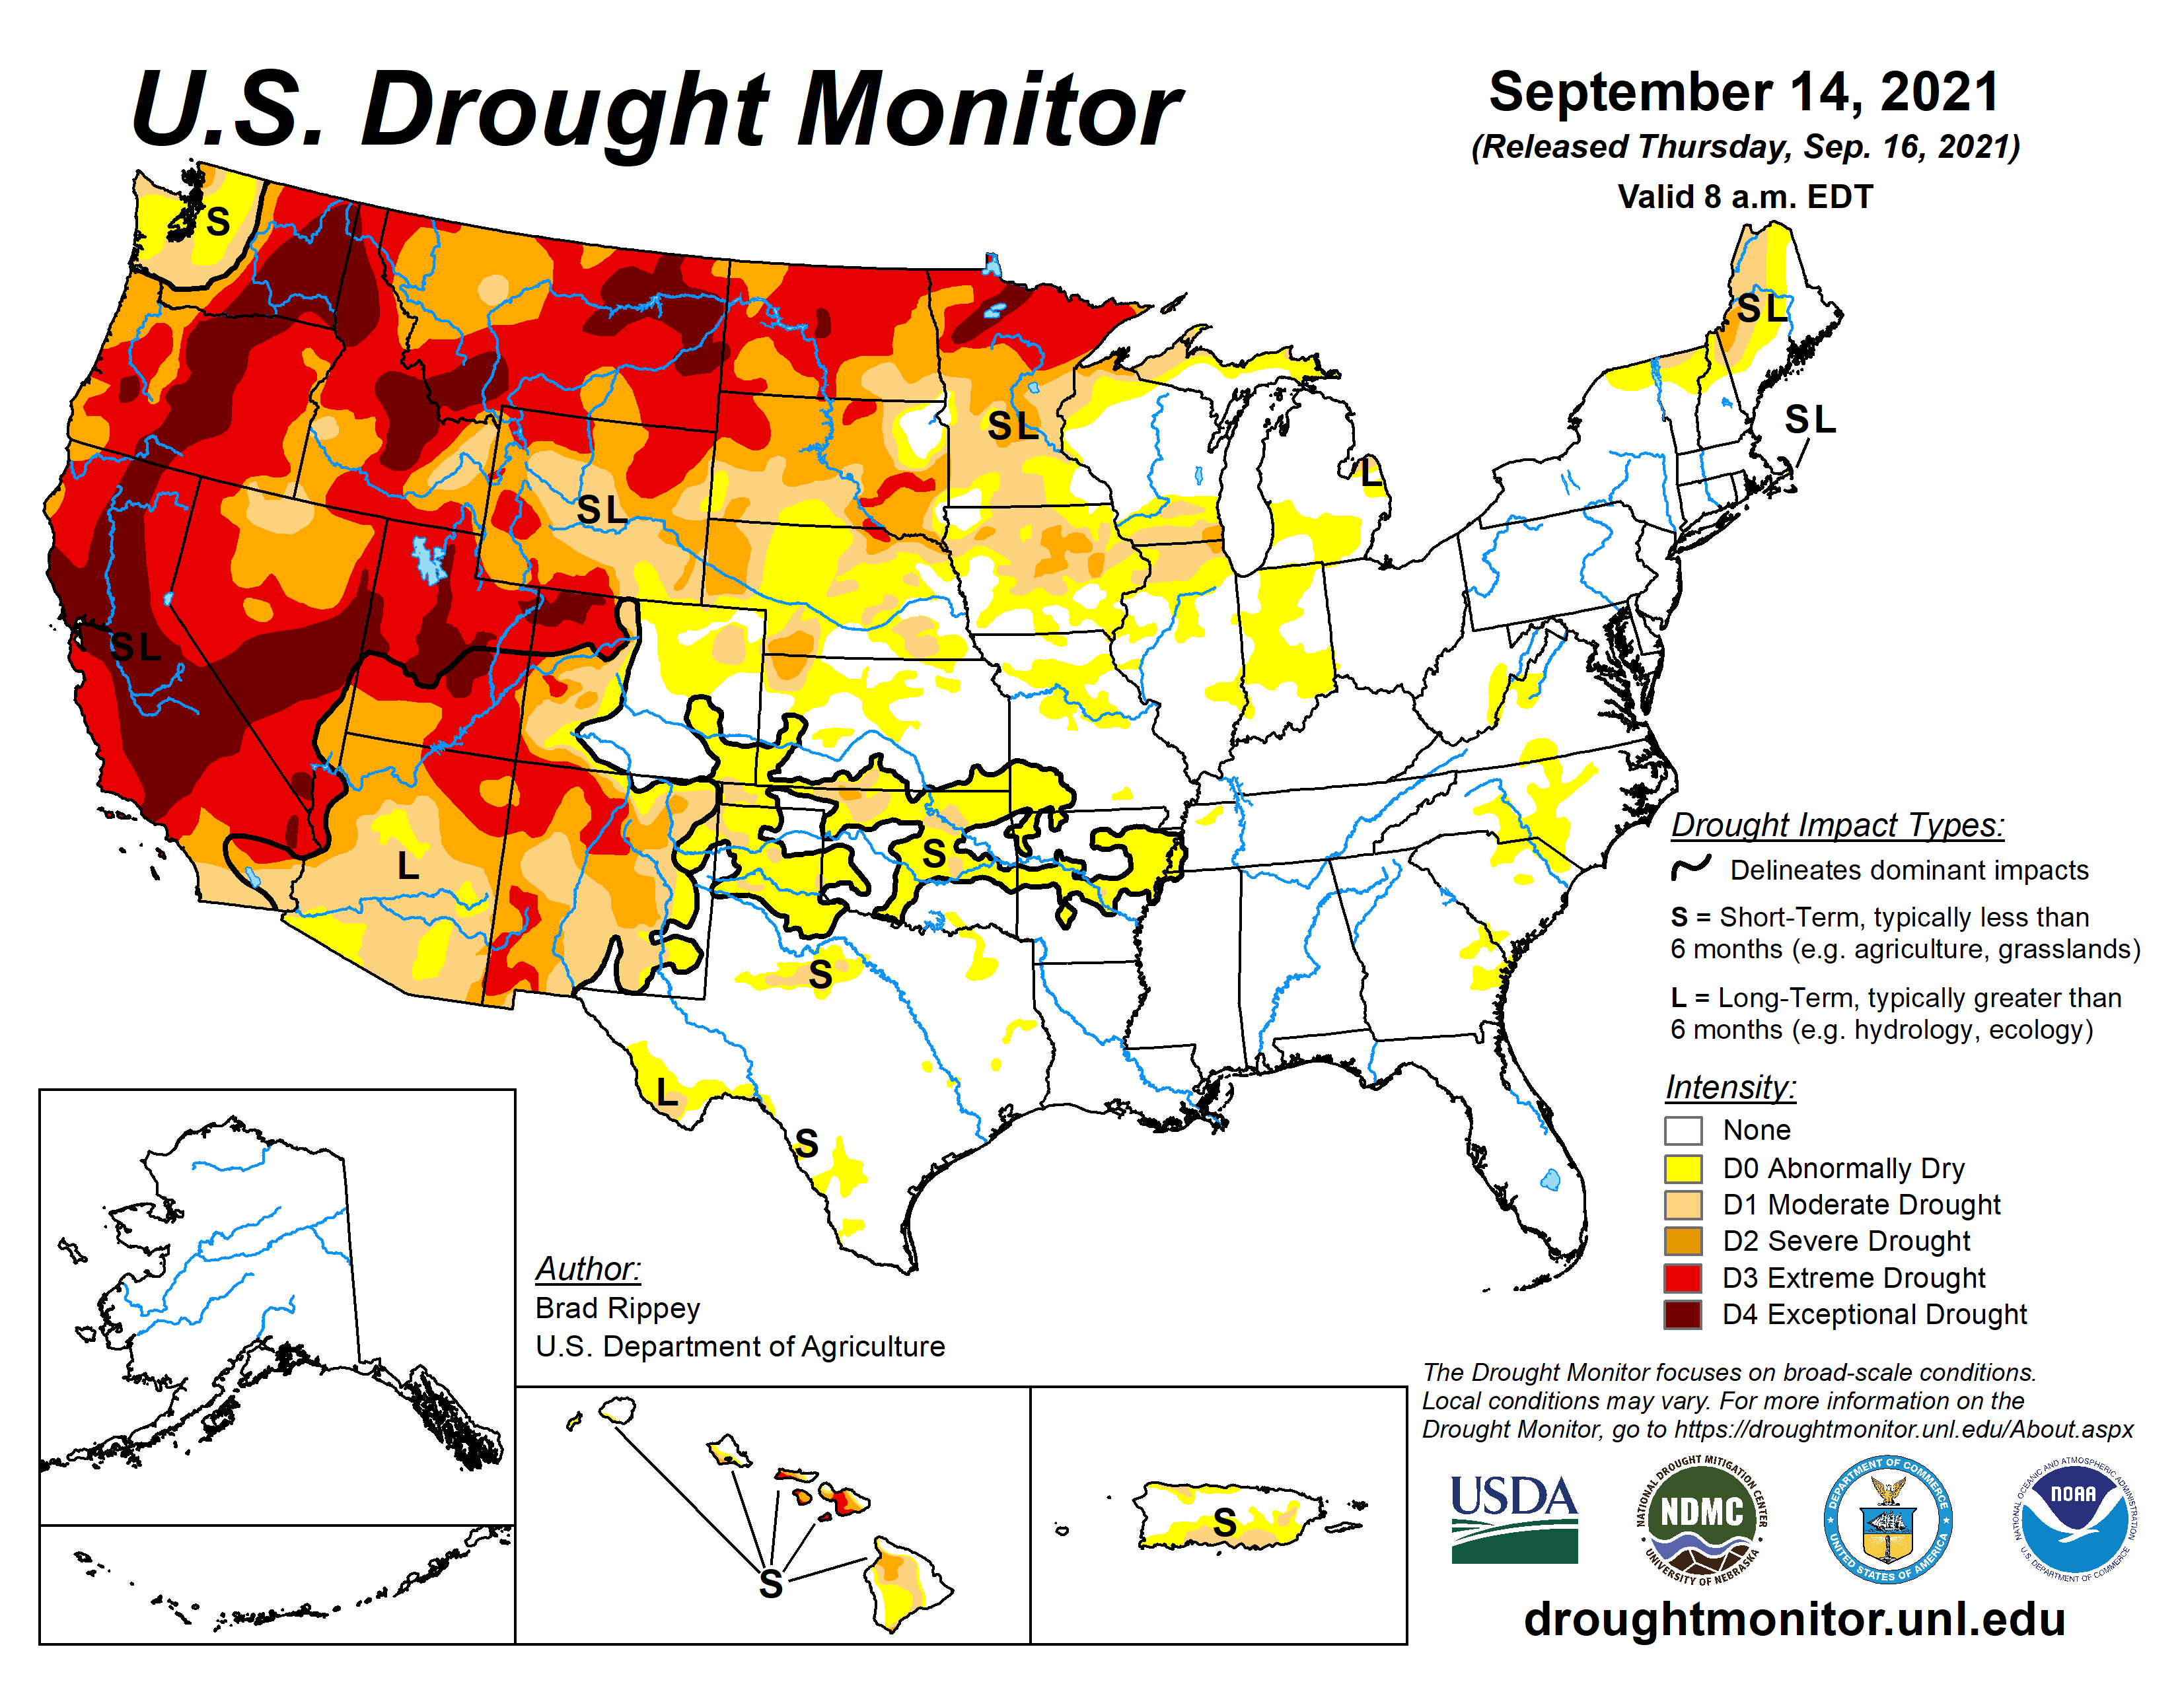
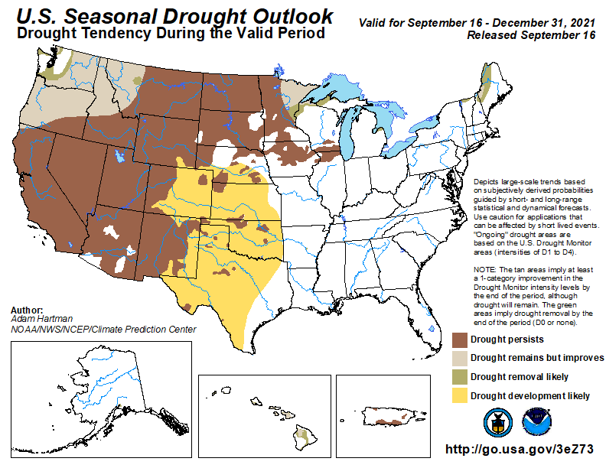
Examples of Seasonal Drought Forecasts
Seasonal Rainfall Forecasts linked to … ... Seasonal Drought Outlooks
Regional drought potential advisory
Monitoring Products linked to …… …….. Seasonal Drought Outlooks
Notes:
.

Slide 16
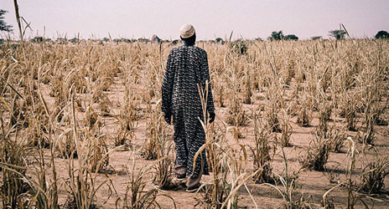
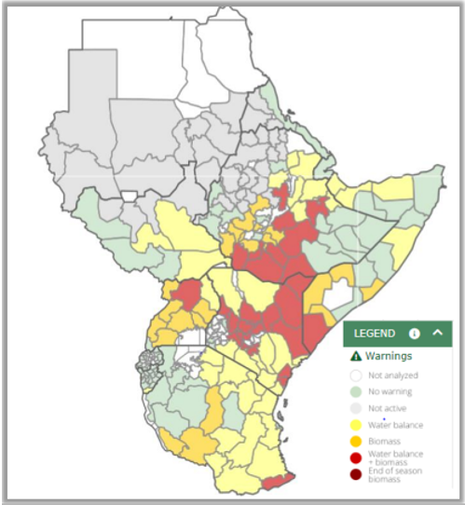
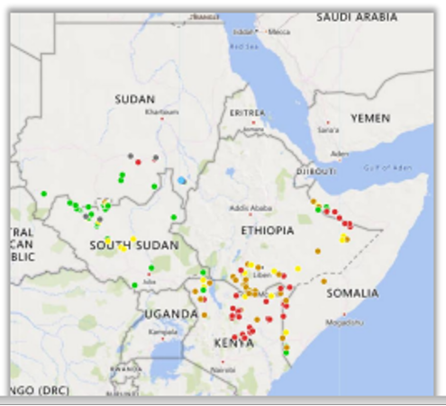
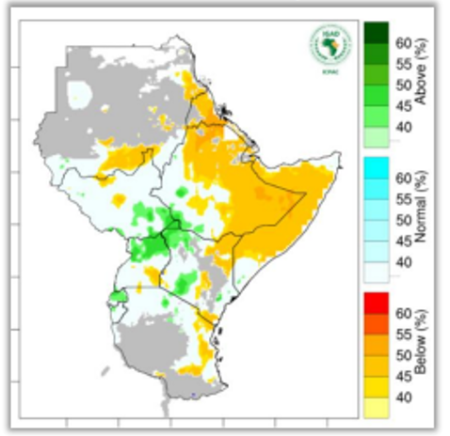
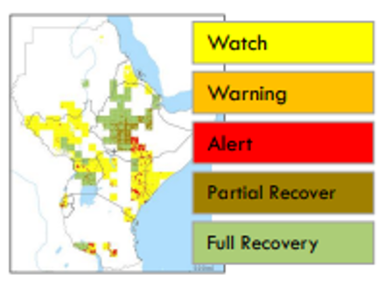
East African Drought information system: DROUGHTWATCH.ICPAC.NET
Service operated by ICPAC and JRC
adopted as prototype by the project: Strengthening Drought Resilience for Smallholder Farmers and Pastoralists in the IGAD Region (DRESS-EA)
Conditions in the field
Public online near-real time system
Provides automatic 10-day warnings
Covering the whole drought cycle: developing, actual and recovery from drought conditions
Tailored approach crucial: Not “one fits all”
EO & station data
Actionable decision making information

Slide 17
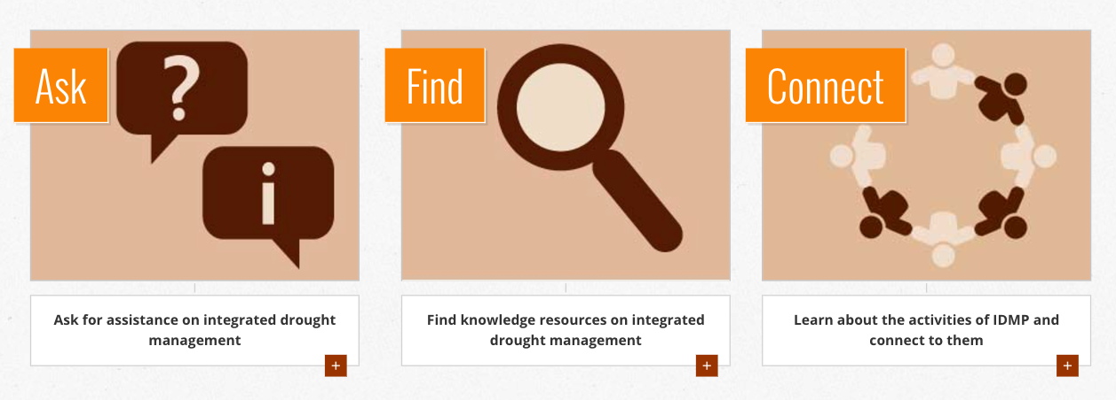
Get in touch: Integrated Drought Management Helpdesk
www.DroughtManagement.info
idmp@wmo.int
valentin.aich@gwp.org
rstefanski@wmo.int

