Slide 1
Valentin Aich
Senior Water and Climate Specialist, Global Water Partnership
Robert Stefanski
Applied Climate Services Division,
World Meteorological Organization
Overview of Integrated Drought Management Programme (IDMP)
Regional Training Workshop on "Implementation of Integrated Drought Management"
8-9 October 2025 | Tehran, Iran – RCUWM

Slide 2
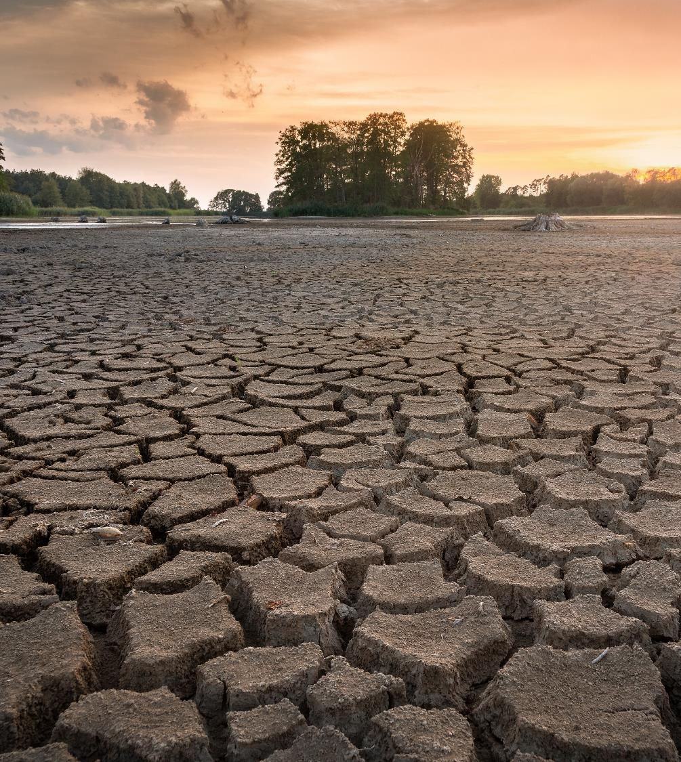
Droughts are among the most complex natural hazards
Drought is a creeping phenomenon with slow onset
Impacts of drought can accumulate gradually
Lack of precise and universal definition for drought leads to confusion about when a drought begins and when it ends
Leads to uncertainty on precise time to implement emergency response actions or mitigation measures.

Slide 3
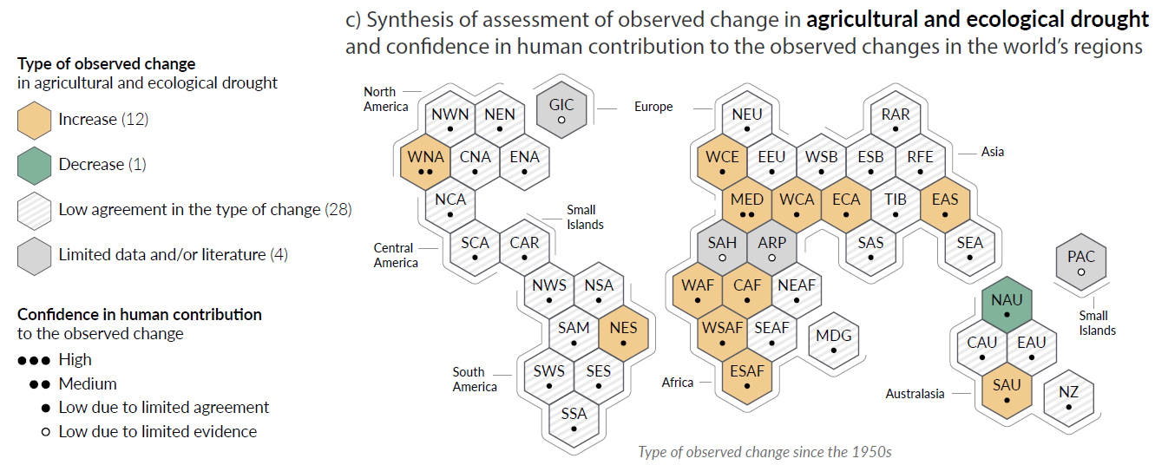
Observed increase in droughts
From the 2021 6th Assessment Report of the IPCC, WGI:

Slide 4
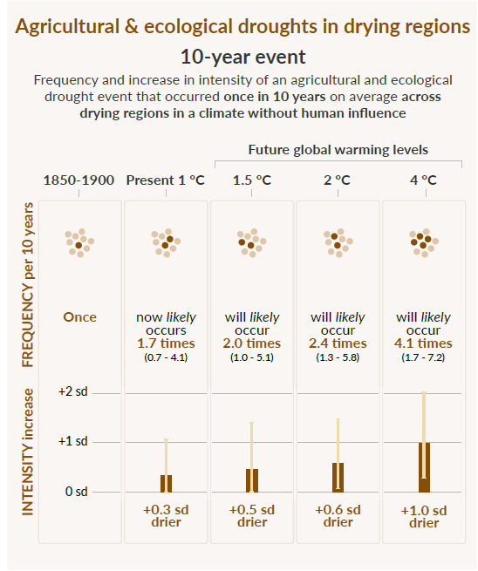
Projections for future drought
Even in a “best case” scenario, when achieving Paris goals (1.5°C warming):
Drought will occur 2 time more often and will be significantly more severe
“There will be an increasing occurrence of some extreme events unprecedented in the observational record with additional global warming, even at 1.5°C of global warming”

Slide 5
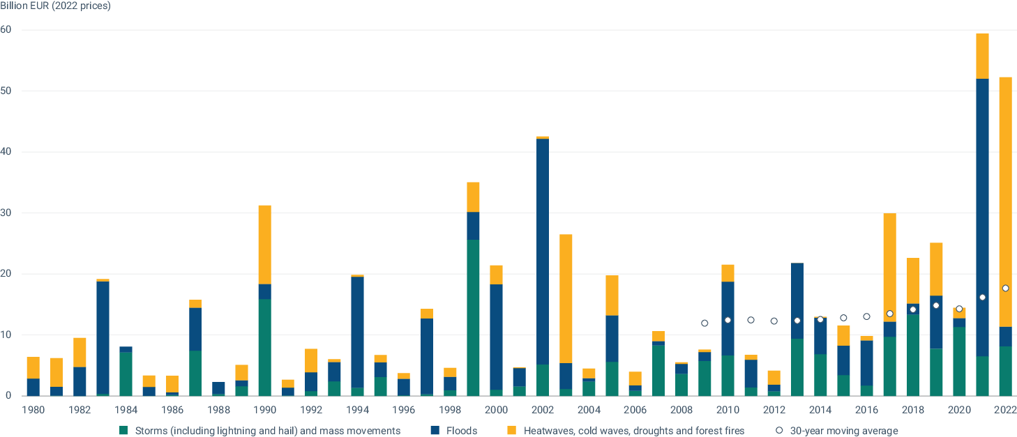
… and does it matter economically?
Losses 1980 and 2022: estimated EUR 650 billion
Most expensive:
2002 flood central Europe: 34 bio €
2021 flood Germany & Belgium 44 bio €
2022 drought and heat: 40 bio €
Annual economic losses caused by weather - and climate-related extreme events in the EU
8th Environment Action Programme (European Environment Agency)

Slide 6
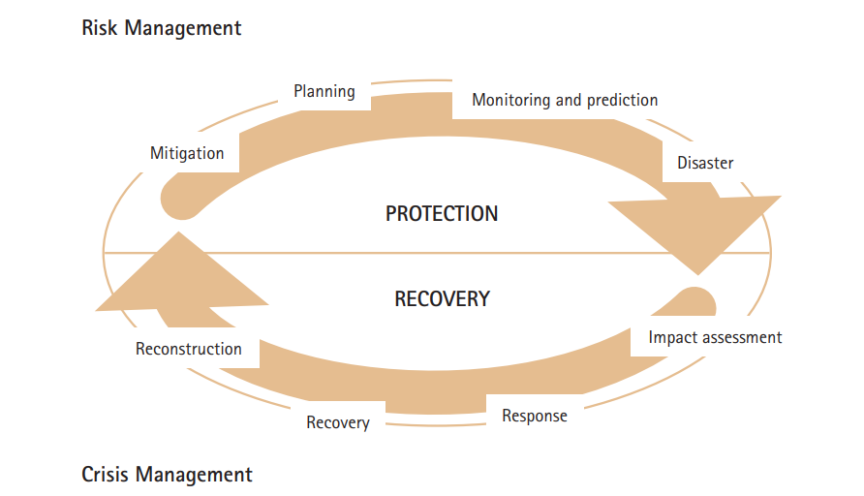
How do we go from CRISIS management to RISK management?
Developing integrated monitoring and drought early warning systems and associated information delivery systems
Improvement and application of seasonal and shorter-term forecasts
Developing preparedness plans at various levels/ sectors
Adopting mitigation actions and programmes
Providing an organizational structure and coordination within and between levels of government and with stakeholders.

Slide 7
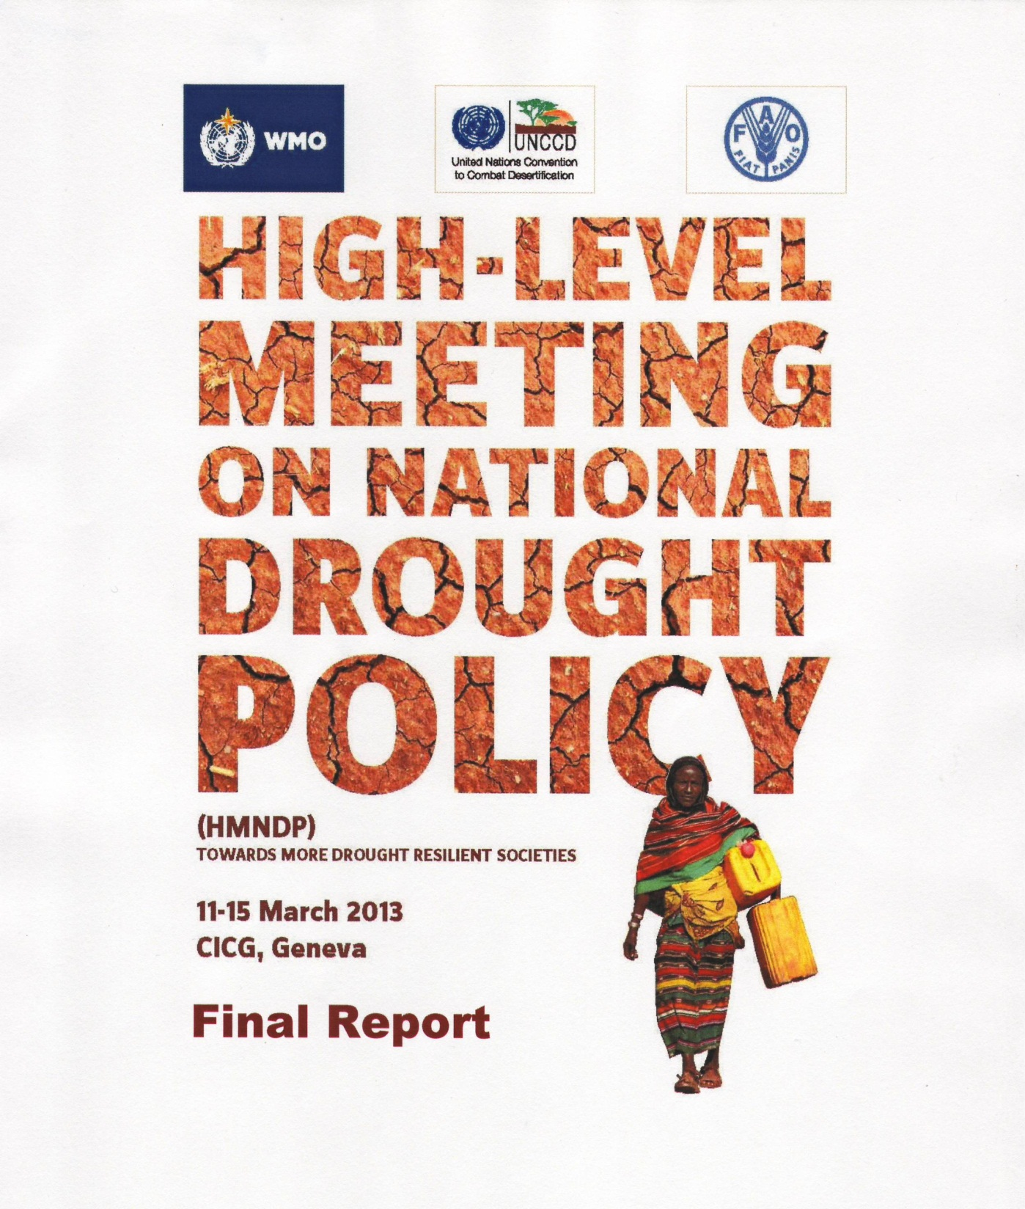
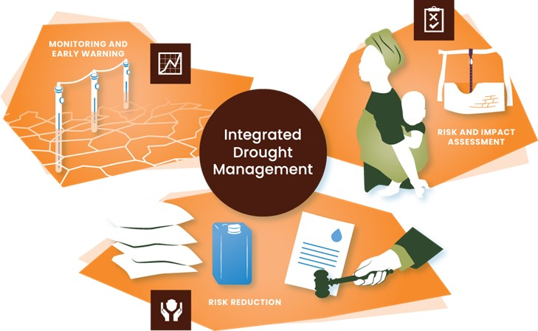
IDMP: 12 Years of Integrated Drought Management
Partner base continuously growing – at 47 in 2024
4 regional programmes work on IDM implementation
Approach:
Runs a HelpDesk to respond to requests
Community of Practice
Develops and contributes to IDM components of projects
Develops knowledge products
Capacity building and trainings on IDM
Virtual Exchanges 2-3 times a year
Youth Engagement
Community of Practice
Est. 2013 after joint High-Level Meeting
Of WMO, GWP, FAO, UNCCD and other partners
Information hub:
droughtmanagement.info

Slide 8
Strengthen Partnerships
Generate and Manage Knowledge
Implement and Catalyze Change
How we work: 3 strategic domains
Technical Support Units staffed by WMO and GWP
Youth Work support by Water Youth Network
Working closely with flood-sister programme (APFM)
HelpDesk

Slide 9
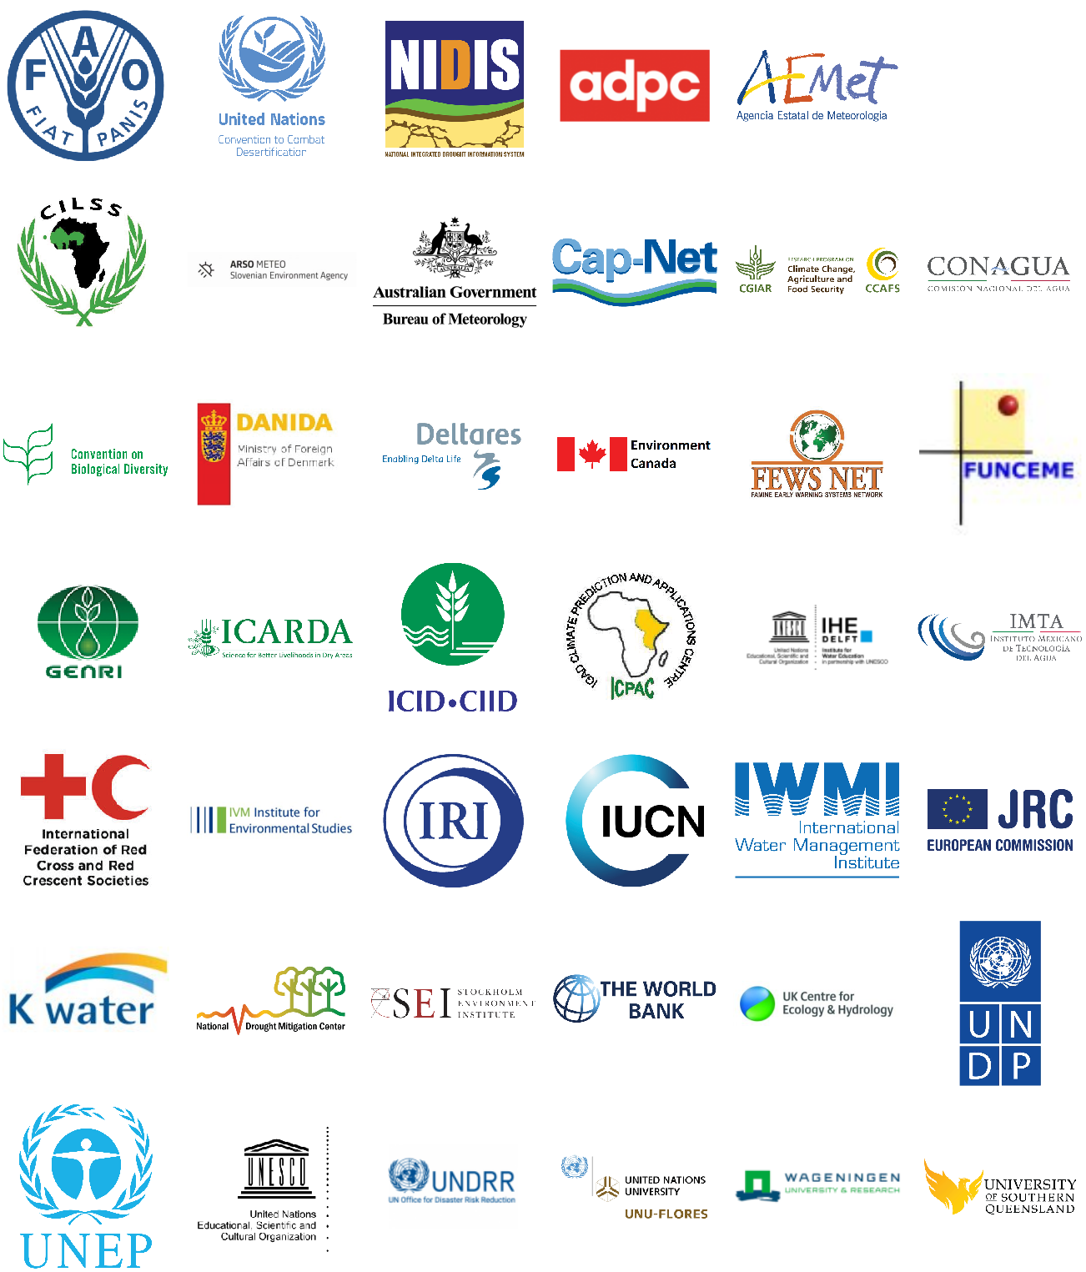
The heart of IDMP: over 45 Partners
Annual Meetings of Partners steer the programmes
Programmes and Projects in most regions of the world
Partners provide in kind support to HelpDesk
Notes:
The IDMP and its partners provide a framework and commensurate technical support to countries.

Slide 10
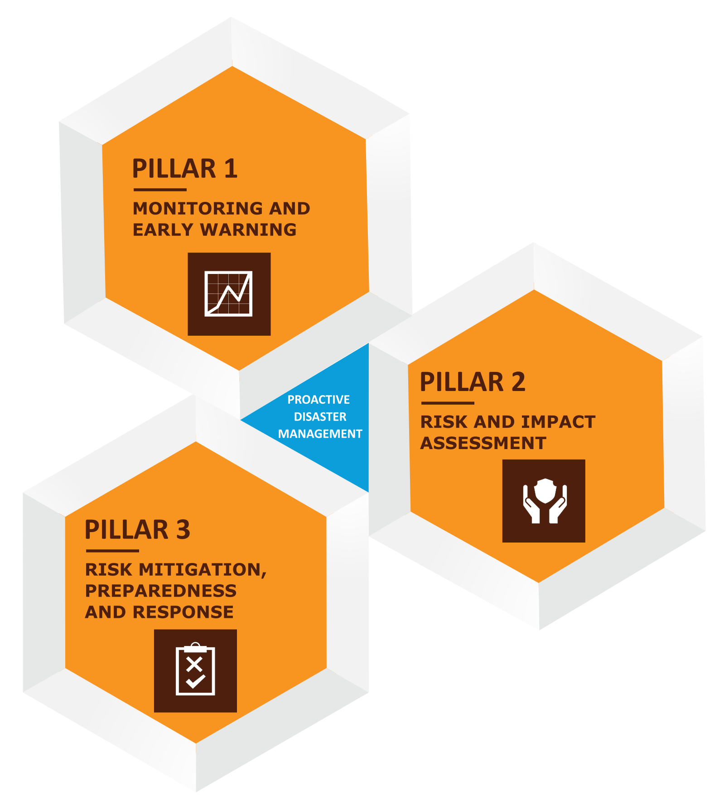
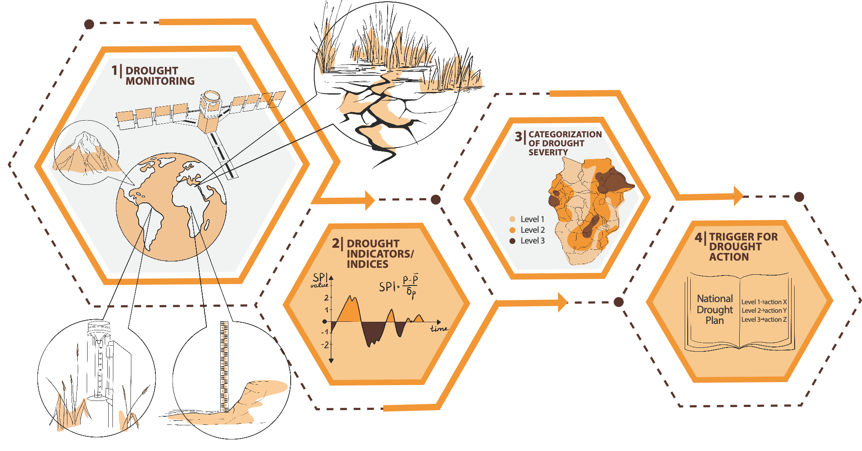
Pillar 1: Monitoring and EWS

Slide 11
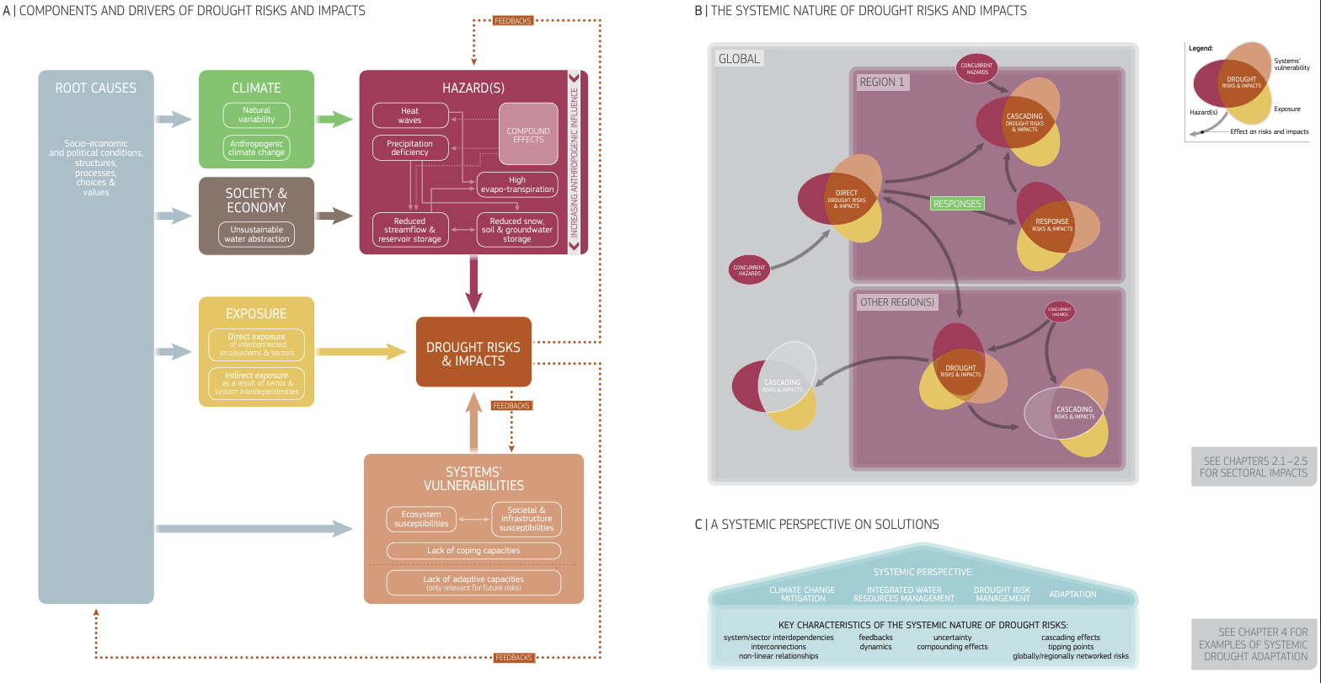
Pillar 2 Drought Risk and Impact Assessment
UNCCD and EC: World Drought Atlas 2024

Slide 12
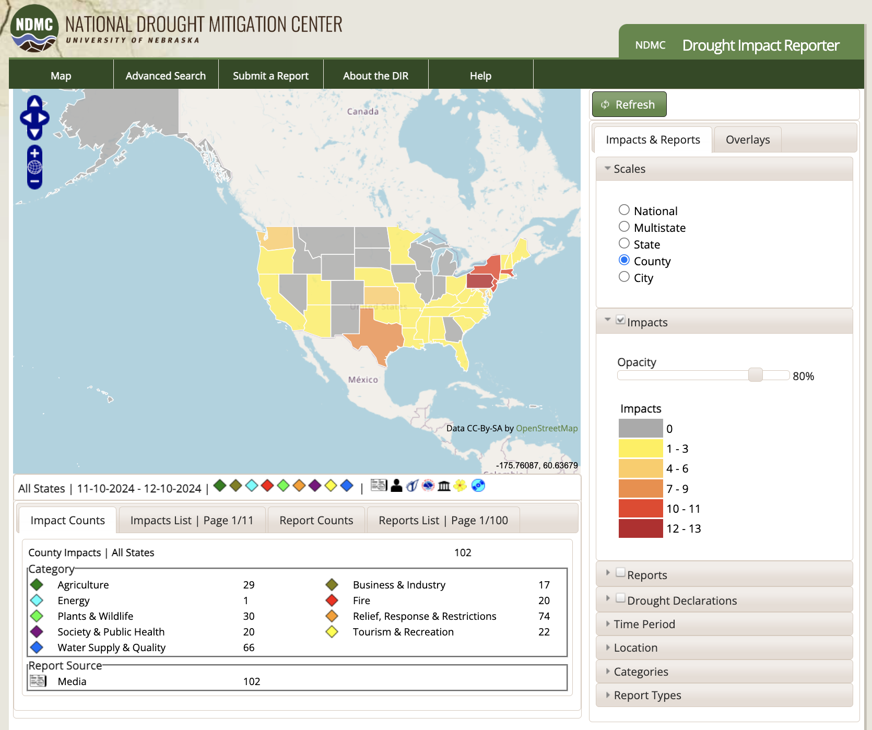
Why monitor Drought Impacts?
To have a comprehensive impact and losses in different sectors (officials tend to underestimate drought impacts)
To use as ground truth to train models
To justify mitigation actions (officials need quantitative impact information)
National Dorught Mitigatioin Center, 2024

Slide 13
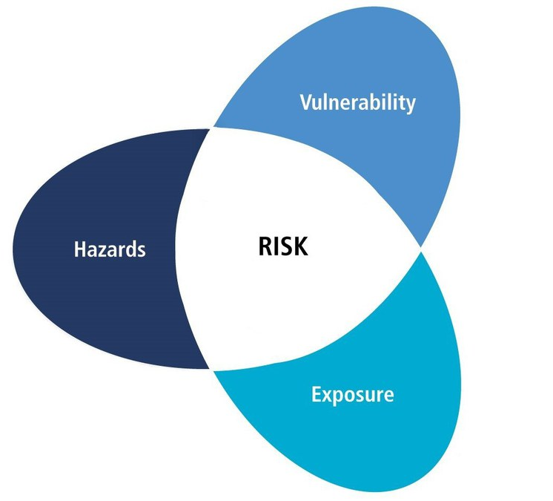
Pillar 3 Drought Risk Mitigation, Preparedness and Response
All aspects of risk can be addressed
Strong focus on vulnerability

Slide 14
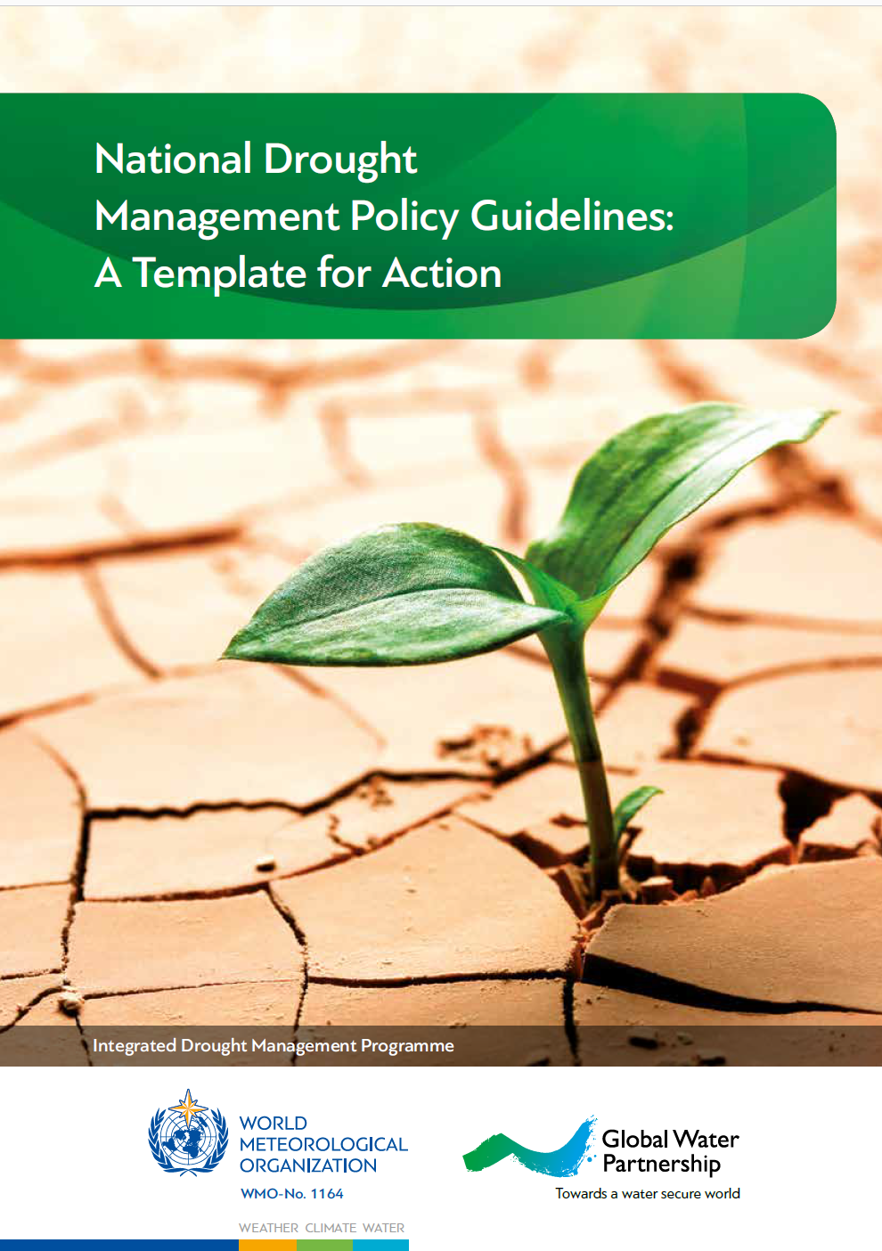
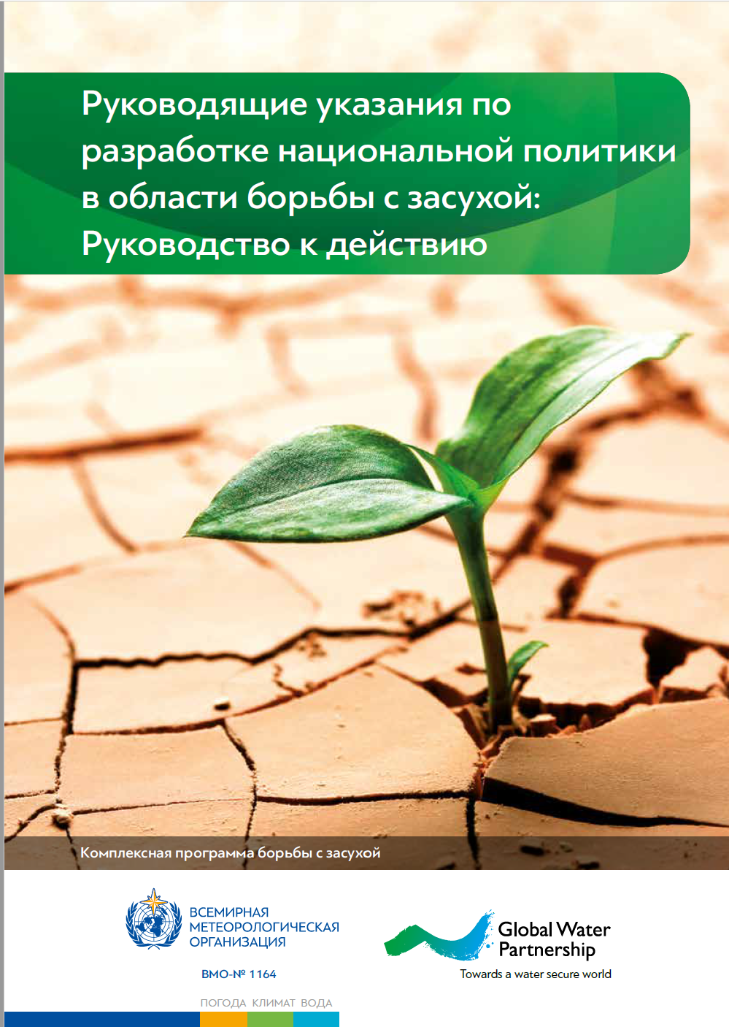
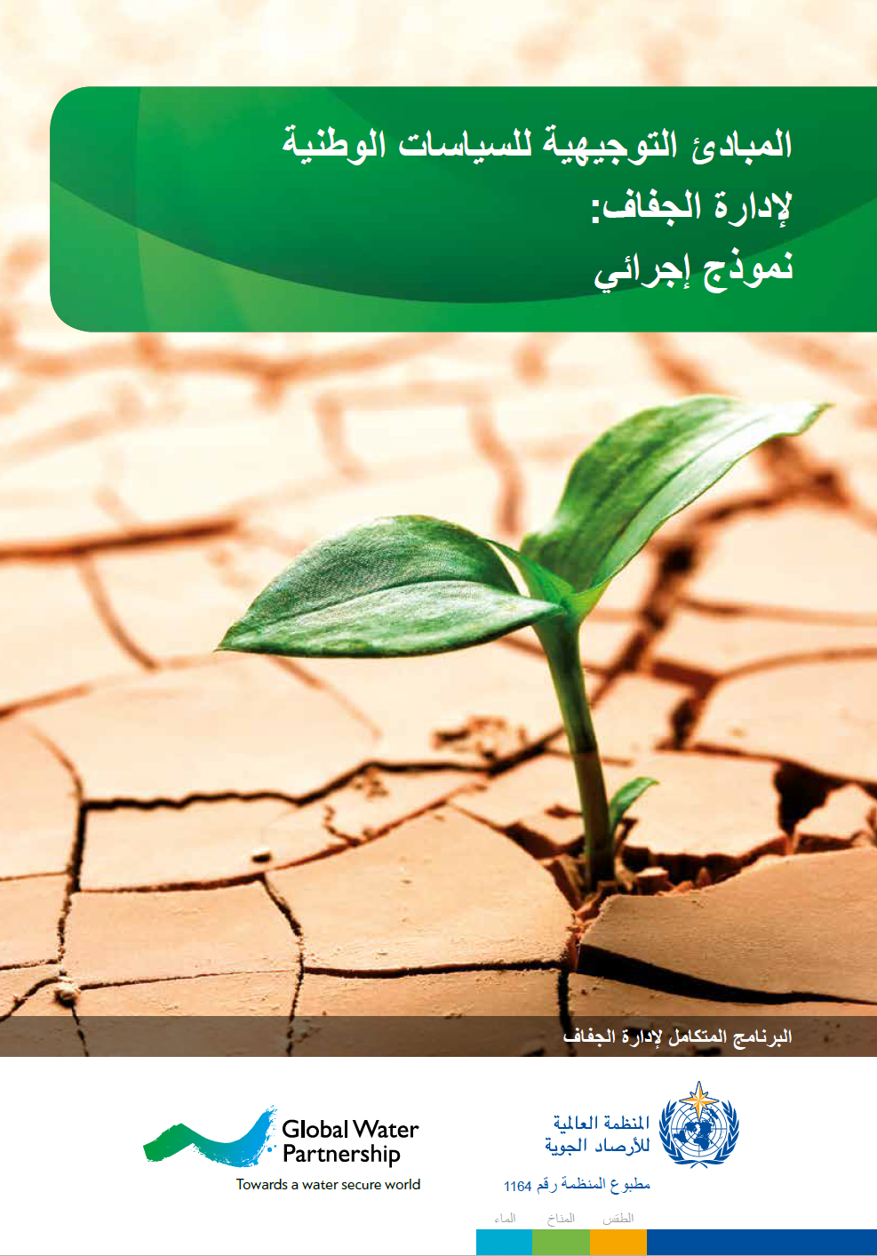
National Drought Management Policy Guidelines:
A Template for Action

Slide 15
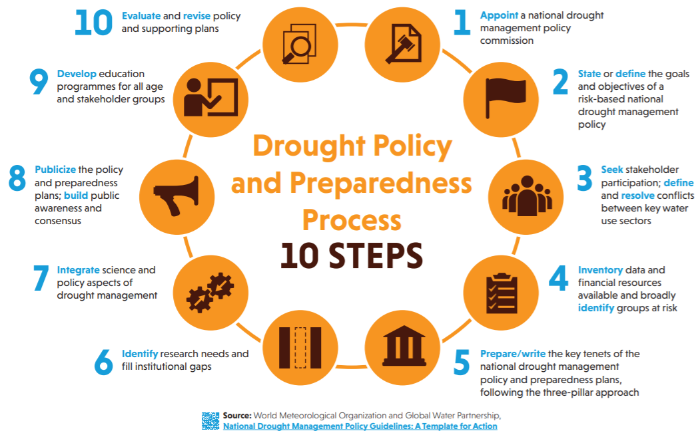
10 steps

Slide 16
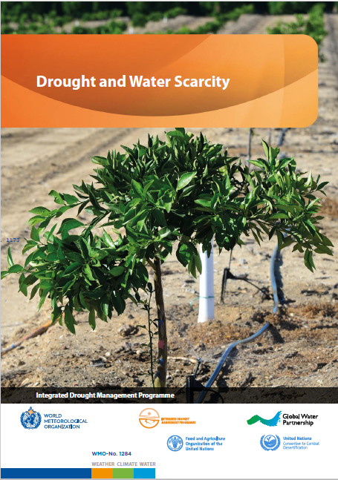

IDMP, 2022. Drought and Water Scarcity. WMO No. 1284. Global Water Partnership, Stockholm, Sweden and World Meteorological Organization, Geneva, Switzerland.
Available on:
https://library.wmo.int/index.php?lvl=notice_display&id=2206

Slide 17
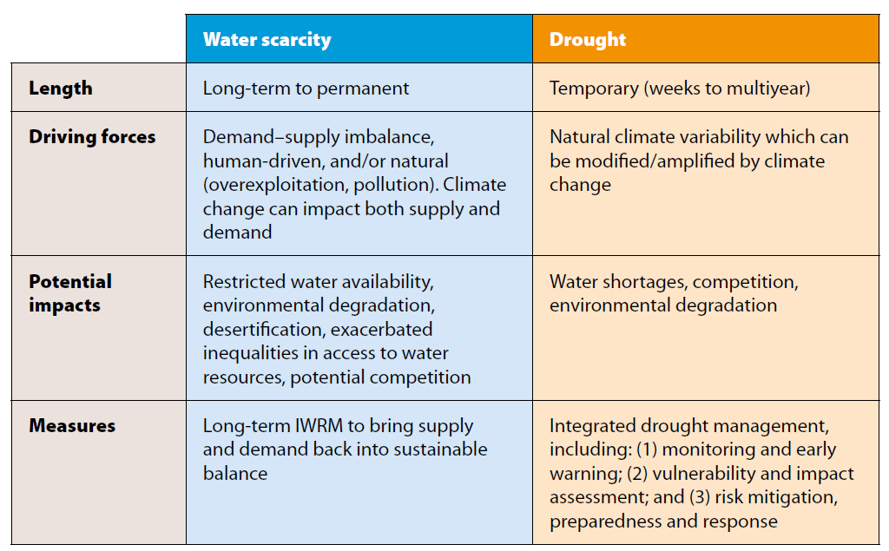
Aim of the publication:

Slide 18
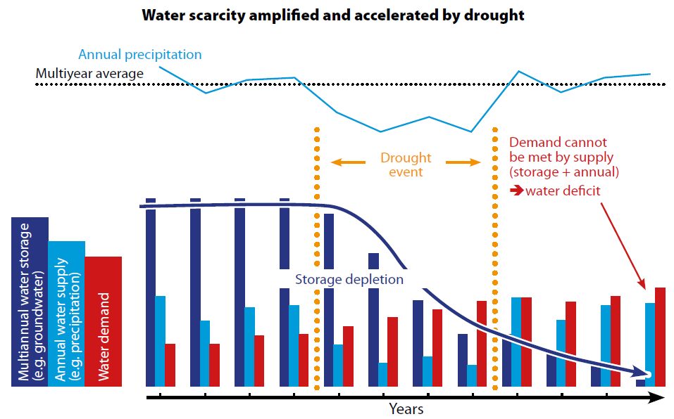
Interrelationships of Drought and Water Scarcity

Slide 19
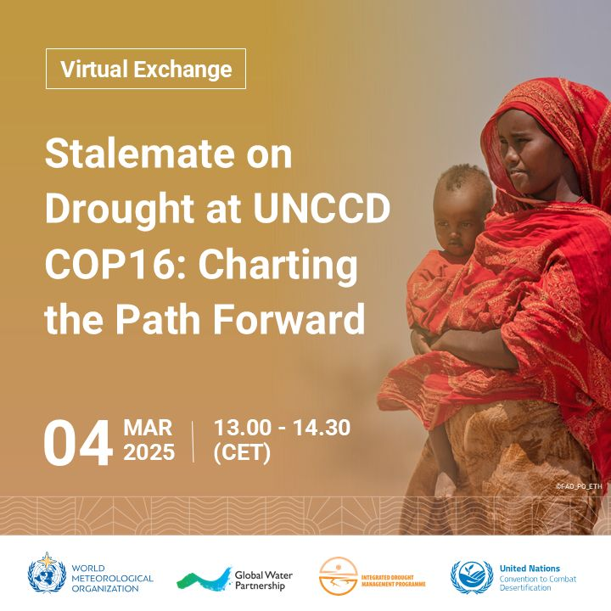
IDMP Virtual Exchanges
171 Participants
Many UNCCD focal points
Next one in May on drought monitoring with examples form all over the world
Send us an email to be included in our email list: valentin.aich@gwp.org or rstefanski@wmo.int
www.DroughtManagement.info

Slide 20

9 Workstreams
N° | Workstream | Leading organizations
1 | Drought resilience and global alignment | UNDRR/NOAA
2 | Drought risk governance: The regional, national, and local challenges | UNCCD/UNESCO
3 | Drought Impact monitoring, assessment and forecasting | WMO/NDMC
4 | Policies into action | UNCCD/FAO
5 | Ecosystems | IWMI/IUCN/TNC
6 | Social inclusion and climate justice | GWP/IWMI/IOM
7 | Drought risk finance | FAO/GM UNCCD
8 | Public-private-civil society partnerships | WMO/GWP/World Bank
9 | Health | University Nebraska/ WHO

Slide 21

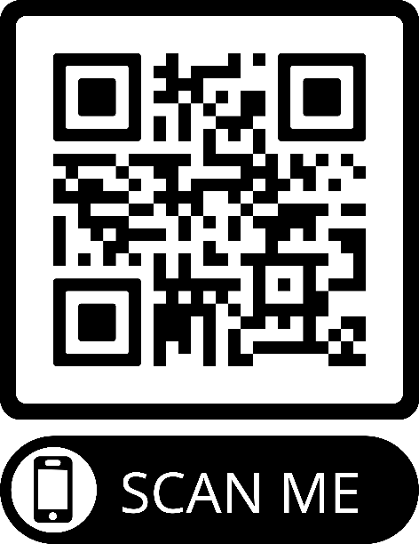
Drought Resilience +10 Conference
30 Sep – 2 Oct 2024 Geneva
Key Takeaways
We need integrated, proactive, and perspective drought management to cope with drought.
Cross-sectoral and whole-of-society approaches must be integrated into national drought policies.
Strengthening data-sharing and monitoring systems is crucial.
Drought action is central to sustainable development, climate adaptation and Early Warnings for All.
There is a critical need to mobilize resources and strengthen political will for drought resilience.
Conference Conclusions and Recommendations
Scan QR code

Slide 22
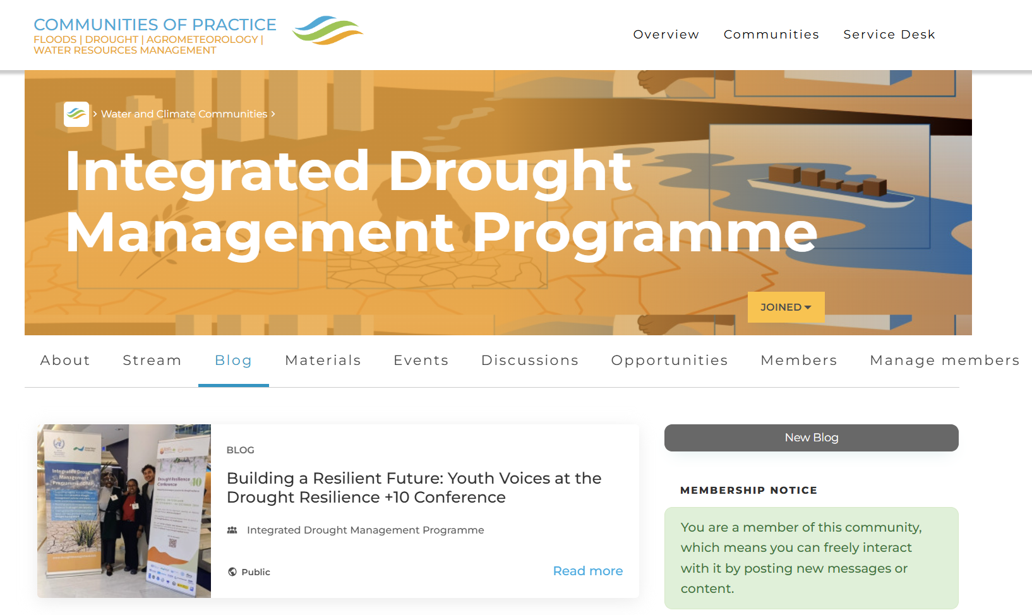
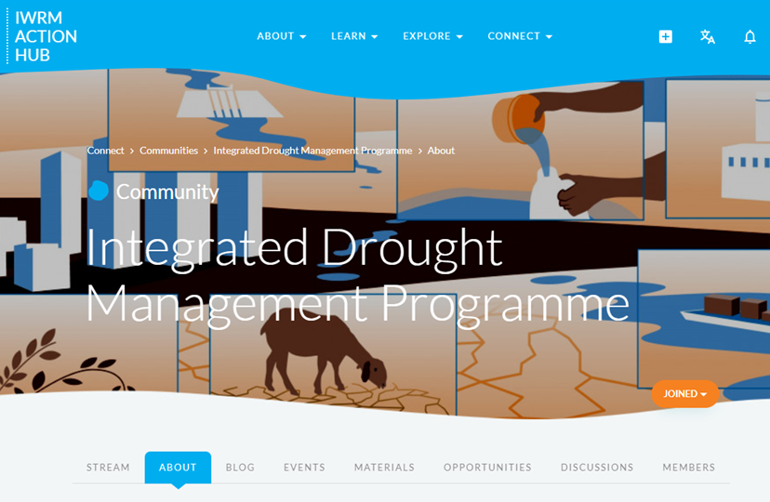
IDMP Community of Practice
Currently 241 members
www.DroughtManagement.info

Slide 23
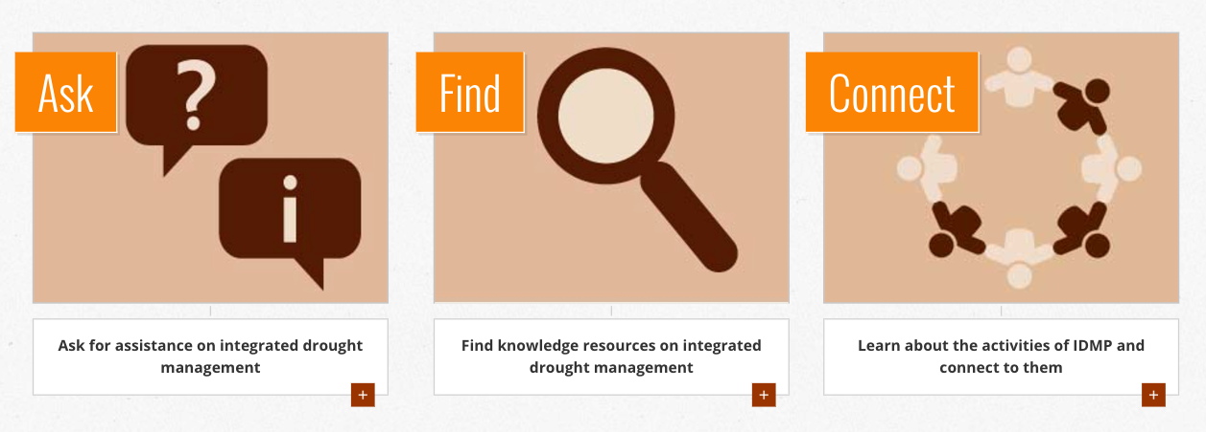
Get in touch: Integrated Drought Management Helpdesk
www.DroughtManagement.info
idmp@wmo.int
valentin.aich@gwp.org
rstefanski@wmo.int

